Slide 1
Cost–Benefit Analysis (CBA)

Slide 2
When Do We Use CBA?
Many projects or policies have a temporal dimension to the flow of costs and benefits.
A common pattern in infrastructure, education, and basic research is an up-front cost that generates a future flow of benefits.
We need a way to evaluate the efficiency of these projects to help us decide what to select and what to reject.
CBA is a tool to evaluate different uses of societal resources.
Do the benefits to society exceed the costs to society?

Slide 3
A Few Key Ideas
Values in the future are going to be expressed in present value.
We will use a discount rate r.
The overall assessment on efficiency grounds is the Kaldor–Hicks criterion.
It is an efficient use of society’s resources if it is potentially possible through redistribution of outcomes to meet the Pareto optimality definition.
The analysis is done from the point of view of what is the best use of society’s resources to meet society’s needs.

Slide 4
What Counts?
Real resources that are used are costs.
Real resources that are created are benefits.
Transfers don’t use or create real resources; they are claims on real resources.
If a farmer takes a loan to buy fertilizer, the increase in the yield resulting from the use of fertilizer is the benefit, even if they have to sell some of the harvest to pay back to the lender.
If you get a paycheck, the top-line “gross” is what counts; all those claims between “gross” and “net” are claims on a real resource that is created.

Slide 5
A Few Key Ideas
It is ex ante analysis of future scenarios.
Analysis is on a timeline before decision point t = 0, and is based on predictions about what will happen after t = 0.
It is comparing counterfactual future scenarios “with” a policy or project compared to other alternative future(s); at least one is “without” the policy or project as the status quo.
This “without” scenario has the sense of what happens if we keep doing in the future what we are doing now.

Slide 6
Examples
$
With
$
Without
With
Status at t = 0
Status at t = 0
Without
Before
t = 0
After
Time
Before
t = 0
After
Time
Temptation to overclaim down to status at t = 0
Temptation to say nothing happened since status at t = 0 is the same as with
Can claim area between with and without
Can claim area between with and without
Many other patterns are possible

Slide 7
Steps to Cost–Benefit Analysis
Define the situation
Identify and value the costs
Identify and value the benefits
Discount future cost and benefits to identify Net Present Value (NPV)
Consider the implications of the choice made on NPV income terms for other objectives (equity for example)
Sensitivity analysis
Interpret and report the results

Slide 8
Defining the Situation

Slide 9
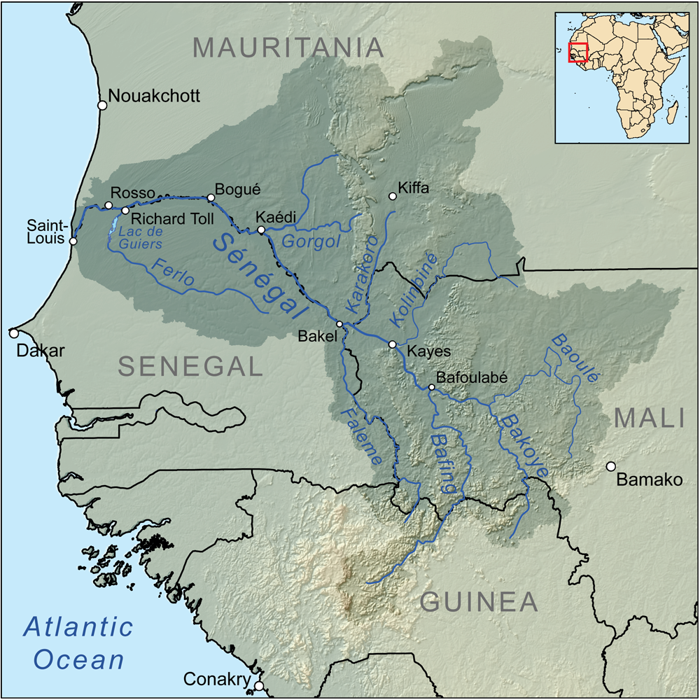
Who Has “Standing”?
Dam is here
Manantali Dam, Mali
Hydro-power for urban residents in Dakar, Nouakchott, Bamako
People upstream of dam now have lands under water
People downstream recessional flood cultivation disrupted
Fishery downstream disrupted
Farmer–herder conflict in 1989 near Bakel
Expulsion of people from Mauritania to Senegal
Expulsion of people from Senegal to Mauritania
Since CBA is a question of what is best use of society’s resources, need to analyze all who experience benefits and costs
Water flows this direction
Rainfall in mountains

Slide 10
Define With and Without
As you come to the decision point of t = 0, what is the prediction of the future with the investment, project, or policy?
What is the prediction of the future if you don’t make the investment, project, or policy (status quo)?
What is the appropriate time horizon for this analysis?
How certain are you of the values you are using in defining these scenarios?

Slide 11
Identify and Value Costs

Slide 12
Identify Costs
Inputs like materials, labor, energy, machines, etc.
What will we be using to make this thing?
When are we going to be using them?
What costs are intangibles, externalities, etc.
Pollution
Traffic delay
Loss of community, heritage, etc.

Slide 13
Value Costs
Is the input bought:
From a perfectly competitive market?
Where the market price reflects the opportunity cost?
And the volume of the purchase is not large enough to impact the market price?
And there are no externalities?
Use input cost from the market.
The concept of the shadow price arises if we don’t think we meet these conditions.

Slide 14
Shadow Price
It might be that the observed price is too high. Minimum Wage.
The minimum wage workers are in a market where we are not allowed to pay p*.
If we use q’ workers in the project at minimum wage, we can apply the shadow value of these workers as the blue shaded area q’.
The area above the supply curve and below $\underline{p}$ for the q’ workers is the policy induced “rent” of the minimum wage.
Of course, this is the minimum measure. If we don’t get these lowest ‘willing to accept’ wage workers but the highest ones over to the right at q’’, the cost is higher.
Could also make a case for estimating and using $p^{∗}$
p
S
$$\underline{p}$$
rent
$$p^{∗}$$
q’’
q’
D
$$q_{D}$$
$$q_{S}$$
q
Surplus

Slide 15
Shadow Price (cont.)
It might be that the observed price is too low. Negative externality.
p
$${MC}_{social}={MC}_{private}+{MC}_{externality}$$
S = ${MC}_{private}$
$${MC}_{Eq′}$$
$$p_{so}$$
The perfectly competitive price is too low.
The perfectly competitive quantity is too high.
so
$$p_{pc}$$
pc
D
$${MC}_{externality}$$
$${MC}_{Eq′}$$
$$q_{so}$$
$$q_{pc}$$
$$q^{′}$$
q
A negative externality is generated as a by-product of production.

Slide 16
Identify and Value Benefits

Slide 17
Things to Look For (agriculture examples)
New production or increased production from current level
Sesame seeds as a new crop
Higher yields per hectare / multiple cropping seasons per year.
Quality improvement
Animal fattening, improved breeds.
Sorting wool by grade.
Ability to access higher return markets
All weather transport infrastructure
Market information systems
Cost reduction
Least cost rations for animal fattening
Avoided losses
Seed storage
Animal transport

Slide 18
How do we value the benefits?
These (again in the absence of externalities) can be valued through market prices
If there are externalities or market imperfections, we need to conduct the same kind of analysis as we discussed for costs.
Some benefits are difficult to reflect in market prices (civic pride, reduction in pollution, etc.)
To approximate these, we use a variety of techniques to estimate the community’s willingness to pay as we have discussed in earlier sessions

Slide 19
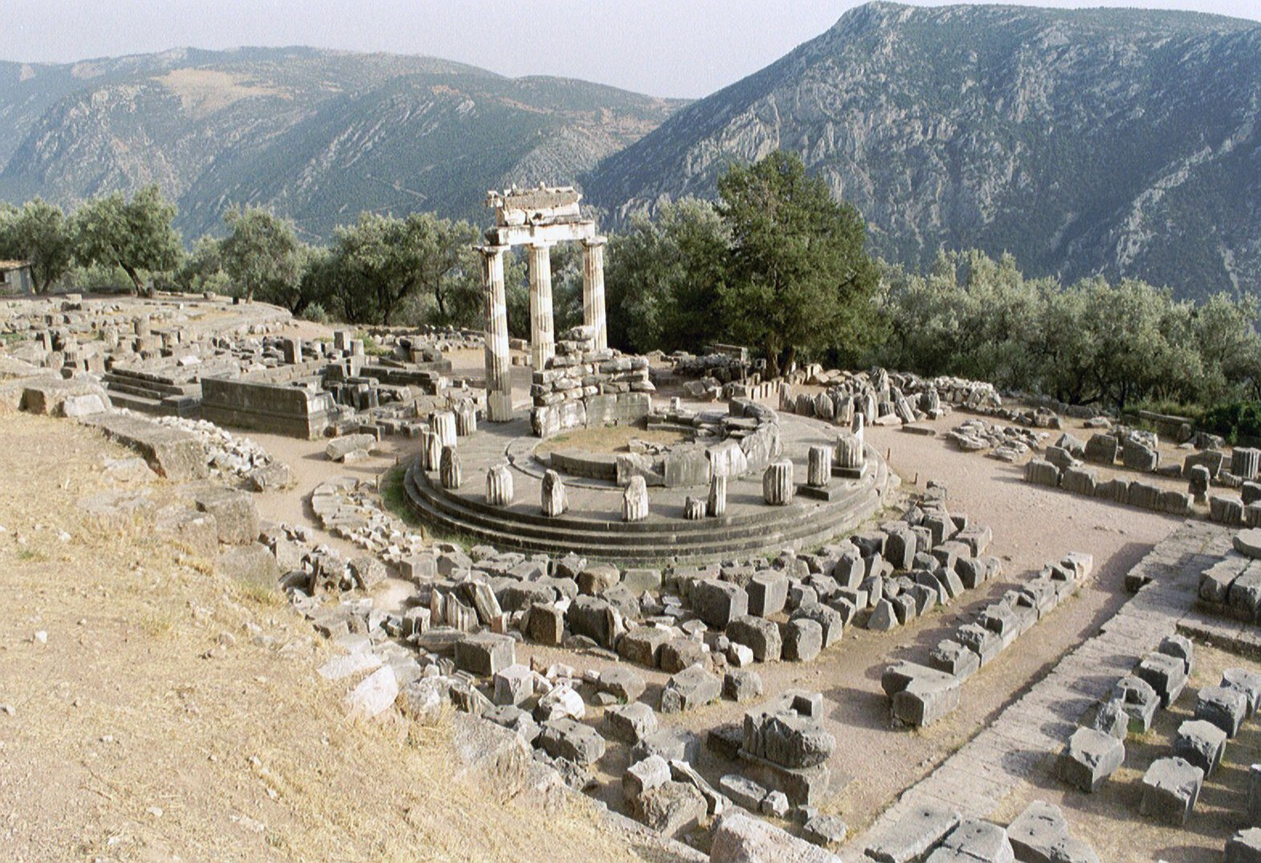
Estimation Methods for WTP
We introduced some of these methods earlier
Hedonic analysis
Travel cost
Private expenditure in absence of a public good
Contingent valuation
Also sometimes use estimations by experts
Called the “Delphi method” in the text
Oracle of Delphi
They are not necessarily channeling Apollo though it could help!

Slide 20
Common Problems
Counting as a new resource that which is really a transfer from another existing resource
A giant mall takes over commercial activity in a region, so smaller malls go out of business
Can count new business, can’t count transferred business
Double-counting a single underlying phenomenon
A new public highway reduces commuting time and cost; I could estimate the value of this with a survey
It also makes the values of houses that are close to this new road increase, and we could use hedonic methods to look at this
Counting labor through created jobs as a benefit
Labor is a cost; what the workers do with the labor is the benefit

Slide 21
Value of a Statistical Life

Slide 22
The Benefit Is Avoided Death
We need a way to put a value on avoided deaths—the value of a statistical life.
Morally we may have qualms but as a practical matter it is something we need to work with.
What kinds of situations would call for us to use this value?
Changes in things like speed limits, drinking age, seatbelt rules, pesticide rules
The US DOT sets the value at 9.4 million
The US EPA sets the value at 10 million
In June 2020, Imperial College in London released a study that non-pharmaceutical COVID-19 interventions (shutting down) saved around 3.1 million lives in Europe
We can use this value 3.1 m * 10 m = 3.1E + 13
The size of the EU economy annually is reported by the World Bank is 1.6 E + 13 (2018)

Slide 23
How Is This Calculated?
Think of it as a willingness to pay for a marginal change to mortality risk.
It has been measured as a stated preference in a survey.
It has been measured as a revealed preference by contrasting the wage premium that is associated with riskier occupations.
Hedonic wage analysis where likelihood of death on the job is a characteristic
A criticism is that it establishes as a reference largely blue-collar white males in the United States
Is that applicable globally?
It has been measured by lifetime earnings potential lost.

Slide 24
Related Concepts
Value of a DALY: disability adjusted life year that combines years of life lost and years lost to disability (WHO)
This measures health outcomes that lead to death but also ones that have less than fatal outcomes
There is a case made that a reasonable approximation of one DALY can be the gross national income (GNI) per capita in a country.
Then the total DALY estimate from a policy change times the GNI would be a possible value to use.
Could also use the same logic with predicted years of life lost / saved.

Slide 25
Discounting

Slide 26
Why Do We Discount?
We are mortal, we are impatient
Inflation is generally greater than zero percent
There is an opportunity cost of resources: compounding
${FV}_{t}={PV}_{0}∗{\left(1+i\right)}^{t}$
The future value at time t equals the present value at time 0 times 1 plus the interest rate compounded over t years
And if ${FV}_{t}={PV}_{0}∗{\left(1+i\right)}^{t}$, replace the interest rate of i with the discount rate r and write:
$${PV}_{0}=\frac{{FV}_{t}}{{\left(1+r\right)}^{t}}$$

Slide 27
How Do We Interpret r?
One way is to think of it as a person’s preference to defer consumption
Intertemporal elasticity of consumption
For an individual with a given r, they are indifferent between getting $100 now:
Discount rate r | Indifferent with amount next year | Would wait if offered next year
0% | $100 | $101
5% | $105 | $106
10% | $110 | $112

Slide 28
Distinguish Between Real and Nominal Values
Nominal is the amount you will pay in the future, as in the dollar value of the check you will write/amount on the future receipt.
Real is the nominal value adjusted for inflation.
Real values are in reference to buying power of a currency in a given base year.
For interest, if i is the nominal rate of interest, $γ$ is the inflation rate, and $\tilde{i}$is the real rate of interest.
$$\left(1+i\right)=\left(1+γ\right)∗\left(1+\tilde{i}\right)$$
$1+i=1+γ+\tilde{i}+γ∗\tilde{i}$, or $i=γ+\tilde{i}+γ∗\tilde{i}$
Since $γ∗\tilde{i}$ is generally “small,” we use nominal − inflation = real.
Replace r for i, and it holds for the discount rate.

Slide 29
What Is the Nature of the Promise?
A nominal promise
I will meet you outside of Maxwell Hall at noon one year from today and hand you a $100 bill.
A real promise
I will meet you at Tops grocery store near campus today, we will fill up a grocery cart with $100 worth of groceries, write down what we have, and then put things back.
I will meet you at Tops at noon one year from today, we will refill the cart with the written list, and I will pay for the groceries.
If nominal r is 8%, inflation $γ$ is 3%, and real r is 5%
The nominal promise is worth $\frac{\$100}{{\left(1 + .08\right)}^{1}}=\$92.59$.
The real promise is worth $\frac{\$100}{{\left(1 + .05\right)}^{1}}=\$95.24$.

Slide 30
Opportunity Cost of Money
To fulfill the nominal promise, I could put $92.59 in the bank today at a rate of 8% interest to have the $100 bill in one year.
To fulfill the real promise, I could put $95.24 in at 5% real, anticipate 3% inflation, and be able to buy the groceries with the amount (more than $100) in a year.
This is something like what a bond market for bonds issued by the U.S. Treasury does.
 | 3-mo | 6-mo | 1-yr | 2-yr | 3-yr | 5-yr | 7-yr | 10-yr | 20-yr | 30-yr
11/1/1990 | 7.28 | 7.38 | 7.32 | 7.68 | 7.88 | 8.15 | 8.42 | 8.57 | 8.63 | 8.70
11/1/1995 | 5.48 | 5.49 | 5.46 | 5.52 | 5.62 | 5.74 | 5.86 | 5.98 | 6.36 | 6.29
11/1/2002 | 1.44 | 1.43 | 1.42 | 1.46 | 1.76 | 2.14 | 2.92 | 3.54 | 4.01 | 5.07
11/2/2009 | 0.06 | 0.17 | 0.38 | 0.92 | 1.44 | 2.33 | 3.00 | 3.45 | 4.22 | 4.26
11/1/2019 | 1.52 | 1.55 | 1.53 | 1.56 | 1.55 | 1.55 | 1.63 | 1.73 | 2.03 | 2.21
8/13/2020 | 0.08 | 0.10 | 0.10 | 0.12 | 0.14 | 0.16 | 0.19 | 0.32 | 0.52 | 0.71
Note, however, that these are generally seen as almost risk-less investments.

Slide 31
Suggested Rates
The Office of Management and Budget (OMB) recommended using a 7% real rate in circular A-94 (first issued 1972, revised 1992).
This approximates the marginal pre-tax rate of return in the private sector.
The OMB later suggested using a 3% and 7% real discount rate in circular A-4 of 2003.

Slide 32
Social Rate
Another issue is that, since we are making decisions about what is best for “society,” we should use a societal discount rate.
Since “society” exists in the future in a way that individuals can’t, “society” has to speak for the interests of future citizens who don’t have a voice in decisions to consume now or save for the future.
The higher the discount rate, the less weight put on the future.
It is argued that the social discount rate should be lower than the values suggested by things like the OMB circulars.

Slide 33
CBA Example
Road Building

Slide 34
Present-Value Cost Computation
Gravelling a road costs $28,000 to do now and requires $2,000 per year upkeep for the next 10 years.
Paving the road costs $35,000 to do now and requires $1,000 per year upkeep over the next 10 years.
We will consider discount rates of 6% and 10%.
We can think of these as nominal rates, and these values are nominal values (signing a contract).

Slide 35
Calculating Present-Value Cost r = 10%
 | Gravel | Pave
Now (t = 0) | 28,000 | 35,000
1 | 2,000/(1 + .1)¹ = 1,818 | 1,000/(1 + .1)¹ = 909
2 | 2,000/(1 + .1)² = 1,653 | 1,000/(1 + .1)² = 826
3 | 2,000/(1 + .1)³ = 1,503 | 1,000/(1 + .1)³ = 751
4 | 2,000/(1 + .1)⁴ = 1,366 | 1,000/(1 + .1)⁴ = 683
5 | 2,000/(1 + .1)⁵ = 1,242 | 1,000/(1 + .1)⁵ = 621
6 | 2,000/(1 + .1)⁶ = 1,129 | 1,000/(1 + .1)⁶ = 564
7 | 2,000/(1 + .1)⁷ = 1,026 | 1,000/(1 + .1)⁷ = 513
8 | 2,000/(1 + .1)⁸ = 933 | 1,000/(1 + .1)⁸ = 467
9 | 2,000/(1 + .1)⁹ = 848 | 1,000/(1 + .1)⁹ = 424
10 | 2,000/(1 + .1)¹⁰ = 771 | 1,000/(1 + .1)¹⁰ = 386
$${PV}_{cost}$$ | $40,289 | $41,144

Slide 36
Least Cost Analysis
There are times when we leave it as this. What is the least cost way of delivering an outcome?
Weekly trash collection
A 5% decrease in child malnutrition
A 10% increase in girls’ primary education enrollment
A 15% decrease in highway deaths

Slide 37
But for CBA we need to add in Benefits
Assume that the impacted population is of size 1,000
Also assume that we did a study that indicates that the average monetary value per year (the MWTP) for the population of 1,000 of an improved road is $8 if paved and $6 if gravelled (per person)
So the total annual benefits of the gravel road are $6,000 and total annual benefits of the paved road are $8,000

Slide 38
Net Present Value (NPV)
${NPV}_{paving}=\sum_{t = 1}^{10}{\frac{\$8,000}{{\left(1 + r\right)}^{t}}}−\sum_{t = 1}^{10}{\frac{\$1,000}{{\left(1 + r\right)}^{t}} −\$35,000}$
${NPV}_{paving}=\$7,000∗\sum_{t = 1}^{10}{\frac{1}{{\left(1 + r\right)}^{t}}} −\$35,000$
${NPV}_{gravelling}=\sum_{t = 1}^{10}{\frac{\$6,000}{{\left(1 + r\right)}^{t}}} −\sum_{t=1}^{10}{\frac{\$2,000}{{\left(1 + r\right)}^{t}} −\$28,000}$
${NPV}_{gravelling}=\$4,000∗\sum_{t = 1}^{10}{\frac{1}{{\left(1 + r\right)}^{t}}} −\$28,000$
If r = 6%,
NPV_{paving} = $16,520
NPV_{gravelling} = $1,440
If r = 10%,
NPV_{paving} = $8,012,
NPV_{gravelling} = –$3,422

Slide 39
Another Solution Concept, IRR
Internal rate of return (IRR), also sometimes called economic rate of return (ERR)
What r makes ${PV}_{Benefits}={PV}_{Costs}$?
$$Paving:what r makes$$
$$\$7,000∗\sum_{t=1}^{10}{\frac{1}{{\left(1+r\right)}^{t}}}=\$35,000$$
$$r ≅15\%$$
$$Gravelling:what r makes$$
$$\$4,000∗\sum_{t=1}^{10}{\frac{1}{{\left(1+r\right)}^{t}}}=\$28,000$$
$$r ≅7\%$$

Slide 40
Another Solution Concept, BCR
Consider the benefit-cost ratio (BCR)
$BCR=\frac{{PV}_{Benefits}}{{PV}_{Costs}}$
A ratio of 1 or more means the benefits are equal to or greater than the cost
Anything less than 1 means the benefits are less than the costs
${BCR}_{paving}=\frac{\sum_{t = 1}^{10}{\frac{\$8,000}{{\left(1 + r\right)}^{t}}}}{\sum_{t = 1}^{10}{\frac{\$1,000}{{\left(1 + r\right)}^{t}}+ \$35,000}}$
With r = 6%, ${BCR}_{paving}=1.4$

Slide 41
Three Solution Concepts
Net present value (NPV) = PVB − PVC
Internal rate of return (IRR),
What r makes PVB = PVC?
Benefit cost ratio (BCR) = $\frac{PVB}{PVC}$
They don’t differ in the component parts, only in how the information is presented and interpreted

Slide 42
CBA Issues Beyond Efficiency

Slide 43
NPV, IRR, BCR
The measures we have just discussed are statements about efficiency.
Passing a benefit cost test is a statement about economic efficiency.
In policy analysis, we consider outcomes in addition to economic efficiency.
Equity
History
Subgroups
Political feasibility
Others are possible depending on the context

Slide 44
Equity
The mean willingness to pay for the paved road is $8 per person, but only 100 out of our 1,000 own a car.
100 car owners are willing to pay on average $62 each if the road is paved.
900 non-car owners are willing to pay on average $2 each if the road is paved.
Income taxes paid by all will be used to fund the road.

Slide 45
History and Subgroup
The community has been promised this road for years and it has not been delivered.
If we pave it, it will be all-weather. If it is gravelled, it is likely to become unusable by farmers trying to deliver crops to market at the end of the rainy season.
The community is Native American, and their need for safe water has been neglected for years.
The residents on this island are isolated, making education and health care difficult to access so we need a ferry.

Slide 46
Political Feasibility
Unemployment is down, income growth is up, and economic conditions are favorable.
Recent elections were won by candidates running on a “rebuild infrastructure” platform.
Recent news highlighted exceptionally high maternal mortality rates due to lack of access to health care services due to poor transport conditions.
Business owners and community leaders have come together around the topic of transport improvement.

Slide 47
CBA Assumptions and Uncertainty

Slide 48
We Are Predicting “With” and “Without” Scenarios
We are doing this before t = 0.
There is no way of doing this without making assumptions.
There is no way of making assumptions without introducing an element of uncertainty.
Parameter values
Unforeseen costs and benefits
Time horizon
Economic conditions
Political conditions
Public opinion

Slide 49
Expected Value
Identify a set of mutually exclusive contingencies that cover all possibilities.
Assign costs and benefits that go along with each of the contingencies.
Assign a probability to each of the contingent outcomes (and these probabilities should sum to one).
Compute expected value as the probability times the value.
Discount to calculate net present value.

Slide 50
Example
Say we are building a dam that costs $25 million in present-value dollars.
The dam prevents flood damage in rare flood events that can cause $100 million damage per event.
Two such events have happened in the last 100 years, so the chance of a flood in any given year is 2% with a 98% chance there will be no flood.
Each year following construction, there is a 98% chance we built it and no flood occurs and a 2% chance we built it and it prevents $100 million in damages due to a flood.
The expected value in a given year of having the dam is the value of averted damages— so 98% chance no value, 2% chance $100 million, or .98 * 0 + .02 * 100 = $2 million.

Slide 51
Expected Value
Discount rate: use 10% for example. Over a 20-year horizon, the discounted expected value of the benefit stream is $\left[\sum_{t = 1}^{20}{\frac{1}{{(1.10)}^{t}}∗\left(.98∗0+.02∗100\right)}\right]$ = 17 million, so NPV = PVB-PVC= 17 − 25 = −8 million.
It does not pass a benefit cost test.
Say we think climate change is occurring, and that flood events are more likely, say 3 out of 100 years, or 3% per year. Now the present value of benefits is 25.5 million, so NPV = 25.5 − 25 or 0.5 million. $\left[\sum_{t = 1}^{20}{\frac{1}{{(1.10)}^{t}}∗\left(.97∗0+.03∗100\right)}\right]−25$ = 0.5 million.
It does pass a benefit cost test.
What if climate change makes storm damage more costly in the future?
Why is the horizon in 20 years?
Why is the discount rate 10%?

Slide 52
Sensitivity of Results
Any analysis is going to be based on a set of assumptions
How wrong can I be in my assumptions and still make the right decision?
Simulation of estimations using both mean and standard deviations of the variables
An example: the Millennium Challenge Corporation of the U.S. government funded an improvement in the airport near Bamako, Mali in 2006
https://www.mcc.gov/where-we-work/err/mali-compact

Slide 53
MCC Bamako, Mali Airport Example
2006
2012 coup d'état

Slide 54
Benefit-Cost Decision Making
We make the best estimate we can at the time.
Events may arise that prove this estimate incorrect.
We can learn from that ex post to improve future decision making.
The world is an unpredictable place, so we do the best we can.

Slide 55
CBA Interpreting and Reporting Out

Slide 56
Universities, Civil Servants
These kinds of questions are often asked of researchers at universities, particularly land-grant universities.
They are also asked of civil servants at government offices like GAO or CBO.
Politicians do not always like our answers.
If our methods are flawed, that is a legitimate critique.
If they just don’t like the answer, there needs to be protection to allow honest answers.

Slide 57
Benefit-Cost Reporting
Report on NPV, IRR, and BCR as statements of economic efficiency.
In other cases, we might report least cost ways of achieving an outcome we don’t try to monetize.
Four percent reduction in child malnutrition
Weekly urban trash collection
Explicitly state assumptions and, when possible, illustrate how different assumptions lead to different decisions.
“It depends” is fine, but indicate on what it depends

Slide 58
Reporting
Do not limit recommendation to efficiency and note other relevant dimensions.
Know as a producer of this content how assumption-dependent your analysis is.
It is critical to be open and ethical.
Know as a consumer of this content how assumption-dependent their analysis is.
Are they being open and ethical?
Are the assumptions justified?
Does the answer change with different assumptions?

