Slide 1
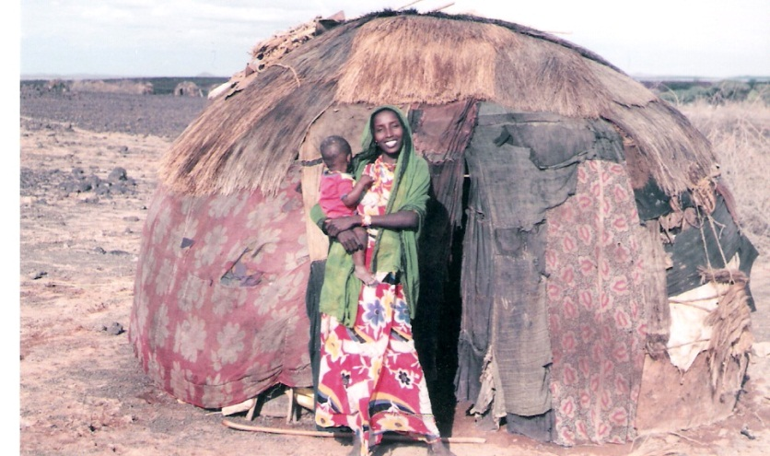
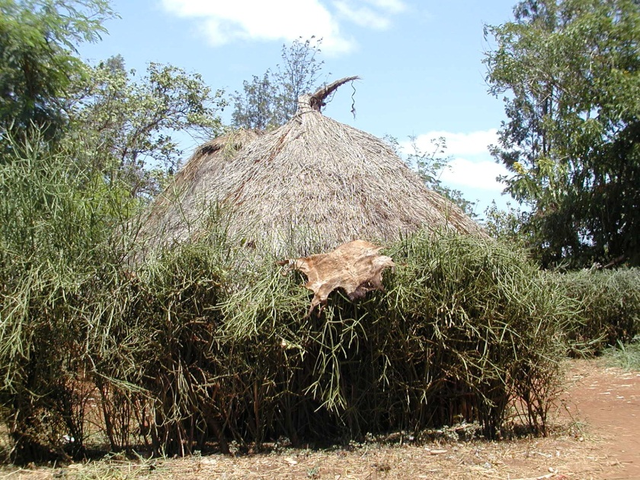
Poverty Dynamics
Overview of topics and presentation for PAI 757 / ECN 661

Slide 2
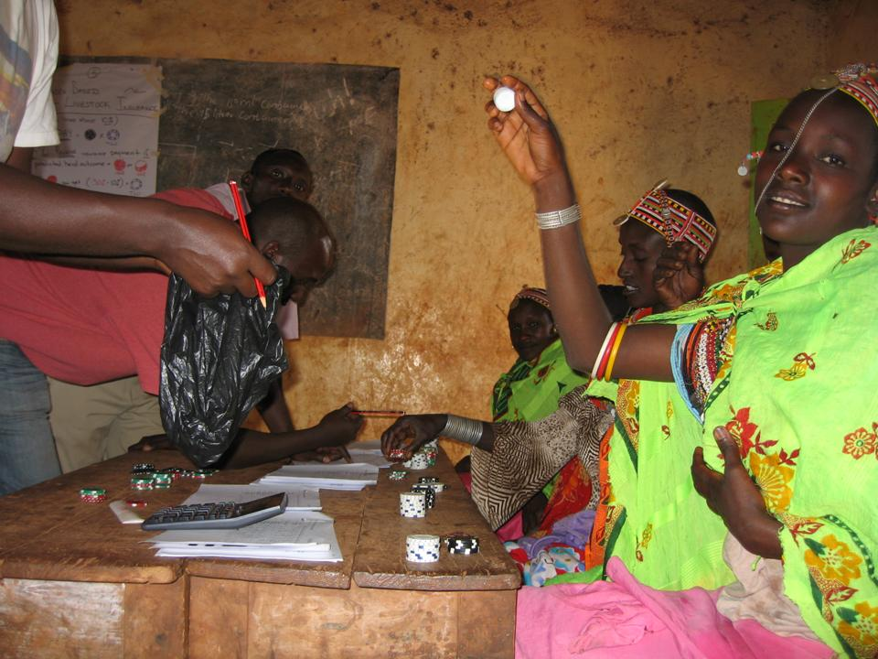
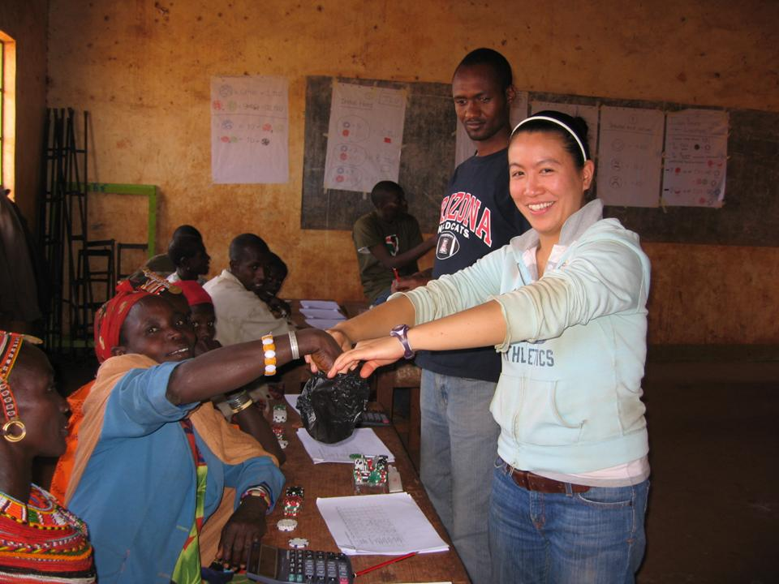
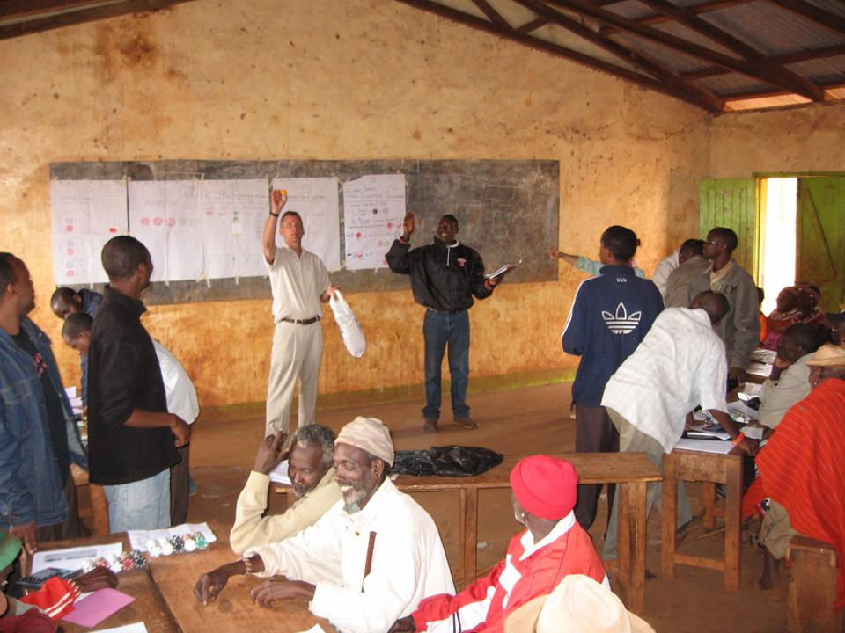
2008 Game Play, Karare Kenya, Index Based Livestock Insurance Project

Slide 3
What is poverty?
If we want to reduce it, first we have to define what it is.
How do we measure poverty?
Do different measures tell us different things?
Do these different messages have different policy implications?

Slide 4
Spatial dimensions
Poverty reduction funding related to the poverty incidence in a PM constituency.
DFiD project bases number eligible for cash transfers on incidence in the location.
Note some areas left off the map as no survey was run

Slide 5
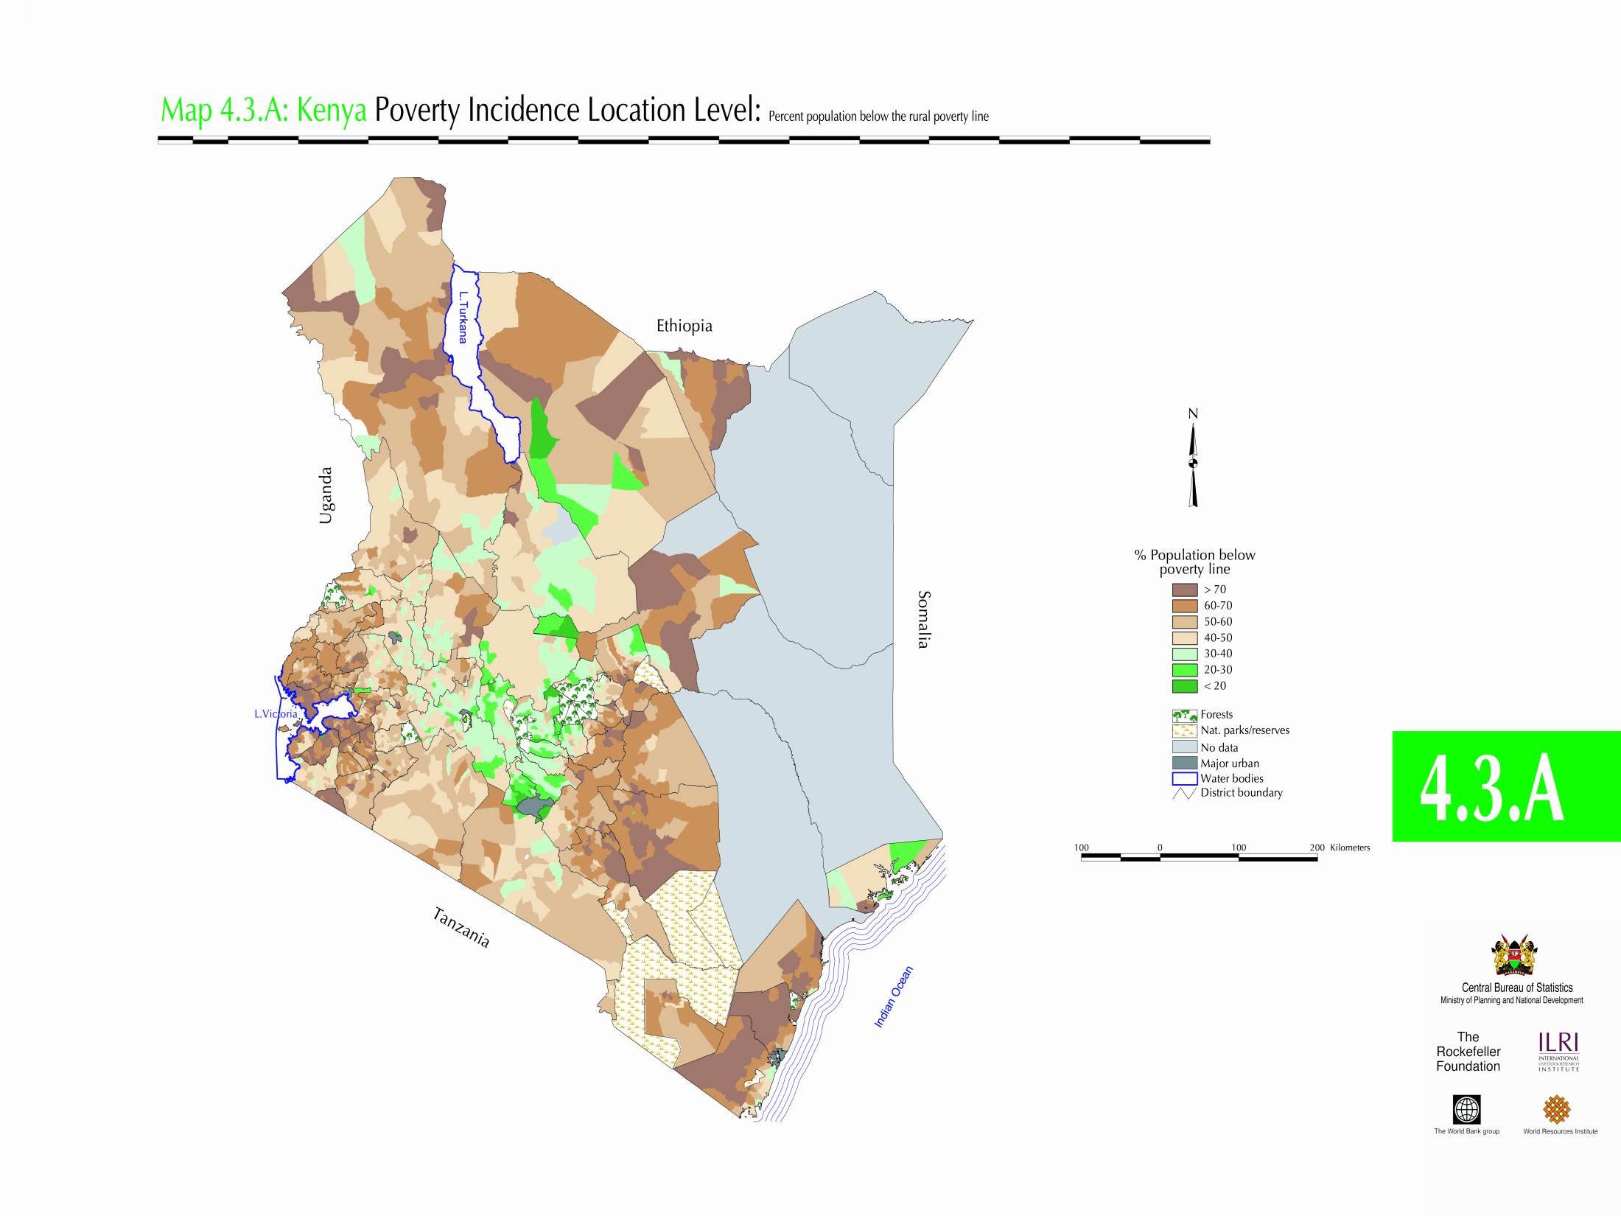

Slide 6
Dynamic measures of poverty
Krishna’s study.
35 villages in five districts of Rajasthan.
Stages of progress exercise to establish what constitutes poverty in each village.
First four stages: buying food to eat, sending children to school, possessing clothes to wear outside the house, retiring debt in regular installments.
Poverty is not being able to meet these four conditions.

Slide 7
Dynamic measures of poverty
Select event prior to the study period
25 years ago (the national emergency).
Discuss each household’s position at the time of the event and current position (ended up excluding education due to changes over time in the view of education).
Men and women draw up different lists, reconcile at end, and follow up with households if outstanding differences exist.

Slide 8
Dynamic measures of poverty
 | Poor 25 years ago | Not poor 25 years ago.
Poor currently | 17.8% remained poor | 7.9% became poor
Not poor currently | 11.1% Escaped poverty | 63.2% remained non poor

Slide 9
Dynamic measures of poverty
Falling into poverty
No single factor, mostly a combination of factors. Not a single blow, but a series of blows.
85% of cases involve some combination of health problems and health related expenses, high interest private debt, and social and customary expenses.
Drunkenness and laziness are mentioned in around 5% of cases.

Slide 10
Dynamic measures of poverty
Escaping poverty.
Diversification of income sources – taking up activities in addition to agriculture.
Often an urban link and information is critical.
Personal capability and enterprise, relatives help.
Direct assistance from government departments, NGOs, political parties less important.
Informal sector is main source of opportunities, not formal full time employment.

Slide 11
Recent paper has similar findings
 | Poor 25 years ago | Not Poor 25 years ago
Poor currently | 51.4% remained poor | 12.2% became poor
Not poor currently | 14.1% escaped poverty | 22.3% remained non poor
2006 study, Andhra Pradesh, 36 villages, World Development 34(2): 271-288

Slide 12
A US Example: Rural NC, 1995-2005
 | Poor 25 years ago | Not poor 25 years ago.
Poor currently | 27% remained poor | 12% became poor
Not poor currently | 23% escaped poverty | 38% remained non poor

Slide 13
Dynamic measures of poverty
Krishna, World Development , 35(11): page 1951. 2007

Slide 14
Dynamic measures of poverty
Policy implications?
First, if we want to help people escape, we should first know what they do themselves.
Second, if we want to help people avoid falling into poverty, we should understand the main factors that lead to a fall and target them.

Slide 15
Dynamic measures of poverty
From the Rajasthan study:
High healthcare costs, high interest consumption debt, social expenses on deaths and marriage.
Escaping poverty can be improved by improved information (water tables for irrigation, disease control for health, contacts and jobs in the city).

Slide 16
Principal reasons for falling into poverty
Ibid. Page 1953. Can add to more then 100% as combinations possible

Slide 17
Principal means of escaping poverty
Ibid. page 1954

Slide 18
In pastoral areas, the key asset is livestock.
This makes asset poverty simpler to analyze than in other settings, but there is broad applicability of this approach

Slide 19
The Basic Idea
$y_{it}=A_{it}^{}′\left[r_{it}\left(A_{it}\right)+{ε_{it}}_{}^{R}\right]+U_{i}+{ε_{it}}_{}^{T}{+ε_{it}}_{}^{M}$
$y_{it}$ is Income for household i at time t
$A_{it}^{}$ is a vector of productive assets for hh i , time t
$r_{it}\left(A_{it}\right)$ is the rate of return on these productive assets, possibly as a function of asset levels.
${ε_{it}}_{}^{R}$ is the household and period specific shock to the return on assets.
$U_{i}$ are household specific but time invariant income flows
${ε_{it}}_{}^{T}$ is household and time specific transitory income
${ε_{it}}_{}^{M}$ is household and time specific measurement error.
From Barrett et al. (2006) JDS paper.
Transfers such as U_{i} could raise income, impact future asset stocks, influence the rate of return to existing assets
Assets could be subject to stochastic shocks, say $A_{i(t+1)}=\left[A_{it}+g(A_{it})\right]∗(1−{θ }_{t}−γ_{it})$, with theta and gamma defined over the interval [0,1].

Slide 20
Research Design for Work in East Africa
IBLI is asset protection, reduce impact of shocks to A.
HNSP is cash transfer, works like U.
Sites with IBLI (Index Based Livestock Insurance) and HSNP (Hunger Safety Net Program)
Sites with only IBLI or HSNP
Sites with neither
Full comparison is ahead

Slide 21
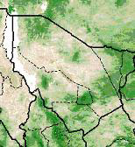
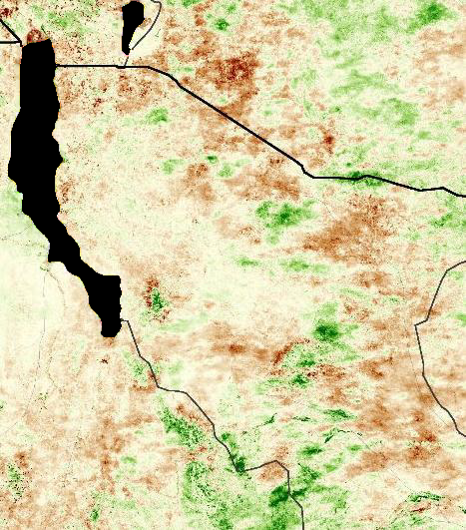
What is the Index Part?
Normal Year (May 2007) Drought Year (May 2009)
From Chantarat and Mude 2011

Slide 22
Annual Deviation of NDVI 1999-2006

Slide 23
Asset poverty can be viewed as “structural poverty”.
the assets of a household are below a threshold that generates expected income above some defined poverty line.
Another issue is that the returns to assets are potentially a function of asset levels
Income poverty can be viewed as “transitory poverty”.
The observed income level is below a threshold in a given time period.
Vulnerability to these different types of poverty differs.

Slide 24
Average household income is highly variable over time periods.
Clear seasonality (1 is the long rains, 3 is the short rains, 2 and 4 are dry seasons).
Slow upward shift of the cycle.

Slide 25
Clearly, this is a highly variable production environment due to rainfall fluctuations.
Contrast households by income variability over time under the assumption that higher variability is “bad”.
CV of household income is a decreasing function of both average herd size and of average income level

Slide 26
Herd dynamics play a critical role in household vulnerability.
Average household herd size (the asset) changed dramatically over time (35% increase to max, 55% decrease from max).
The late 1996 loss to the average herd corresponds to a 34% drop in expected income.

Slide 27
Regression analysis allows us to trace out the relationship between herd size per adult equivalent and expected income.
Threshold using a $0.50 per person per day poverty line:
wet season 6.5 animals
dry season 9.5 animals

Slide 28
Definition | Structural Poverty | Stochastic Poverty
Chronic Poverty | Always income poor Asset poor | Always income poor Asset non-poor
Transitory Poverty | Sometimes income poor Asset poor | Sometimes income poor Asset non-poor
Examples | Structural Poverty | Stochastic Poverty
Chronic Poverty | No animals | String of bad luck
Transitory Poverty | Seasonal Escape / Had temporary good luck | Drought

Slide 29
Contrast Asset and Income HC index
When you measure and how you measure poverty leads to different implications (income poor at $0.50 line)

Slide 30
When you measure and how you measure poverty leads to different implications (11 sites in Kenya and Ethiopia)

Slide 31
Returns as influenced by location (return to spatial story)

Slide 32
Evidence from the Borana Plateau
Threshold around 10 animals per person (also note this is close to the dry season asset poverty line)
This pattern suggests restocking should be targeted at people around the threshold.

Slide 33
Poverty and Vulnerability linked
What do people say they are worried about when you ask them?
Risk rankings from the PARIMA survey.
Developed list of common concerns through open ended work.
“which of these you are afraid could affect your household in the coming three months”.
Allowed them to say “not a concern” and they could add others as well.

Slide 34
Rankings Overall [1 highest, 0 not a concern]
Food Shortage | 0.57
Human Sickness | 0.43
Lack of Pasture | 0.38
High Consumer Prices | 0.37
Animal Sickness | 0.36
Low Selling Price | 0.30
Lack of Water for Animals | 0.27
Crop Failure | 0.26
No Buyers | 0.22
Raids | 0.16

Slide 35
Concerns change over time

Slide 36
The implications for development policy
Vulnerability to poverty may influence behavior as much as the state of poverty.
Asset complementarities may be critical (and wealth may matter). Land plus irrigation as opposed to just land.
Access to assets – who has access? Will markets alone allocate assets to allow people to climb out of poverty?

Slide 37
Conclusion
Different static measures have different advantages and disadvantages.
Applying a variety of them to the same data set helps.
Spatial analysis can help targeting of policy efforts.

Slide 38
Conclusion
Dynamic measures provide different types of information on poverty.
What do people identify as the causes of falling into poverty?
What do people identify as the main paths out of poverty?
What can government / NGOs do with this information?
Policy to prevent falls (“safety nets”) may differ from policy to allow escape (“cargo nets”).
Humanitarian is by nature targeted at transitory, crisis relief. Does this crowd out longer term development assistance?

Slide 39
Conclusion
Asset based poverty measures differ from income based poverty measures.
Asset vulnerability may be important.
Seasonality of income measures may be misleading.

