Slide 1
PST 410 Overview of Economic Concepts and Policy Implications – Provision of Goods and Services in the Context of Rivalry and Exclusion
September 9, 2024

Slide 2
Defining Types of Goods
A good can be termed as rival or non-rival.
  Rival means consumption of a given unit of q by one individual precludes consumption of that same unit of q by another individual.
  Non-rival means both individuals can benefit at the same time from the same unit of q.
    Sometimes described as depletable or non-depletable
A good can be termed excludable or non-excludable.
  Excludable means there is a means to control who has access to the good.
  Non-excludable means there is no means to control who has access to the good.

Slide 3
The Four Types of Goods
Types of goods | Rival | Non-rival
Excludable | Private | Club
Non-excludable | (common property) Open access | Public
Examples of goods | Rival | Non-rival
Excludable | Candy bar | Concert that is not sold out
Non-excludable | (rangeland for an ethnic group’s use) Fish in international waters | Clean air

Slide 4



Aggregate Demand for a Private Good
Private good, demand person i and person j
p
p
p
$$D_{i}$$
$$D_{j}$$
$$D_{S}=D_{i}+D_{j}$$
10
10
10
8
8
8
5
+
5
=
5
5
8
9
q
4
7
10
q
9
15
19
q
Horizontal summation of q for a given p since the good is rival
The means of “exclusion” is the price p

Slide 5
Assumptions of a Perfectly Competitive Market for a Private Good
Four key assumptions
Large number of buyers and sellers/price-taking behavior/no market power
Information is symmetric for buyers and sellers (and assumed to be “correct”)
The good is homogeneous
There are no costs beyond the selling price associated with the transaction/no transaction costs

Slide 6


Consumer Surplus and Producer Surplus
p
Consumer
surplus (CS)
S: consider as MC
Total social welfare: TSW, also called social surplus
Total social welfare = Consumer surplus + Producer surplus
TSW = CS + PS
$$p^{∗}$$
Producer
surplus
(PS)
D: consider as MWTP
$$q^{∗}$$
q

Slide 7
Fundamental Theorem of Welfare Economics
A perfectly competitive market will lead to outcomes that are Pareto optimal/efficient.
  Pareto optimality/efficiency means that there is no way to make one individual better off without making another individual worse off.
    There is no slack, no waste, no inefficiency.
A benevolent social dictator can at best equal the Pareto optimal/efficient outcome of a perfectly competitive market.
  History suggests that we should not count on benevolent social dictators!

Slide 8
Public Goods
Non-rival, Exclusion not feasible

Slide 9
Recall the Public Good Definition
A public good is non-rival.
A public good is non-excludable.
  There is no market for a public good.
A public good is a good usually provided by government that confers positive benefits to citizens.
  Not all goods provided by government are public goods.
    Licensing fees, permit to drill on public lands, immigration paperwork…
  Not all public goods are provided by government.
    Light at the end of a driveway, flowers in the front lawn…

Slide 10
A Public Good Will Suffer from Under-Provision
There is an incentive to benefit from the public good without paying the cost of provision.
The “free rider” problem is the name given to this problem.
The “free rider” problem will lead to under-provision of the public good.
We want as much of it as possible, but don’t want to pay for it if we can get away with it.

Slide 11



Illustrating Aggregate Demand for a Public Good
Vertical summation of MWTP for each individual (again person i and person j add up to societal demand) for a given unit of the public good
Over all individuals—non-exclusion
Summing MWTP for a given unit—non-rival
For unit 2, person i has MWTP of 8, person j has MWTP of 7—total of 15 for society
p
20
15
15 = 8 + 7 at q = 2
12
8
$$D_{s}=D_{i}+D_{j}$$
7
$$D_{j}$$
$$D_{i}$$
2
6
14
q

Slide 12
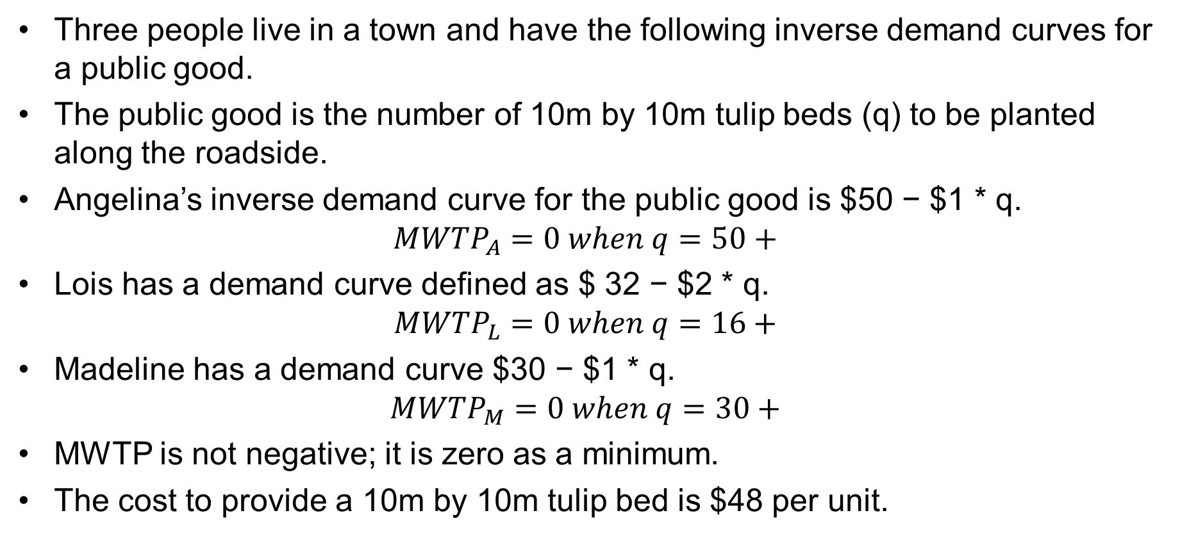
An Example
Three people live in a town and have the following inverse demand curves for a public good.
The public good is the number of 10m by 10m tulip beds (q) to be planted along the roadside.
Angelina’s inverse demand curve for the public good is $50 − $1 * q.
$${MWTP}_{A}=0 when q=50+$$
Lois has a demand curve defined as $ 32 − $2 * q.
$${MWTP}_{L}=0 when q=16+$$
Madeline has a demand curve $30 − $1 * q.
$${MWTP}_{M}=0 when q=30+$$
MWTP is not negative; it is zero as a minimum.
The cost to provide a 10m by 10m tulip bed is $48 per unit.

Slide 13
Free Riding and Socially Optimal Outcomes
Socially
optimal
outcome

Slide 14
There Is No Market for a Public Good
Because they are non-rival and non-exclusive, there is no market for public goods.
Public goods are sometimes described as goods provided by government to generate positive externalities.
As economists, we are sometimes asked by government to help come up with an estimate of the size of the public’s willingness to pay (WTP).
We have a few tools in our toolkit to do this.

Slide 15
Hedonic Methods
Look at something sold in a market that has both private and public good characteristics embedded in the bundled commodity.
  Apartments with air quality
  Ranches with permits to graze on public lands
  Lakefront undeveloped land lots
  Genetic characteristics of plants and animals
Regress selling price on characteristics to get the implicit price of the public good characteristics.

Slide 16
Travel Cost
Access to the public good requires both displacement and the use of time.
Look at the cost of the displacement, the opportunity cost of time, and out-of-pocket costs to develop an estimate of the amount spent to access the public good.
  Economic value of recreational fishing
  Economic value of public parks and beaches
  Economic value of fuelwood collected in public lands or commons
  Economic value of endangered species

Slide 17
Averting Behavior Cost
If people are privately paying for a service in the absence of public provision of a service, we can use that as an estimate of what public provision would be worth.
Spending on bottled water and fuel to boil water in the absence of safe publicly-available drinking water
Spending on private security in the absence of adequate public security
Private education expenditure due to the absence of adequate public education

Slide 18
Contingent Valuation
Survey-based method that asks contingent upon a specified change—would you be willing to pay more for a service or in taxes?
Efforts to improve the quality of a lake
Replacing electricity generated by coal with electricity generated by windmills

Slide 19
Discrete Choice Experiments
Hypothetical scenarios that bundle sets of characteristics and ask people to make relative evaluations of them
One of the characteristics is a cost or price
  Public health delivery modalities
  Value of conservation and environmental investment
  Job incentives for public services like medical clinics and public schools

Slide 20
Open Access / Commons

Slide 21
Tragedy of the Commons Non Exclusion, Rival
In the tragedy of the commons, each herder considers the private cost of adding another animal to the commonly held pasture
They do not consider the marginal cost of the externality this imposes to the other users
At the center of the tragedy is the idea of a negative externality
The pasture is rival and there is no exclusion

Slide 22
Tragedy of the Commons (cont.)
Forests, forest products, fuelwood
Rangelands
Public health care / education / infrastructure under capacity constraints
Wi-Fi signals under capacity limitations without password protection
Water in an irrigation system
Water in rivers that cross multiple jurisdictions
Shared work and study areas

Slide 23
The Nature of the Problem
Think of the fixed input in production being the fixed extent of the pasture that the herders share
The variable input is the total herd size that is put on the pasture
The production function mixes pastureland and the size of the herd to generate the output—milk
  Labor is also a variable input, but we assume it is in a fixed ratio to herd size so it can be ignored
Diminishing marginal returns to aggregate herd size in milk production

Slide 24
Milk Production
Total herd size | Total milk in liters | Total milk value in $
0 | 0 | $0
5 | 10 | $10
10 | 20 | $20
15 | 30 | $30
20 | 36 | $36
25 | 40 | $40
30 | 44 | $44
Total herd size
Note diminishing marginal product sets in as the herd size passes 15

Slide 25
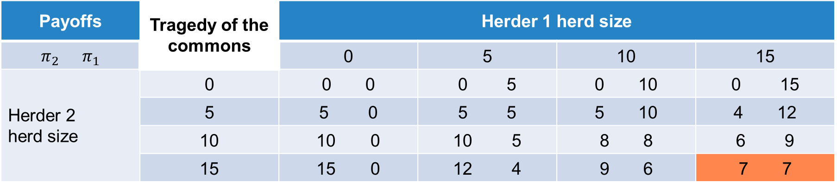
Tragedy of the Commons
Payoffs | Tragedy of the commons | Herder 1 herd size
$$π_{2} π_{1}$$ |  | 0 | 5 | 10 | 15
Herder 2 herd size | 0 | 0 0 | 0 5 | 0 10 | 0 15
 | 5 | 0 | 5 5 | 5 10 | 4 12
 | 10 | 0 | 5 | 8 8 | 6 9
 | 15 | 0 | 4 | 9 6 | 7 7
Best response Nash equilibrium
H1 plays 0, H2 plays 15 H2 plays 0, H1 plays 15 H1 plays 15 gets $7, H2 plays 15 gets $7
H1 plays 5, H2 plays 15 H2 plays 5, H1 plays 15 Nash equilibrium is not Pareto optimal
H1 plays 10, H2 plays 15 H2 plays 10, H1 plays 15
H1 plays 15, H2 plays 15 H2 plays 15, H1 plays 15

Slide 26
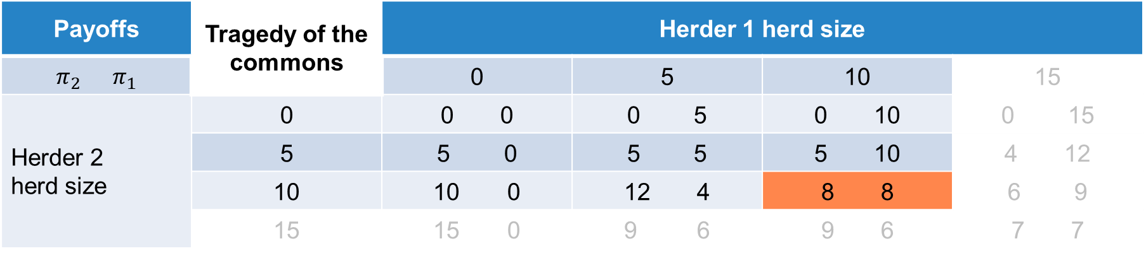
Tragedy of the Commons: Limit Use
Payoffs | Tragedy of the commons | Herder 1 herd size
$$π_{2} π_{1}$$ |  | 0 | 5 | 10 | 15
Herder 2 herd size | 0 | 0 0 | 0 5 | 0 10 | 0 15
 | 5 | 0 | 5 5 | 5 10 | 4 12
 | 10 | 0 | 12 4 | 8 8 | 6 9
 | 15 | 0 | 9 6 | 9 6 | 7 7
Best response Nash equilibrium
H1 plays 0, H2 plays 10 H2 plays 0, H1 plays 10 H1 plays 10 gets $8, H2 plays 10 gets $8
H1 plays 5, H2 plays 10 H2 plays 5, H1 plays 10 Nash equilibrium is Pareto optimal
H1 plays 10, H2 plays 10 H2 plays 10, H1 plays 10 Nash equilibrium is Pareto improving
H1 plays 15, H2 plays 15 H2 plays 15, H1 plays 15

Slide 27

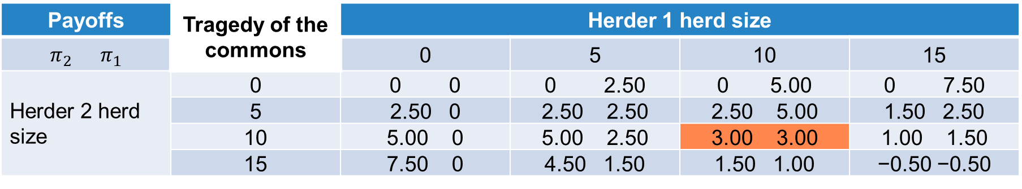
Tragedy of the Commons: User Fee
Charge user fee of $0.50 per animal put on the commons, collected by the state
  $$π_{1}=\$1∗\left(\frac{h_{1}}{h_{1}+h_{2}}\right)∗f\left(h_{1}+h_{2}\right)−\$1∗h_{1}−\$0.50∗h_{1}$$
  $$π_{2}=\$1∗\left(\frac{h_{2}}{h_{1}+h_{2}}\right)∗f\left(h_{1}+h_{2}\right)−\$1∗h_{2}−\$0.50∗h_{1}$$
Payoffs | Tragedy of the commons | Herder 1 herd size
$$π_{2} π_{1}$$ |  | 0 | 5 | 10 | 15
Herder 2 herd size | 0 | 0 0 | 0 2.50 | 0 5.00 | 0 7.50
 | 5 | 2.50 0 | 2.50 2.50 | 2.50 5.00 | 1.50 2.50
 | 10 | 5.00 0 | 5.00 2.50 | 3.00 3.00 | 1.00 1.50
 | 15 | 7.50 0 | 4.50 1.50 | 1.50 1.00 | −0.50 −0.50
Best response Nash equilibrium
H1 plays 0, H2 plays 15 H2 plays 0, H1 plays 15 H1 plays 10 gets $3, H2 plays 10 gets $3, tax is $10
H1 plays 5, H2 plays 10 H2 plays 5, H1 plays 10 Nash equilibrium is Pareto optimal
H1 plays 10, H2 plays 10 H2 plays 10, H1 plays 10 State gets ($0.50 * 10 + $0.50 * 10) = $10, herders $6, total $16
H1 plays 15, H2 plays 5 H2 plays 15, H1 plays 5 Nash equilibrium is not Pareto improving

Slide 28
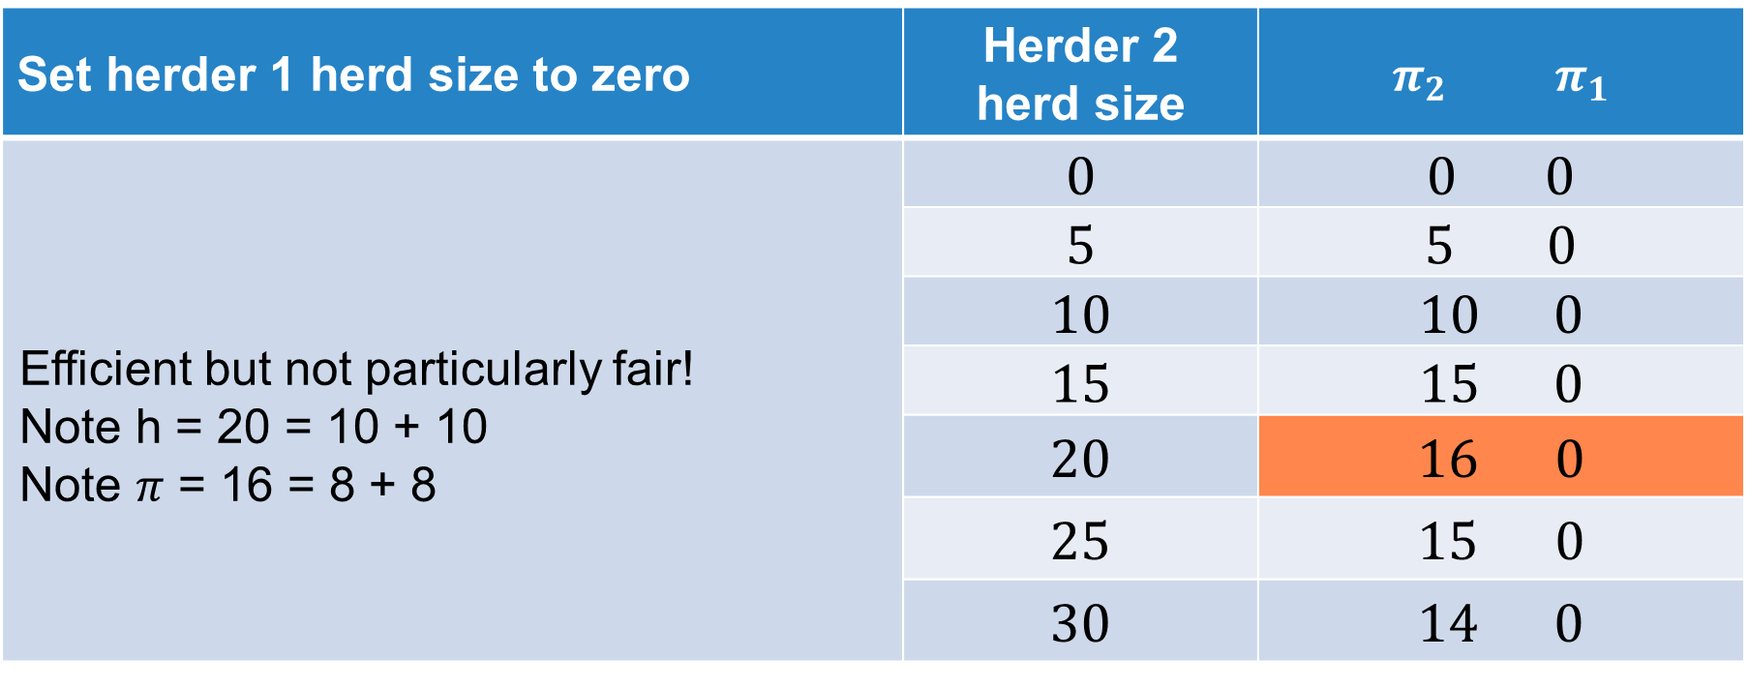
Tragedy of the Commons: Privatize
Set herder 1 herd size to zero | Herder 2 herd size | $$π_{2} π_{1}$$
Efficient but not particularly fair! Note h = 20 = 10 + 10 Note $π$ = 16 = 8 + 8 | 0 | 0 0
 | 5 | 0
 | 10 | 0
 | 15 | 0
 | 20 | 0
 | 25 | 0
 | 30 | 14 0

Slide 29
Tragedy of the Commons
Policy options
  Limit use
  User fees
  Property rights
Next, we turn to the topic of club goods

Slide 30
Club Goods

Slide 31


Club Goods
Exclusion is possible.
Consumption of the good is non-rival.
  Movie
  Concert
  Country club
  Toll road
If we don’t restrict access, we may suffer from congestion when rivalry sets in.

Slide 32
Example of a Road or Bridge
We can start with the idea of a public good again.
  Non-rival
  Non-excludable
If we all want to cross the bridge or use the road at the same time, we begin to impose a negative externality on others.
Like the commons example, with free access and fixed capacity, we can end up with a suboptimal outcome.
We have time periods with high demand (peak) and time periods with low demand (off peak).

Slide 33
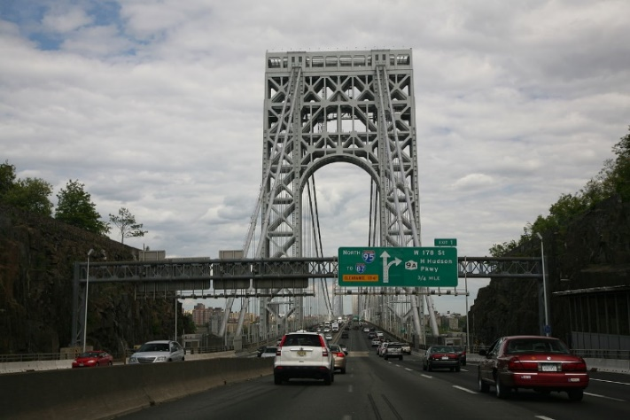





Congestion Pricing
$${MC}_{society}$$
$$D_{low}$$
$${toll}_{S}$$
DWL
$$D_{high}$$
$${bc}_{S}$$
Bridge crossings per hour

Slide 34
New York City Transport Creates a Means of Exclusion
Bronx-Whitestone, Throgs Neck, and Robert F. Kennedy Bridges; Hugh L. Carey and Queens Midtown Tunnels
  E-ZPass®: $6.12
  Tolls by mail: $9.50
Verrazzano-Narrows Bridge
  E-ZPass®: $12.24
  Tolls by mail: $19.00
Metro North Rail Fares

Slide 35
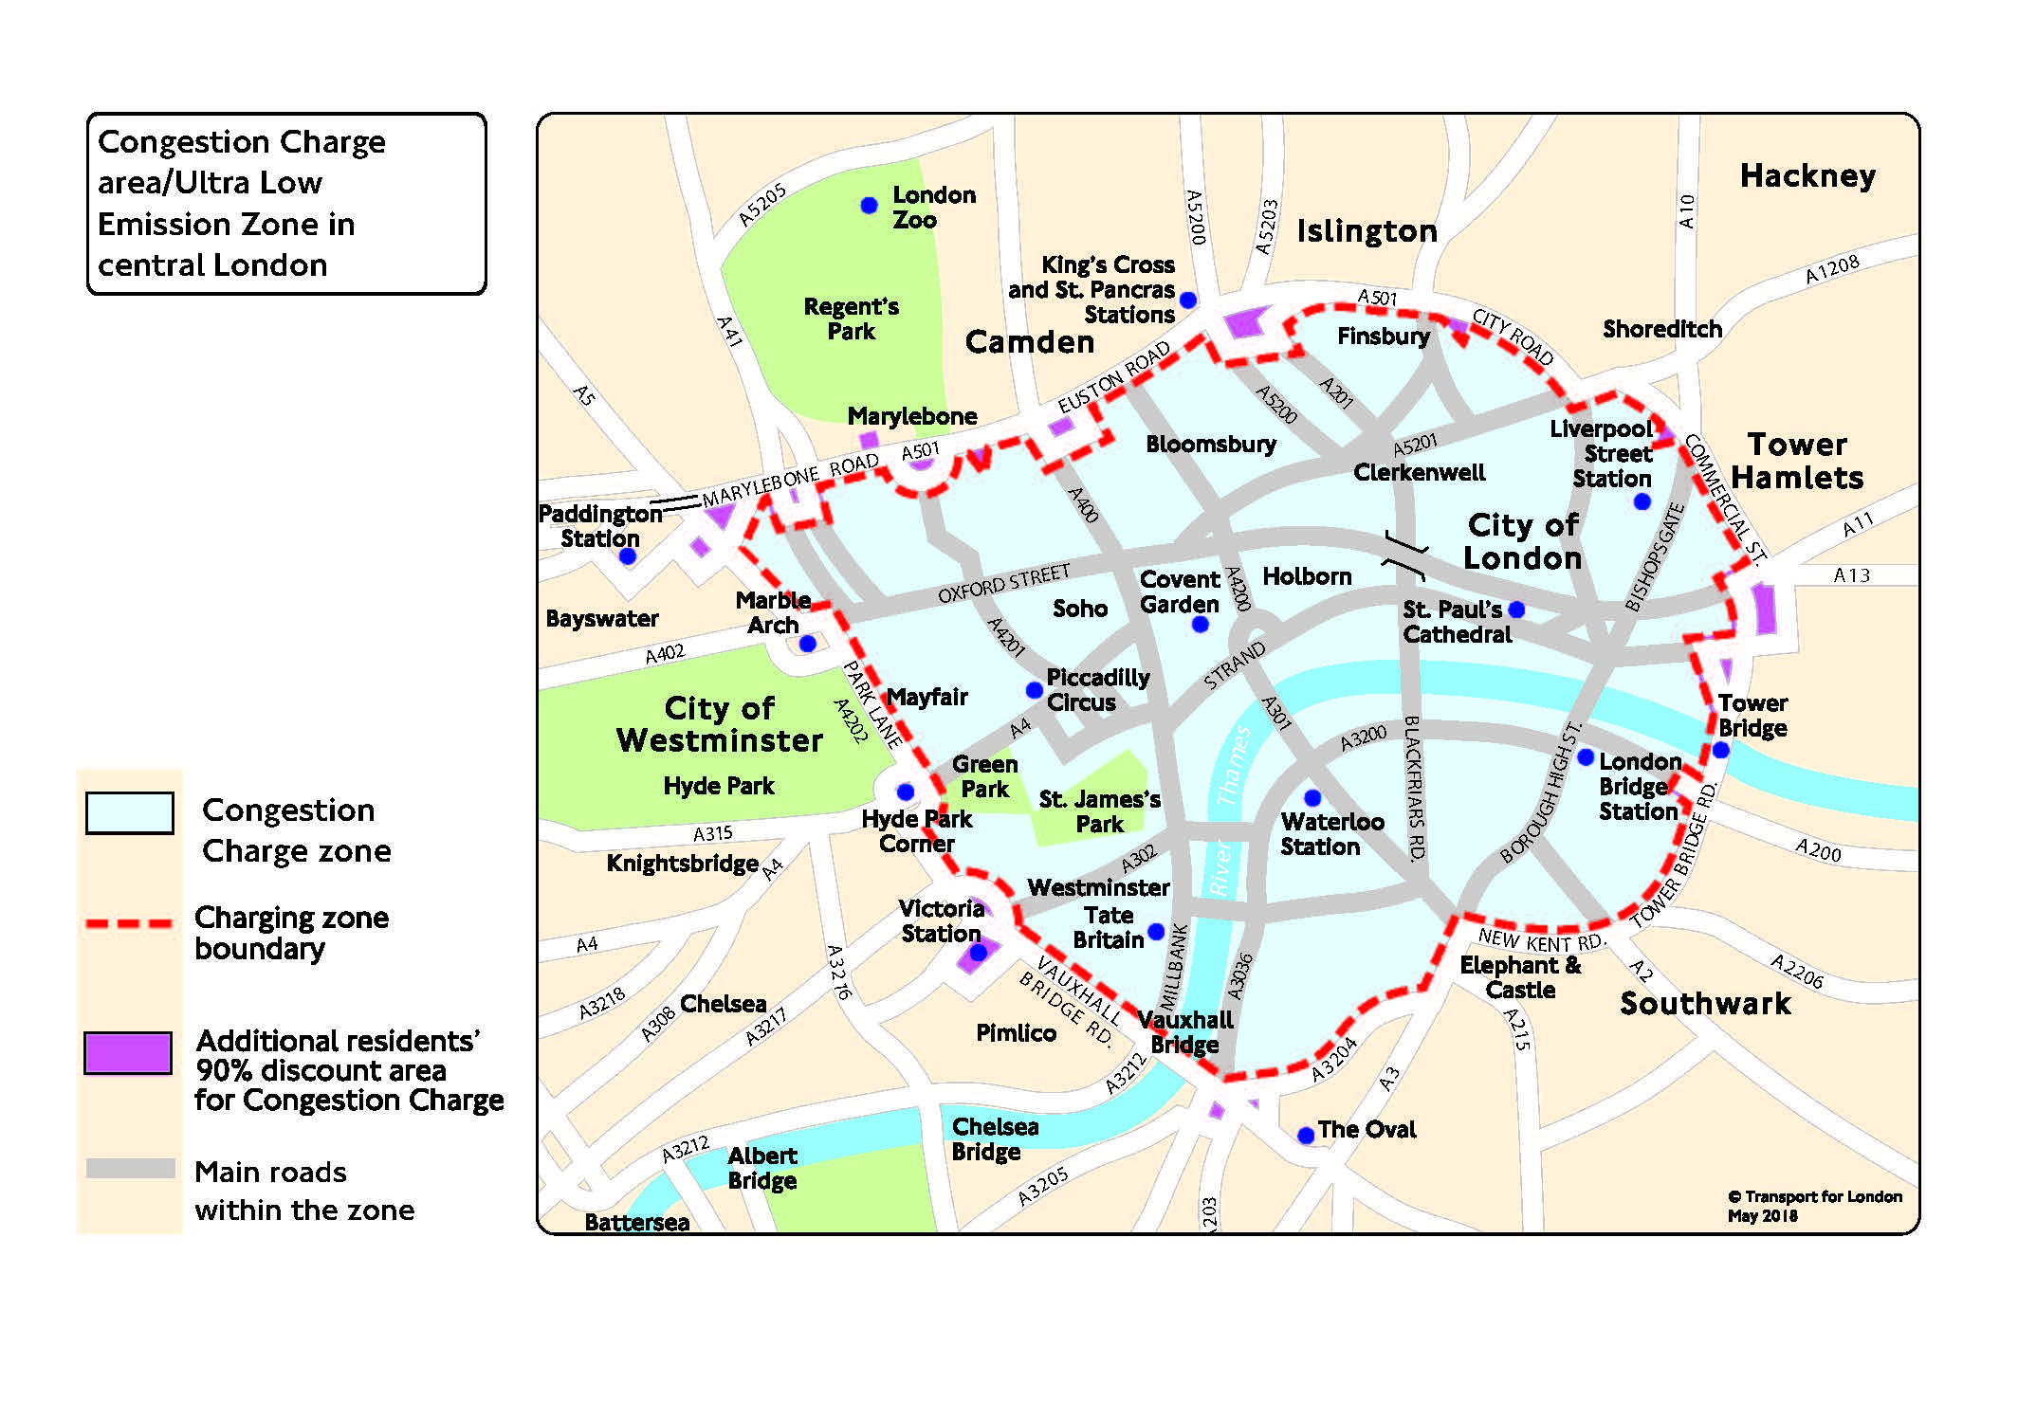
London Congestion and Emission Pricing
You need to pay a £15 daily charge if you drive within the Congestion Charge zone 07:00-22:00, every day, except Christmas Day (25 December). If your vehicle does not meet the Ultra Low Emission Zone (ULEZ) standards, you must also pay the ULEZ charge.
To help improve air quality, an Ultra Low Emission Zone (ULEZ) operates 24 hours a day, 7 days a week, every day of the year, except Christmas Day, within the same area of central London as the Congestion Charge. Most vehicles, including cars and vans, need to meet the ULEZ emissions standards or their drivers must pay a daily charge to drive within the zone:
£12.50 for most vehicle types, including cars, motorcycles and vans (up to and including 3.5 tonnes)
£100 for heavier vehicles, including lorries (over 3.5 tonnes) and buses/coaches (over 5 tonnes)

Slide 36
A Few Other Concepts
Monopoly, Natural Monopoly
Benefit-Cost
Positive Externalities

Slide 37
Monopoly
A monopoly exists when there is a single provider of a good for which there is no close substitute.
It can happen due to the nature of production.
  Technology of production has increasing returns to scale
It can happen due to legal reasons.
  Patents to allow rewards for R&D
It can happen due to non-competitive behavior by the firm.
  That is the kind we try to prevent
It can happen by policy due to the thing being produced.
  Military

Slide 38






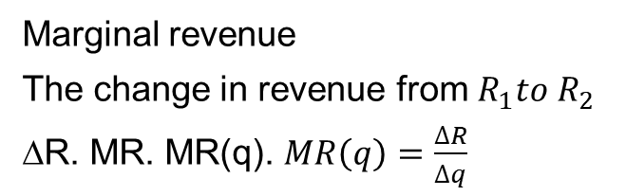
The Decision Facing a Monopolist
In perfect competition, the profit maximizing firm chose q in response to the market signal of p.
p
$$R_{1}=p_{1}∗q_{1}$$
Marginal revenue
The change in revenue from $R_{1}to R_{2}$
∆R. MR. MR(q). $MR\left(q\right)=\frac{∆R}{∆q}$
$$p_{1}$$
1
$$p_{2}$$
Loss
$$R_{2}=p_{2}∗q_{2}$$
2
In contrast, the monopolist chooses the (p, q) pair from the demand curve.
They are the only firm that supplies the good for which there is demand.
Gain
D
$$q_{1}$$
$$q_{2}$$
q

Slide 39




TSW Implications
TSW perfect competition
CS = 1 + 2 + 3
PS = 4 + 5
TSW = 1 + 2 + 3 + 4 + 5
TSW monopoly
CS = 1
PS = 2 + 4
TSW = 1 + 2 + 4
DWL = 3 + 5
p
1
$$p_{m}$$
M
S
2
3
$$p_{pc}$$
4
5
PC
MR
This is the economic objection to monopoly.
It is inefficient.
D
0 1 2 3 4 5 6 7 8 9 10 11
$$q_{m}$$
$$q_{pc}$$
q

Slide 40
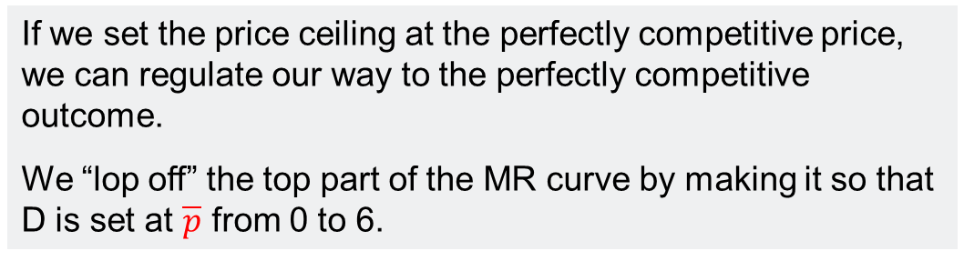

Price Ceiling to Regulate
If we set the price ceiling at the perfectly competitive price, we can regulate our way to the perfectly competitive outcome.
We “lop off” the top part of the MR curve by making it so that D is set at $\overline{p}$ from 0 to 6.
1
$$p_{m}$$
M
S
2
3
$$p_{pc}=\overline{p}$$
MR=D
4
5
PC
CS = 1 + 2 + 3
PS = 4 + 5
Regulated TSW = 1 + 2 + 3 + 4 + 5
D
0 1 2 3 4 5 6 7 8 9 10 11
$$q_{m}$$
$$q_{pc}$$

Slide 41
The Case of a Natural Monopoly
A natural monopoly arises when the average cost of production is declining over the feasible range of demand
  (MC is below AC over this range)
Why could this happen?
  Large infrastructure cost to deliver service
  But the marginal cost of connecting to this infrastructure is relatively small
Economies of scale
  It means one large firm can produce at a lower average cost than multiple smaller firms producing the same total amount

Slide 42






Regulating a Natural Monopoly
Monopoly outcome Π > 0
Note when MC is below AC then MC is decreasing.
MC crosses AC from below at the minimum of AC.
AC is increasing when MC is above AC.
D
Average cost pricing Π = 0
$$p_{m}$$
M
MC
$$p_{ac}$$
AC
$$p_{pc}$$
AC
PC outcome with a subsidy
Π = 0 without subsidy Π < 0
Subsidy
pc
MR
$$q_{m}$$
$$q_{ac}$$
$$q_{pc}$$

Slide 43
Public Decisions With Impacts Over Time
$
With
$
Without
With
Status at t = 0
Status at t = 0
Without
Before
t = 0
After
Time
Before
t = 0
After
Time
Temptation to overclaim down to status at t = 0
Temptation to say nothing happened since status at t = 0 is the same as with
Can claim area between with and without
Can claim area between with and without
Many other patterns are possible

Slide 44
Education/Skills Demand
A kind of benefit-cost tradeoff to go from the wage if not trained labor market to the wage if trained market
$
Wage if Trained
NPV = PVB - PVC
Is discounted (benefit of training) greater than the discounted sum of the (direct and opportunity costs) of training?
Benefit of training
Wage if Not Trained
Opportunity cost of training
Direct costs
of training
Retirement age
Time/age
Length of training
Invest in human capital

Slide 45
Applicable for Many Kinds of Investment
Education
Health
Infrastructure
Environmental
What will it cost now?
What will be the benefits in the future?
What will be the costs if we don’t make the investment now?

Slide 46
A Final Issue is When Benefits Spillover
There are private benefits that influence an individual’s decisions.
The private decisions may lead to benefits to other people.
  This is called a positive externality.
There is a case for using policy to influence decision making.
  Home ownership
  Home repair
  Lead abatement
  Public Health
  Education

Slide 47











Positive Externality
p
S = ${MC}_{}$
$$p_{so}$$
The perfectly competitive price is too low
The perfectly competitive quantity is too low
so
$$p_{pc}$$
pc
$$D_{society}={MB}_{private}+{MB}_{external}$$
$${MB}_{externalq′}$$
$${MB}_{external}$$
$${MB}_{private}$$
$${MB}_{externalq′}$$
$$q_{so}$$
$$q^{′}$$
q
$$q_{pc}$$

Slide 48















Subsidy to Get to Socially Optimal Outcome
Subsidize consumer
Subsidize producer
$$S={MC}_{p}$$
p
S
p
σ
$${p_{so = }p}_{s}$$
$$S={MC}_{p}−σ$$
$${p_{so = }p}_{s}$$
$$p_{pc}$$
$$p_{pc}$$
σ
$$σ$$
$$p_{c}$$
$$p_{c}$$
$$σ$$
D + σ
D
D
$$q_{so}$$
q
$$q_{so}$$
$$q_{pc}$$
$$q_{pc}$$
q
$$p_{s}=p_{c}+σ, p_{s}−σ=p_{c}$$

Slide 49
Closing Thoughts
Where might your internship fit into these concepts?

