Slide 1
Lecture 7: Limits to Government Intervention
PAI 897 Policy Analysis

Slide 2
Agenda Control
Y axis is social spending,
X axis is defense spending.
Policy makers 1,2,3 have ‘bliss points’, B₁, B₂, and B₃.
Around these respective ‘bliss points’ they have circular indifference curves, where closer in is preferred to farther out.
The status quo is the current spending on both.
“Win Sets” W are the areas where a positive vote (2 yes, 1 no) are possible.
  There is a W₁₃ where one and three vote yes and two votes no.
  There is a W₁₂ where one and two vote yes and three votes no.
  There is a W₂₃ where two and three vote yes and one votes no.
If Person 1 can set the agenda, then can propose B₁ and it will win, as it is preferred (slightly) by three to the status quo. If two could set the agenda, could propose something in either of the two other ‘win sets’ to build a majority.

Slide 3
Limits to Voting: Shaping the Agenda
Direct democracy – voting.
Issues arise when using voting to reveal preferences.
Condorcet in France in the 18th century discovered that in a set of pair-wise votes, majority votes can disobey the properties of transitivity for a group.
Budget.
    Low – low-cost budget
    Medium – same as the area norm
    High – with fancy high-cost stuff
Three groups in society:
    Moderates, who prefer Medium, to High, to Low (45%)
    Fiscal Conservatives, who prefer Low, to Medium, to High (35%)
    Effective Schoolers, who prefer High, to Low, to Medium (20%)

Slide 4
 | Preferences over Budget Levels |  |  | Percent of the vote
 | First Choice | Second Choice | Third Choice
Moderates Fiscal Conservatives Effective Schoolers | Medium Low High | High Medium Low | Low High Medium | 45% 35% 20%
Two rounds of voting, pair-wise voting, 3 ways to shape the agenda.
Agenda A: Compare High to Low, then winner takes on Medium
Round 1: High versus Low. High wins 45% moderates, 20% effective schoolers = 65%
Round 2: High versus Medium. Medium wins 45% of moderates, 35% of fiscal conservatives=80%
RESULT: Medium
Agenda B: Compare Medium versus Low, winner takes on High
Round 1: Medium versus Low. Low wins 35% of conservatives, 20% of effective schoolers = 55%
Round 2: Low versus High. High wins 45% moderates, 20% effective schoolers = 65%
RESULT: High
Agenda C: Compare High versus Medium, winner takes on Low
Round 1: High versus Medium, Medium wins 45% of moderates, 35% of fiscal conservatives=80%
Round 2: Medium versus Low. Low wins 35% of conservatives, 20% of schoolers = 55%
RESULT: Low

Slide 5
Arrow’s Result
Arrow in 1951 illustrated that any rule of voting that satisfies a basic set of fairness conditions can lead to an illogical, non-transitive result.
The analysis considers a group of two or more people choosing from a set of three or more options according to a process that obeys the following set of rules.
  First: each person has transitive preferences over the options (axiom of unrestricted domain). Recall the principle of transitivity; if A is preferred to B and B is preferred to C, then A is preferred to C as well.
  Second: If one alternative is unanimously preferred to a second, then the rule of choice will not select the second (axiom of Pareto choice).
  Third: The ranking for any two alternatives should not change if a third alternative is introduced (axiom of independence).
  Fourth: The rule should not allow one person to have dictatorial power over the other members deciding (axiom of nondictatorship).
Any fair voting system that obeys these four properties will fail to ensure a transitive social ordering of policy alternatives.

Slide 6
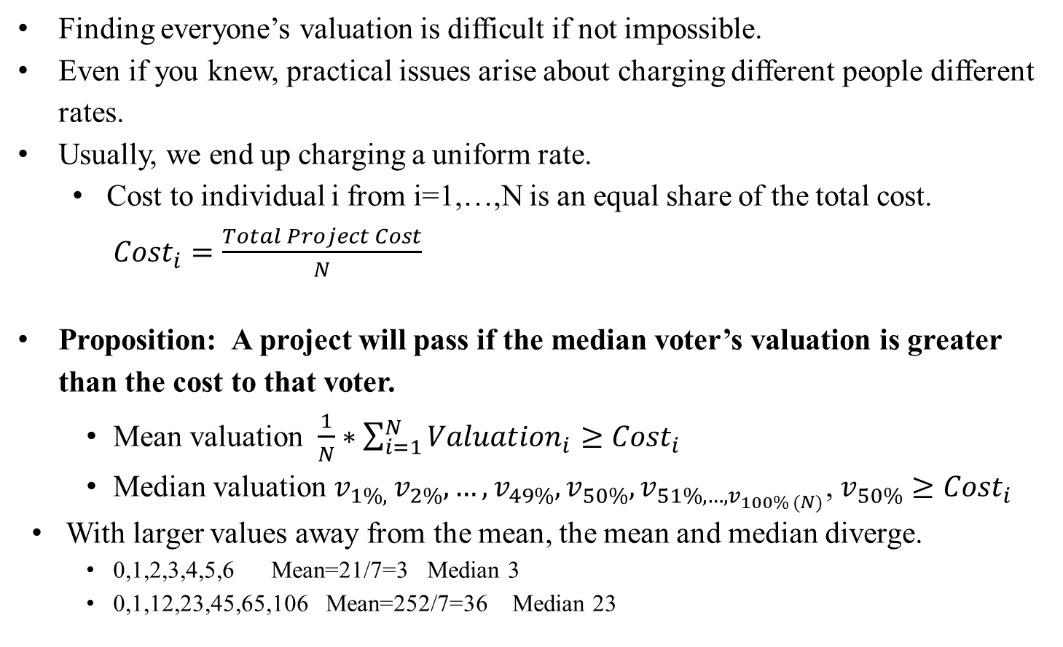
Voting and Public Goods
Finding everyone’s valuation is difficult if not impossible.
Even if you knew, practical issues arise about charging different people different rates.
Usually, we end up charging a uniform rate.
  Cost to individual i from i=1,…,N is an equal share of the total cost. ${Cost}_{i}=\frac{Total Project Cost}{N}$
Proposition: A project will pass if the median voter’s valuation is greater than the cost to that voter.
    Mean valuation $\frac{1}{N}∗\sum_{i=1}^{N}{{Valuation}_{i}}≥{Cost}_{i}$
    Median valuation $v_{1\%, }v_{2\%},…,v_{49\%},v_{50\%},v_{51\%,…,v_{100\% (N)}}$, $v_{50\%}≥{Cost}_{i}$
  With larger values away from the mean, the mean and median diverge.
    0,1,2,3,4,5,6 Mean=21/7=3 Median 3
    0,1,12,23,45,65,106 Mean=252/7=36 Median 23

Slide 7
 | Fred | Barney | Wilma
Corner A | 50 | 100 | 150
Corner B | 50 | 75 | 250
Corner C | 50 | 100 | 110
Project is a traffic light. Total cost of light installation is $300. There are 3 voters here who get benefits and pay the costs. Assume they split the costs evenly, so each one pays $100 per light installed.
They can install no lights, one light, two lights, or three lights.
Three corners are being voted on, and the following represents the voters WTP.
Corner A has a total WTP of 300 ($50+$100+150)
Corner B has a total WTP of 375 ($50+$75+$250)
Corner C has a total WTP of 260 ($50+$100+$110)
Which ones will pass if we vote and people vote yes if their WTP-cost is greater than or equal to zero?
Yes – no voting ignores intensity of preferences.
If the valuation of the median voter is greater than or equal to the cost to that voter, it will pass a vote with a majority.
 | Fred | Barney | Wilma | OUTCOME
Corner A | NO | YES | YES | PASS
Corner B | NO | NO | YES | FAIL
Corner C | NO | YES | YES | PASS

Slide 8
Economic Concept of Rent
In this setting, we assume there is a minimum acceptable price.
  For suppliers, the marginal cost of production.
  The ‘reservation’ price of the good used car or the lemon we looked at in information asymmetries and adverse selection.
  The supply of labor as revealed by the supply curve in the minimum wage policy floor example.
Economic rent is the amount you are paid over and above what is the minimum you would have been willing to accept.

Slide 9
Producer Surplus is a kind of rent
The area under the competitive market price and the marginal cost / supply curve.
p
p
S
p*
p*
S
D
D
q*
q
q*
q
Why does supply slope up?
Short Run, fixed input gives rise to diminishing marginal product increasing MC
Long Run, technology, regulation, environment, scarcity of inputs, location, input costs
  We sometimes interpret PS as returns to a variable such as proximity to consumers.
  There is an idea that under competition, the presence of PS (profit) leads to market entry to eliminate the PS to look like the graph on the right with perfectly elastic supply

Slide 10
Rent seeking
Closed Economy with no imports.
Infant Industry argument;
  domestic producers protected
    behind an import tariff
    behind a quota

Slide 11









Rent Seeking, Closed, Tariff, Open
$$S_{Domestic }$$
D
$$p_{C}$$
$$p_{T}$$
C
$$S_{World}+T$$
$$p_{O}$$
Tax Revenue
$$S_{World}$$
$$q_{C}$$
$$q_{T}$$
$$q_{O}$$

Slide 12
Rent Seeking, Closed, Quota, Open
Same basic pattern for DWL here as for the tariff
Rent C

Slide 13




Rent Seeking
Seek regulatory protection of monopoly status
“Evergreening” in the pharmaceutical industry.
Patent expiring for the 10 mg formulation after 14 years?
Release an 18 mg formulation!
Patent expiring after 14 years for that?
Release a slow release version!
Repeat as necessary….
p
MR
D
$$p_{M}$$
M
Rent
$$p_{pc}$$
MC=S
PC
$$q_{M}$$
$$q_{pc}$$
q

Slide 14



Rent Dissipation Price Ceiling
p
Dissipation of this CS is possible though:
search costs, waiting in line, bribery,…
S
CS
$$\overline{p}$$
D
SHORTAGE
$$q_{S}$$
$$q_{D}$$
q

Slide 15
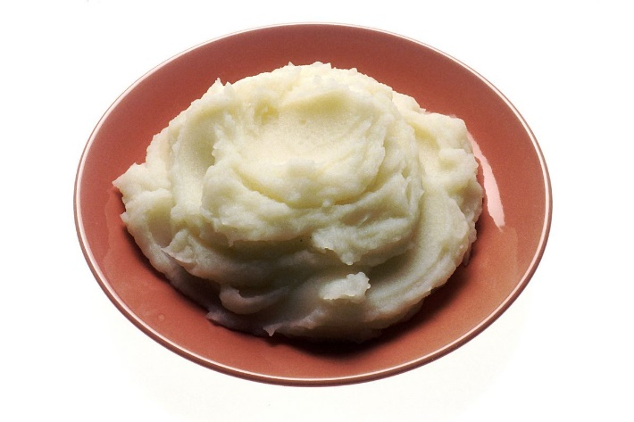
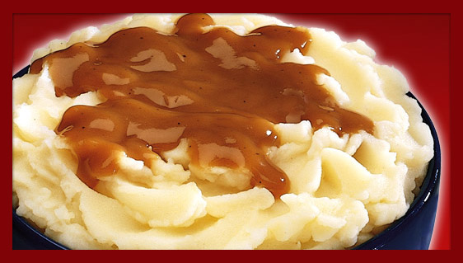
A Final Take on Rent
One funny description I have heard to explain rent is gravy on mashed potatoes.
You would have eaten the mashed potatoes anyway.
But with gravy as well on top?!?
YOU BET!!!!!!

Slide 16
THE POLITICAL PROCESS OF PUBLIC DECISION MAKING
Planning horizon in public sector is tied to election cycle (for elected officials).
Importance of media attention for policy makers as means of communicating to voters their messages. Importance of media to campaigns in terms of advertising.
Role of policy ‘windows’. Reactive to event, leads to policy outcomes that respond to the event rather than perhaps underlying issues.
View of sunk costs may differ, public and private.
  Private (or at least market forces) make sunk cost not relevant – do the marginal revenues outweigh the marginal costs of going forward.
  Public may have less discipline than private in that it may consider sunk costs as backing down is admitting a mistake that can be used against politicians in a political context.
  Public decisions and political exposure may lead to a throwing good money after bad approach.
Importance of precedents in public decision making. If you bail out one, you have to bail out others. If you allow a provision for one state’s residents, you may have to allow it for others. Firms don’t have to be as consistent.

Slide 17
Some Reasons Socially Optimal Outcomes May Differ From Political Outcomes
Nature of the interests among the voting population | Concentrated interests have a strong incentive to lobby and monitor.
 | Diffuse interests have weak incentives to lobby and monitor.
 | Organized diffuse interests that overcome collective action problems are able to lobby and monitor
 | Diffuse interests may be mobilized around sudden media attention to the topic and creation of a ‘policy window’ but might not endure.
Incentives of elected representatives generally | Focused on how actions will influence elections, which tends to underemphasize long run cost, overemphasize short run benefits
 | Emphasis placed on risk or cost of opponents’ proposals to take advantage of risk aversion
Incentives of elected representatives with regard to their constituency | Seek benefits of a policy for the district even if it is to the detriment of society
 | Seek to capture the contracts for factor suppliers from the district even if they are not the lowest cost or best suppliers.

Slide 18
Incentive Structures in Private and Public Sectors
Private sector firms select q to maximize profit as revenue minus cost. Incentives to minimize / reduce cost to maximize return.
Public organizations write a budget, get awarded a given amount with budget lines for different activities, and scramble to spend out by the end of the fiscal year.
  The amount you get next year is often a function of how much you got this year, so not much incentive to underspend.
  Also, can’t use distribution of unspent money as an incentive structure (without getting in trouble at least we hope).
Pay scale in private sector at least in theory based on the value of the marginal product.
In the public sector there is often some kind of pay scale based on job category, education level of the worker, and time served.
  https://www.opm.gov/policy-data-oversight/pay-leave/salaries-wages/2024/general-schedule/

