Slide 1
Lecture 6: Income and Income Distribution
PAI 897

Slide 2
Distributional Goals
Chapter 7 in Weimer and Vining: Distributional and other goals.
Return to the Pareto efficiency idea – that is one standard.
    If a market leads us to a distribution that is not Pareto efficient, we have suffered a market failure.
But there are lots of different Pareto efficient outcomes.
How can we choose among them?
One idea is a social welfare function.
The best option is the one that is Pareto efficient and maximizes the social welfare function.

Slide 3
Three Social Welfare Functions
1. Utilitarian : add them.
  One person ‘one vote’ all accorded equal weight
  Greatest overall good.
  Has redistribution potential due to the diminishing marginal utility of income (transfer income from richer to lower should increase utility of lower more than decrease to richer since utility exhibits diminishing marginal returns to income)
2. Rawlsian: Pick the minimum.
  “Rawlsian veil of ignorance” thought experiment.
  What distribution would we agree to ex ante if we only found out our realization ex post.
3. Multiplicative: Multiply them.
  Puts weight on overall values
  Punishes more unequal distributions; 2*2=4, average is 2. 1*3=3, average is 2. 0*4=0, average is 2.
  But picks up on increases; 2*2=4, 2*3=6.

Slide 4
Social Welfare Functions
Table 7.1 from Policy Analysis: Three different social welfare functions
Utilitarian: Utility A + Utility B + Utility C
Rawlsian: Minimum (Utility A, Utility B, Utility C)
Multiplicative: Utility A*Utility B*Utility C
 | Utility person 1 | Utility person 2 | Utility person 3 | AVERAGE | Utilitarian SWF | Rawlsian SWF | Multiplicative SWF / 1000
Policy A | 80 | 80 | 40 | 66.7 | 200 | 40 | 256
Policy B | 70 | 70 | 50 | 63.3 | 190 | 50 | 245
Policy C | 100 | 80 | 30 | 70.0 | 210 | 30 | 240
 |  |  |  |  | C is best | B is best | A is best
Contrast when all have equal outcome by Utilitarian outcome
 | Utility person 1 | Utility person 2 | Utility person 3 | AVERAGE | Utilitarian SWF | Rawlsian SWF | Multiplicative SWF / 1000
Policy A | 70 | 70 | 70 | 70.0 | 210 | 70 | 343
Policy B | 70 | 80 | 60 | 70.0 | 210 | 60 | 336
Policy C | 70 | 90 | 50 | 70.0 | 210 | 50 | 315

Slide 5












Edgeworth-Bowley Box Revisited
 | Katie | Janis | Utilitarian | Rawlsian | Multiplicative / 10
Point a | 17 | 5 | 22 | 5 | 8.5
Point b | 15 | 9 | 24 | 9 | 13.5
Point c | 12 | 11 | 23 | 11 | 13.2
Point d | 6 | 13 | 19 | 6 | 7.8
$${bananas}_{K}$$
KATIE
 | 25 | 24 | 23 | 22 | 21 | 20 | 19 | 18 | 17 | 16 | 15 | 14 | 13 | 12 | 11 | 10 | 9 | 8 | 7 | 6 | 5 | 4 | 3 | 2 | 1 | 0 | K
20 |  |  |  |  |  |  |  |  |  |  |  |  |  |  |  |  |  |  |  |  |  |  |  |  |  |  | 0
19 |  |  |  |  |  |  |  |  |  |  |  |  |  |  |  |  |  |  |  |  |  |  |  |  |  |  | 1
18 |  |  |  |  |  |  |  |  |  |  |  |  |  |  |  |  |  |  |  |  |  |  |  |  |  |  | 2
17 |  |  |  |  |  |  |  |  |  |  |  |  |  |  |  |  |  |  |  |  |  |  |  |  |  |  | 3
16 |  |  |  |  |  |  |  |  |  |  |  |  |  |  |  |  |  |  |  |  |  |  |  |  |  |  | 4
15 |  |  |  |  |  |  |  |  |  |  |  |  |  |  |  |  |  |  |  |  |  |  |  |  |  |  | 5
14 |  |  |  |  |  |  |  |  |  |  |  |  |  |  |  |  |  |  |  |  |  |  |  |  |  |  | 6
13 |  |  |  |  |  |  |  |  |  |  |  |  |  |  |  |  |  |  |  |  |  |  |  |  |  |  | 7
12 |  |  |  |  |  |  |  |  |  |  |  |  |  |  |  |  |  |  |  |  |  |  |  |  |  |  | 8
11 |  |  |  |  |  |  |  |  |  |  |  |  |  |  |  |  |  |  |  |  |  |  |  |  |  |  | 9
10 |  |  |  |  |  |  |  |  |  |  |  |  |  |  |  |  |  |  |  |  |  |  |  |  |  |  | 10
9 |  |  |  |  |  |  |  |  |  |  |  |  |  |  |  |  |  |  |  |  |  |  |  |  |  |  | 11
8 |  |  |  |  |  |  |  |  |  |  |  |  |  |  |  |  |  |  |  |  |  |  |  |  |  |  | 12
7 |  |  |  |  |  |  |  |  |  |  |  |  |  |  |  |  |  |  |  |  |  |  |  |  |  |  | 13
6 |  |  |  |  |  |  |  |  |  |  |  |  |  |  |  |  |  |  |  |  |  |  |  |  |  |  | 14
5 |  |  |  |  |  |  |  |  |  |  |  |  |  |  |  |  |  |  |  |  |  |  |  |  |  |  | 15
4 |  |  |  |  |  |  |  |  |  |  |  |  |  |  |  |  |  |  |  |  |  |  |  |  |  |  | 16
3 |  |  |  |  |  |  |  |  |  |  |  |  |  |  |  |  |  |  |  |  |  |  |  |  |  |  | 17
2 |  |  |  |  |  |  |  |  |  |  |  |  |  |  |  |  |  |  |  |  |  |  |  |  |  |  | 18
1 |  |  |  |  |  |  |  |  |  |  |  |  |  |  |  |  |  |  |  |  |  |  |  |  |  |  | 19
0 |  |  |  |  |  |  |  |  |  |  |  |  |  |  |  |  |  |  |  |  |  |  |  |  |  |  | 20
J | 0 | 1 | 2 | 3 | 4 | 5 | 6 | 7 | 8 | 9 | 10 | 11 | 12 | 13 | 14 | 15 | 16 | 17 | 18 | 19 | 20 | 21 | 22 | 23 | 24 | 25
d
c
$${apples}_{J}$$
$${apples}_{K}$$
$$I_{J}^{4}=13$$
b
$I_{J}^{3}$=11
a
$$I_{K}^{1}=6$$
$$I_{K}^{2}=12$$
$$I_{K}^{4}=17$$
$$I_{K}^{3}=15$$
$$I_{J}^{2}=9$$
$$I_{J}^{1}=5$$
JANIS
$${bananas}_{J}$$
Contract curve: Pareto optimal outcomes

Slide 6
What Influences Attitudes about Distributional Outcomes?
Social norms come into play.
  Note ultimatum game.
    Division of a dollar.
    By economic theory, the leader should offer one cent, the follower should accept it.
    People tend toward 40% or 50% in experiments.
  Limits to knowing all the impacts on current members who would be subject to the policy.
  Limits to knowing how the policy would impact people in the future.
Current positions might come into play.
  We don’t live behind a Rawlsian veil of ignorance.
  We know our outcomes and have interests and attitudes based on these outcomes.

Slide 7
Input Market Outcomes
We have been thinking about markets for the products made by producers.
Now, think about markets for the inputs.
There are suppliers of inputs.
  Workers offering labor
  People own machines that can be rented out
There are people who have a demand for the inputs.
  Employers of labor
  People who need the machines
Markets determine the wage rate (w) of labor and the rental rate (r) of capital/machines.

Slide 8
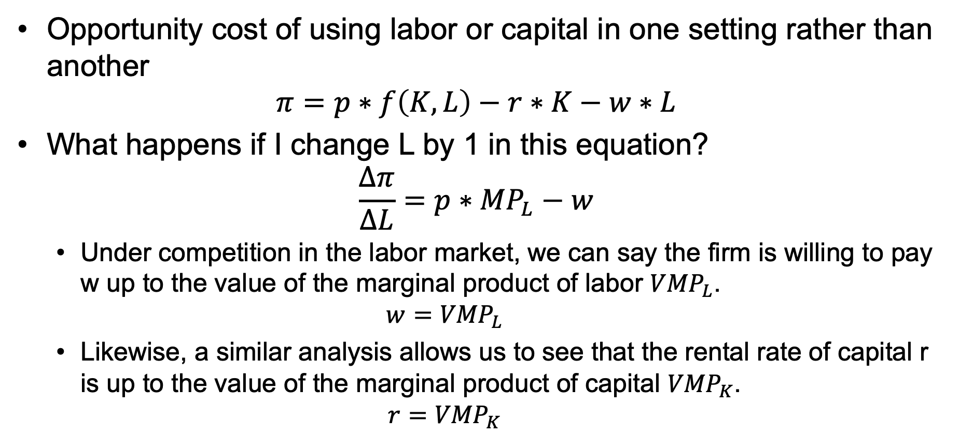
What Determines w and r?
Opportunity cost of using labor or capital in one setting rather than another
$$π=p∗f\left(K,L\right)−r∗K−w∗L$$
What happens if I change L by 1 in this equation?
$$\frac{∆π}{∆L}=p∗{MP}_{L}−w$$
  Under competition in the labor market, we can say the firm is willing to pay w up to the value of the marginal product of labor ${VMP}_{L}$.
  $w={VMP}_{L}$
  Likewise, a similar analysis allows us to see that the rental rate of capital r is up to the value of the marginal product of capital ${VMP}_{K}$.
  $r={VMP}_{K}$

Slide 9


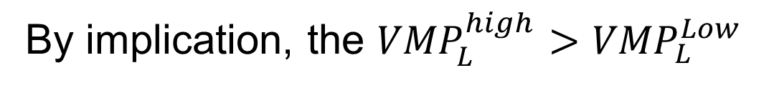


In Theory
Labor market for high quality labor
Labor market for low-quality labor
p
p
S of high-quality labor
$$p^{high}$$
S of low-quality labor
D for high-quality labor
$$p^{low}$$
D for low-quality labor
q
q
$$q^{high}$$
$$q^{low}$$
By implication, the ${VMP}_{L}^{high}>{VMP}_{L}^{Low}$

Slide 10
Education/Skills Demand – how did they get into the high-quality market?
A kind of benefit-cost tradeoff to go from the low-quality market to the high-quality market
$
High-quality wage
NPV = PVB - PVC
Is discounted (benefit of training) greater than the discounted sum of the (direct and opportunity costs) of training?
Benefit of training
Low-quality wage
Opportunity cost of training
Direct costs
of training
Retirement age
Time/age
Length of training
Invest in human capital

Slide 11
A Few Issues with This Model
The decision to invest in the training occurs before the benefits of the training will be realized.
  What if you trained to be a bank teller, and while in training, the ATM was developed?
  What if you trained to repair floppy drives, and while in training, USB flash drives were invented?
The funds to cover the direct cost and the ability to bear the opportunity cost may be different for people with different starting wealth.
  Credit constraints
  Opportunity costs

Slide 12
Transition to Other Determinants
In Policy Analysis, we might investigate some of the other determinants of differences in income.
  Some are legally/morally acceptable.
  Others are not legally/morally acceptable.
Consider an income determinant that falls somewhere in between.
  There is a concept in agrarian developing countries called the nutrition-based efficiency wage in agriculture.
    Why do taller farmworkers get paid more and have lower unemployment rates than shorter farmworkers?

Slide 13
Early Childhood Impact on Adult Outcomes

Slide 14
Income Distribution Measures

Slide 15
Measuring Incomes
Pre-tax, post-tax?
Other deductions?
Employer expenditures on health care?
Employer expenditures on retirement accounts?
Including transfers from government?
  Cash transfer? Non-cash? Tax expenditure?
Imputed value of increased ownership of homes? Paying a mortgage instead of rent?
Census definition? IRS definition?
Individual? Household? Family?

Slide 16
Income (2009) W&V 5th Edition
Measures | 1) Money income excluding capital gains but including government cash transfers | 2) Column 1 minus government transfers | 3) Column 2 plus capital gains and health insurance supplements | 4) Column 3 plus government transfers and noncash benefits less taxes | 5) Column 4 plus imputed return on equity in own home
Median household income | $50,233 | $45,722 | $49,240 | $49,122 | $50,514
Mean household income | $67,609 | $62,452 | $68,550 | $62,248 | $63,978
Upper limit of lowest quintile of household income | $20,752 | $11,723 | $12,221 | $23,758 | $24,733
Gini coefficient | 0.44 | 0.40 | 0.49 | 0.40 | 0.40
Percentage of persons in poverty | 12.50% | 20.10% | 19.30% | 9.50% | 9.30%
Percentage of persons over 64 in poverty | 9.70% | 47.30% | 46.30% | 7.90% | 6.30%

Slide 17
Distribution of Income
Quintile | 2018 US Share of Income | Cumulative
Lowest 0% to 20% | 3% | 3%
Second 20%+ to 40% | 8% | 11%
Third 40%+ to 60% | 14% | 25%
Fourth 60%+ to 80% | 23% | 48%
Highest 80%+ to 100% | 52% | 100%
Decile (by 10%)
Quintile (by 20%)
Quartile (by 25%)
Top 5%? Top 1%?
US Census Bureau Data

Slide 18
Comparative Distributions

Slide 19
Lorenz Curve

Slide 20
Lorenz Curve
Max Lorenz, a PhD student at the University of Wisconsin–Madison in 1905, came up with the idea.
Sort your population from lowest income to highest income.
Put percentage of the population on the x-axis.
Put percentage of total income on the y-axis.
Compare to the line of perfect equality which is a 45-degree angle.

Slide 21
U.S. Income 1967, 2018
Percent of the income
Percent of the population
U.S. Census Bureau Data https://www.census.gov/data/tables/2019/demo/income-poverty/p60-266.html

Slide 22
Lorenz Curve, Northern Kenya 1997

Slide 23
Lorenz Can Be Used for Assets
2000–2002 herd ownership
North Horr, Kenya Kargi, Kenya

Slide 24
Lorenz of Education Kenya Sites

Slide 25
Gini Coefficient

Slide 26
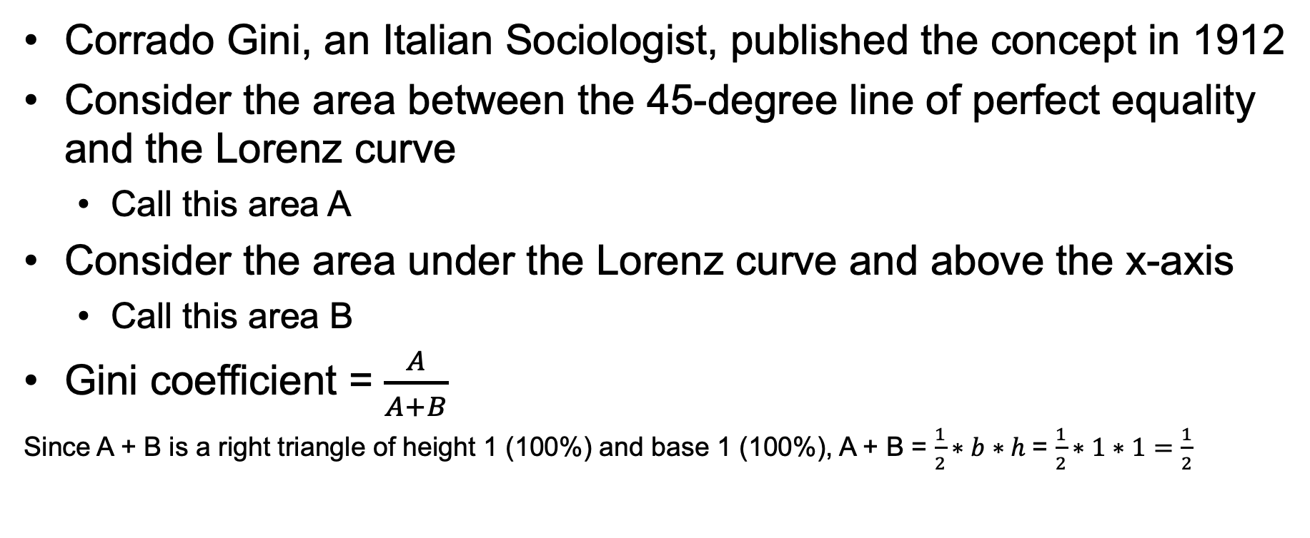
Gini Coefficient
Corrado Gini, an Italian Sociologist, published the concept in 1912
Consider the area between the 45-degree line of perfect equality and the Lorenz curve
  Call this area A
Consider the area under the Lorenz curve and above the x-axis
  Call this area B
Gini coefficient = $\frac{A}{A+B}$
Since A + B is a right triangle of height 1 (100%) and base 1 (100%), A + B = $\frac{1}{2}∗b∗h$= $\frac{1}{2}∗1∗1=\frac{1}{2}$

Slide 27

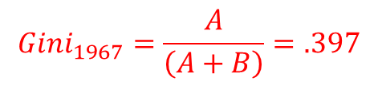
U.S. Income 1967, 2018
Percent of the income
$${Gini}_{1967}=\frac{A}{\left(A+B\right)}=.397$$
A
A
B
B
${Gini}_{2018}=\frac{A}{\left(A+B\right)}$=.486
Percent of the population
The higher the Gini, the more unequal the distribution
US Census Bureau Data https://www.census.gov/data/tables/2019/demo/income-poverty/p60-266.html

Slide 28
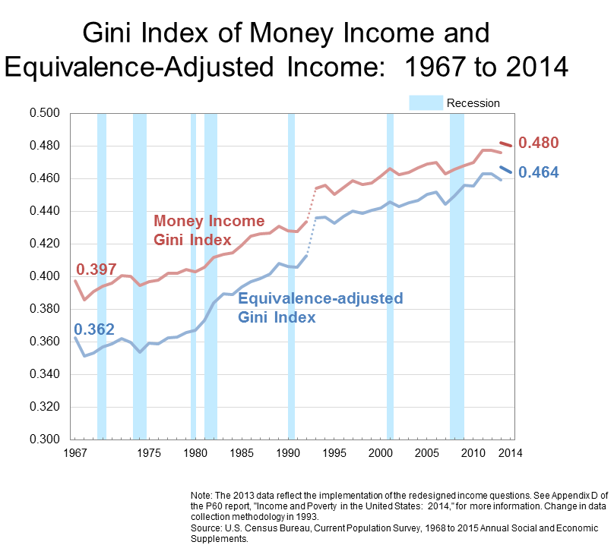
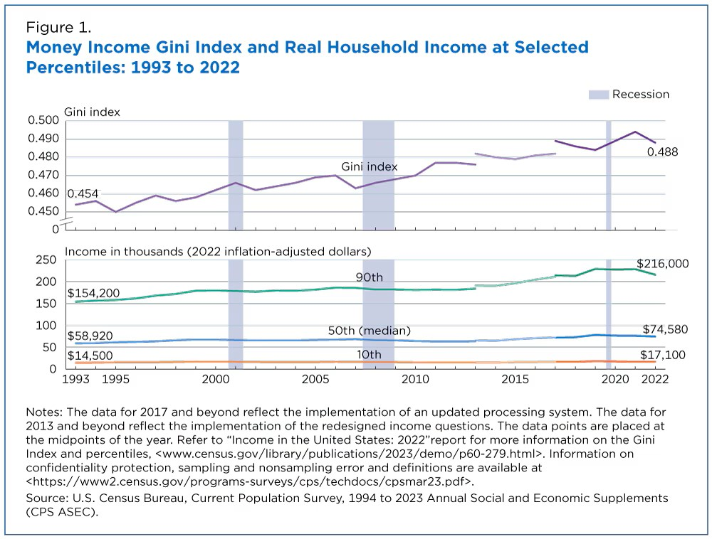
U.S. Census Gini over Time

Slide 29
Policy and Inequality
From a policy point of view, should we worry about inequality?
Will growth over time take care of inequality?
What impacts might inequality have on other social outcomes?

Slide 30
Kuznets Curve
Simon Kuznets in the 1950s
Inverted U-shaped relationship between inequality and income per capita
We begin poor and equal
As the economy grows, we become more unequal (Gini increases)
Eventually the industrialized, urbanized economy allows us to become more equal and wealthier
Not really supported by the data

Slide 31
Kuznets Curve
Danger of using cross sectional data to tell and over time story
Todaro and Smith, 2012

Slide 32
Individual Countries over Time
Fields, Gary (2001)

Slide 33
Economic Origins of Dictatorship and Democracy
Acemoglu and Robinson (2006)

Slide 34
Gini and Political Rights

