Slide 1
Market Failures
PAI 897 Lecture 5

Slide 2
Monopoly
A monopoly exists when there is a single provider of a good for which there is no close substitute.
It can happen due to the nature of production.
  Technology of production has increasing returns to scale
It can happen due to legal reasons.
  Patents to allow rewards for R&D
It can happen due to non-competitive behavior by the firm.
  That is the kind we try to prevent
It can happen by policy due to the thing being produced.
  Military

Slide 3






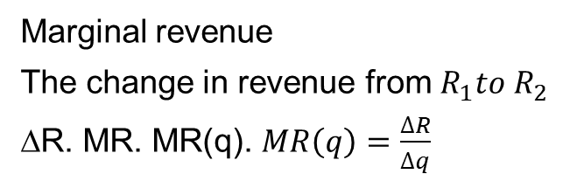
The Decision Facing a Monopolist
In perfect competition, the profit maximizing firm chose q in response to the market signal of p.
p
$$R_{1}=p_{1}∗q_{1}$$
Marginal revenue
The change in revenue from $R_{1}to R_{2}$
∆R. MR. MR(q). $MR\left(q\right)=\frac{∆R}{∆q}$
$$p_{1}$$
1
$$p_{2}$$
Loss
$$R_{2}=p_{2}∗q_{2}$$
2
In contrast, the monopolist chooses the (p, q) pair from the demand curve.
They are the only firm that supplies the good for which there is demand.
Gain
D
$$q_{1}$$
$$q_{2}$$
q

Slide 4
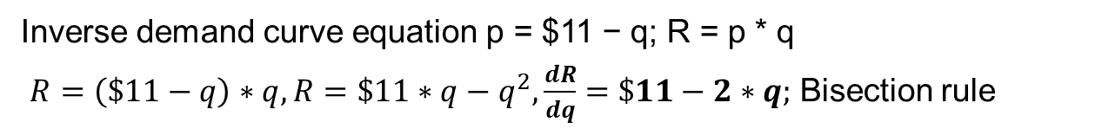
Demand and Marginal Revenue
Price | Quantity | Revenue | Discrete MR | Bisection MR
$11 | 0 | $0 | NA | $11
$10 | 1 | $10 | $10 | $9
$9 | 2 | $18 | $8 | $7
$8 | 3 | $24 | $6 | $5
$7 | 4 | $28 | $4 | $3
$6 | 5 | $30 | $2 | $1
$5 | 6 | $30 | $0 | -$1
$4 | 7 | $28 | -$2 | -$3
$3 | 8 | $24 | -$4 | -$5
$2 | 9 | $18 | -$6 | -$7
$1 | 10 | $10 | -$8 | -$9
$0 | 11 | $0 | -$10 | -$11
Inverse demand curve equation p = $11 − q; R = p * q
$R=\left(\$11−q\right)∗q, R=\$11∗q−q^{2}, \frac{dR}{dq}=\$11−2∗q;$ Bisection rule

Slide 5




Monopoly Contrast to Perfectly Competitive
p
$$p_{m}$$
M
S
$$p_{pc}$$
PC
MR
D
0 1 2 3 4 5 6 7 8 9 10 11
$$q_{m}$$
$$q_{pc}$$
q

Slide 6
TSW Implications
TSW perfect competition
CS = 1 + 2 + 3
PS = 4 + 5
TSW = 1 + 2 + 3 + 4 + 5
TSW monopoly
CS = 1
PS = 2 + 4
TSW = 1 + 2 + 4
DWL = 3 + 5
p
1
$$p_{m}$$
M
S
2
3
$$p_{pc}$$
4
5
PC
MR
This is the economic objection to monopoly.
It is inefficient.
D
0 1 2 3 4 5 6 7 8 9 10 11
$$q_{m}$$
$$q_{pc}$$
q

Slide 7
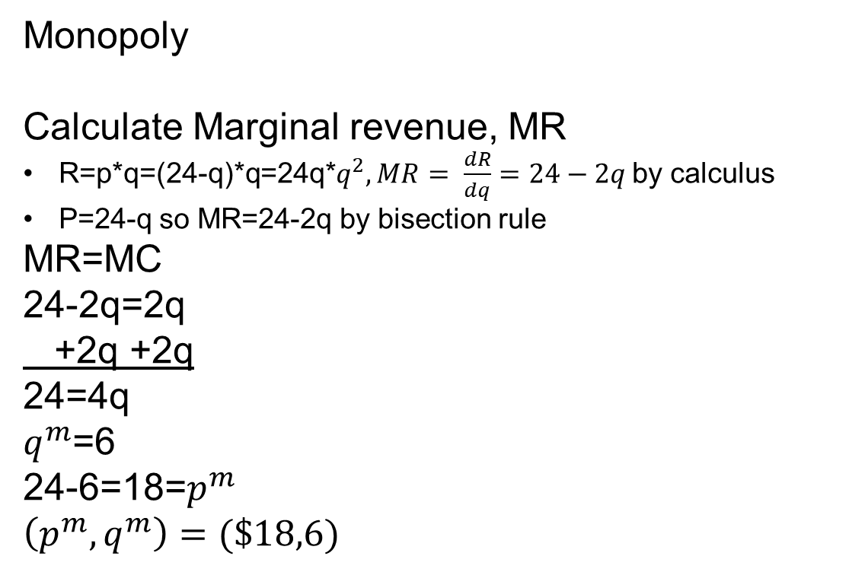
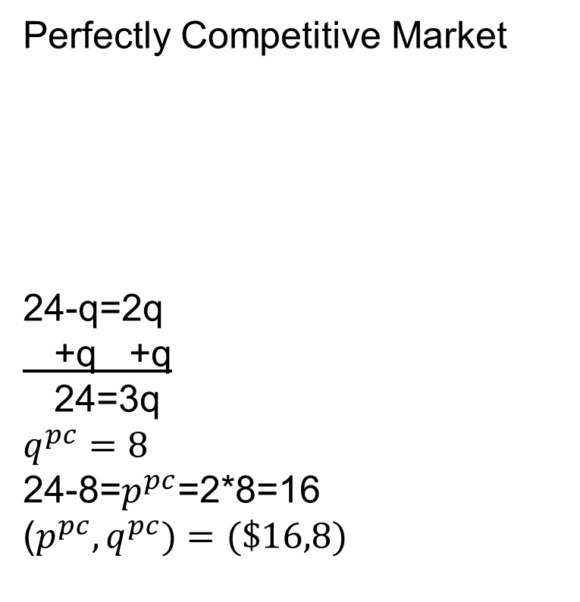
Monopoly Example
Inverse demand p=24-q.
Inverse supply p=2q=MC
Perfectly Competitive Market
24-q=2q
+q +q
24=3q
$$q^{pc}=8$$
24-8=$p^{pc}$=2*8=16
($p^{pc},q^{pc})=(\$16,8)$
Monopoly
Calculate Marginal revenue, MR
R=p*q=(24-q)*q=24q*$q^{2}, MR= \frac{dR}{dq}=24−2q$ by calculus
P=24-q so MR=24-2q by bisection rule
MR=MC
24-2q=2q
+2q +2q
24=4q
$q^{m}$=6
24-6=18=$p^{m}$
$$\left(p^{m},q^{m}\right)=(\$18,6)$$

Slide 8
Monopoly Example Continued
 | Perfect Competition | Monopoly
Consumer Surplus | =(1/2)* (24-16)*(8-0) =32 | =(1/2)* (24-18)*(6-0) =18
Producer Surplus | =(1/2)* (16-0)*(8-0) =64 | =(18-12)*(6-0)+ (1/2)*(12-0)*(6-0)= 36+36 =72
Dead Weight Loss | =0 | =(1/2)*(18-12)*(8-6) =6
Total Social Welfare | 32+64 =96 | 18+72 =90
S=MC
D
MR
q

Slide 9
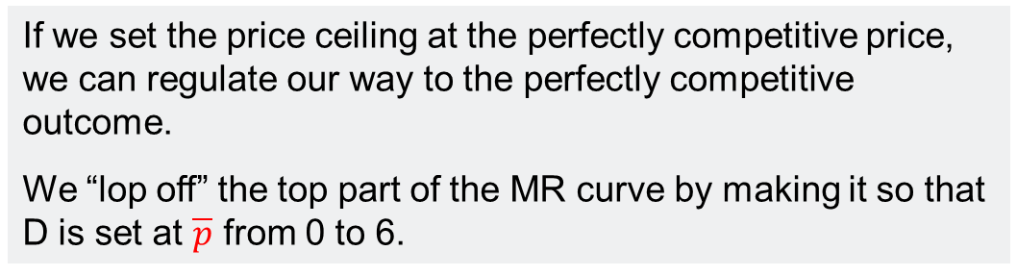

Price Ceiling to Regulate
If we set the price ceiling at the perfectly competitive price, we can regulate our way to the perfectly competitive outcome.
We “lop off” the top part of the MR curve by making it so that D is set at $\overline{p}$ from 0 to 6.
1
$$p_{m}$$
M
S
2
3
$$p_{pc}=\overline{p}$$
MR=D
4
5
PC
CS = 1 + 2 + 3
PS = 4 + 5
Regulated TSW = 1 + 2 + 3 + 4 + 5
D
0 1 2 3 4 5 6 7 8 9 10 11
$$q_{m}$$
$$q_{pc}$$

Slide 10
The Case of a Natural Monopoly
A natural monopoly arises when the average cost of production is declining over the feasible range of demand
  (MC is below AC over this range)
Why could this happen?
  Large infrastructure cost to deliver service
  But the marginal cost of connecting to this infrastructure is relatively small
Economies of scale
  It means one large firm can produce at a lower average cost than multiple smaller firms producing the same total amount

Slide 11






Regulating a Natural Monopoly
Monopoly outcome Π > 0
Note when MC is below AC then MC is decreasing.
MC crosses AC from below at the minimum of AC.
AC is increasing when MC is above AC.
D
Average cost pricing Π = 0
$$p_{m}$$
M
MC
$$p_{ac}$$
AC
$$p_{pc}$$
AC
PC outcome with a subsidy
Π = 0 without subsidy Π < 0
Subsidy
pc
MR
$$q_{m}$$
$$q_{ac}$$
$$q_{pc}$$

Slide 12
Contrast Monopoly with Monopsony
Monopoly with a single seller of a good
Monopsony is when there is a single buyer of a good
  Agricultural marketing board
  Only employer in a town
  Certain kinds of military equipment

Slide 13
Violating Perfectly Competitive
Market Condition 1
Oligopoly and Game Theory

Slide 14
Game Theory
Strategic interactions
My outcome is not just a function of my decisions and aggregate outcomes, but changes based on your decisions
Solved by the concept of best response
  If-then statements
  If you do A, my best response from my options is C
  If you do B, my best response from my options is D
The solution concept here is a Nash equilibrium
  This is where we are playing best response to each other
  It is an equilibrium in actions and outcomes
  The name comes from John Nash (the movie “A Beautiful Mind”)

Slide 15


A Game in Normal Form: Prisoner’s Dilemma
Sundance payoff Butch payoff
Prisoner’s dilemma |  | Butch
 |  | Squeal | Quiet
Sundance | Squeal | −2 −2 | 0 −4
 | Quiet | −4 0 | −1 −1
Both quiet: lesser charge, both go to jail for a year
One squeals, the other is quiet: the one who squeals plea bargains to get 0 jail time, quiet partner gets 4 years in jail. (0, −4) or (−4, 0)
Both squeal: higher charge but plea bargain, each goes to jail for 2 years
If Butch plays squeal, Sundance can play squeal and get −2 or quiet and get −4
BR is squeal
If Butch plays quiet, Sundance can play squeal and get 0 or quiet and get −1
BR is squeal
If Sundance plays squeal, Butch can play squeal and get −2 or quiet and get −4
BR is squeal
If Sundance plays quiet, Butch can play squeal and get 0 or quiet and get −1
BR is squeal
Nash equilibrium outcome
Butch squeals and gets −2
Sundance squeals and gets −2

Slide 16


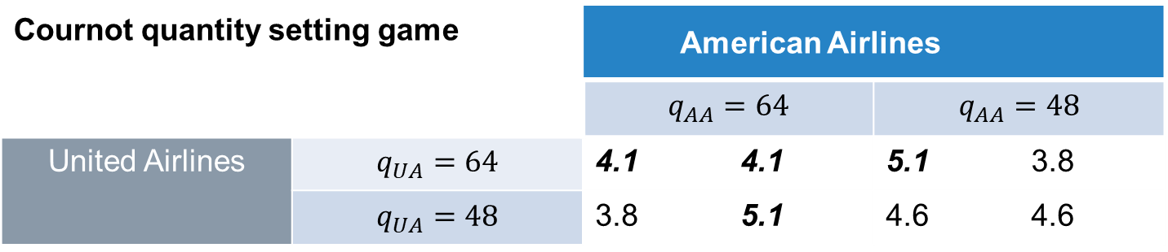
An Oligopoly Quantity Setting Game
Cournot quantity setting game |  | American Airlines
 |  | $$q_{AA}=64$$ | $$q_{AA}=48$$
United Airlines | $$q_{UA}=64$$ | 4.1 4.1 | 5.1 3.8
 | $$q_{UA}=48$$ | 3.8 5.1 | 4.6 4.6
If AA chooses 64, UA’s best response is 64 and get 4.1 over 48 and get 3.8
If AA chooses 48, UA’s best response is 64 and get 5.1 over 48 and get 4.6
If UA chooses 64, AA’s best response is 64 and get 4.1 over 48 and get 3.8
If UA chooses 48, AA’s best response is 64 and get 5.1 over 48 and get 4.6
Nash equilibrium is United plays 64 and gets 4.1 and American plays 64 and gets 4.1
Note that if they collude and restrict quantity, they are better off and get 4.6 each
Consumers are worse off with 96 flights compared to 128 flights
Example from Perloff, Microeconomics

Slide 17
Policy Example
Tompkins County (Ithaca) and Broome County (Binghamton) each operate a county airport.
Currently Broome is earning $45,000 per day and Tompkins is earning $50,000 per day from their county airports.
If they both close their county airport and merge, they will share revenue equally from a southern tier regional airport between Tompkins and Broome.
  Revenue will be $150,000 per day at the regional airport.
  It will increase the airport revenue by having more flights per day than the current combined total for the county airports.
If one county closes the county airport and the other does not, the revenue from the county that closes will be diverted to the remaining open county airport.
Regional airport? |  | Broome
 |  | Close-regional | Keep county
Tompkins | Close-regional | 75 | 0 95
 | Keep county | 95 0 | 50 45
If Tompkins closes, Broome keeps; if Tompkins keeps, Broome keeps
If Broome closes, Tompkins keeps; if Broome keeps, Tompkins keeps

Slide 18
Commitment Problem based on Greif (2006)
A ruler of a city state can offer security to a visiting merchant.
The ruler can protect the merchant from being robbed by the citizens of the city state at a cost of 1.
The merchant has goods that cost him 1 to obtain elsewhere and transport to the city state if he decides to come.
If they are sold in the city state, they earn revenue of 6, thus generating a profit of 5.
  The deal is that if the merchant comes with goods that generate a profit of 5 the ruler gets 2, the merchant keeps 3. The ruler thus nets 1 after paying the security cost; [3 1].
  If the merchant does not come, no security costs are incurred; no goods are bought elsewhere to be sold in the city state, the ruler and the merchant get zero; [0 0].
  If the merchant comes and the ruler does not provide security, the ruler and his mob of citizens rob the stuff and sell it for profit of 6. The ruler keeps half (3), the mob keeps half (3). The merchant suffers a loss of −1; [−1 3].
  If the ruler pays for protection but the merchant does not come, loss of −1; [0 −1].
The commitment problem |  | Ruler
 |  | Protect | Don’t protect
Trader | Come | 3 1 | −1 3
 | Don’t come | 0 −1 | 0 0

Slide 19
Violating Perfectly Competitive
Market Condition 2
Information Asymmetry

Slide 20
Incorrect Information
S
p
p uninformed
Producer rent due to
uninformed demand
p informed
Deadweight loss of uninformed demand
Uninformed demand
Informed demand
q informed
q uninformed
q

Slide 21




Asymmetric Information: Moral Hazard
Provision of insurance changes behavior to become more risky
D for knee replacement surgery with insurance
p
D for knee replacement surgery without insurance
S of knee replacement surgery
$$p_{with}$$
Costs that occur in presence of insurance due to more risky behavior above the MWTP of the original demand curve
$$p_{without}$$
Costs of health care expenditure that would not have happened if behavior did not change
$$q_{without}$$
$$q_{with}$$

Slide 22
Asymmetric Information: Adverse Selection
Add to asymmetric information heterogeneity in the good
Example: demand for used cars where the seller knows things the buyer does not
Akerlof’s (1970) “lemons” model
Assume there are 1,000 bad used cars (lemons) worth $4,000 each
Assume there are 1,000 good used cars worth $8,000 each

Slide 23










Akerlof’s Lemons Market (Graphs from Perloff’s Microeconomics)
Bad cars-lemons
Good cars
$$S_{G}$$
$$S_{L}$$
With full information by buyers, we could separate into the two equilibrium outcomes of eL and eG.
Suppliers of L have a minimum acceptable price of $3,000.
Suppliers of G have a minimum acceptable price of $7,000.
p
p
$$D_{G}$$
$8,000
eG
$7,000
$4,000
eL
$$D_{L}$$
$3,000
1,000
q
1,000
q
$$S_{G}$$
Without full information by buyers, they must assume they have a 50/50 chance of a good car and a lemon.
So a used car of uncertain quality is worth: .50*$4000 + .50*$8,000 = $6,000.
$$S_{L}$$
p
p
$$D_{G}$$
$8,000
$7,000
$6,000
$$D_{can^{′}t tell}$$
$6,000
$$D_{can^{′}t tell}$$
$4,000
$$D_{L}$$
$3,000
1,000
q
1,000
q
Only lemons are sold, no good cars are sold.
The expectation becomes that if a used car is for sale it is a lemon.
There is no good used car market and we move to eL.

Slide 24
This Example Violates
Assumptions 2 (Information) and 3 (Homogeneity)
If we add in that trying to resolve the information asymmetry requires costs of research, we can add in a violation of assumption 4 (no transaction costs)
Pay mechanic to inspect
Pay for a Carfax report
In real estate, paying for a house inspection

Slide 25
Principal: Agent Problems
The principal commissions the agent to act.
There is information known by the agent that the principal can’t observe.
Example: I am a teacher (the principal) trying to interpret outcomes on a quiz by students (the agents).
  Outcomes could be influenced by student study effort level.
  Outcomes could be influenced by whether the student had a good exam day or a bad exam day.

Slide 26
Numerical Example
Principal-agent problem |  | Study effort
 |  | High effort | Low effort
Luck | Good exam day | 99 | 75
 | Bad exam day | 75 | 60
Optimal design of contracts to try to make incentives of agents compatible with objectives of principals

Slide 27
Externalities

Slide 28
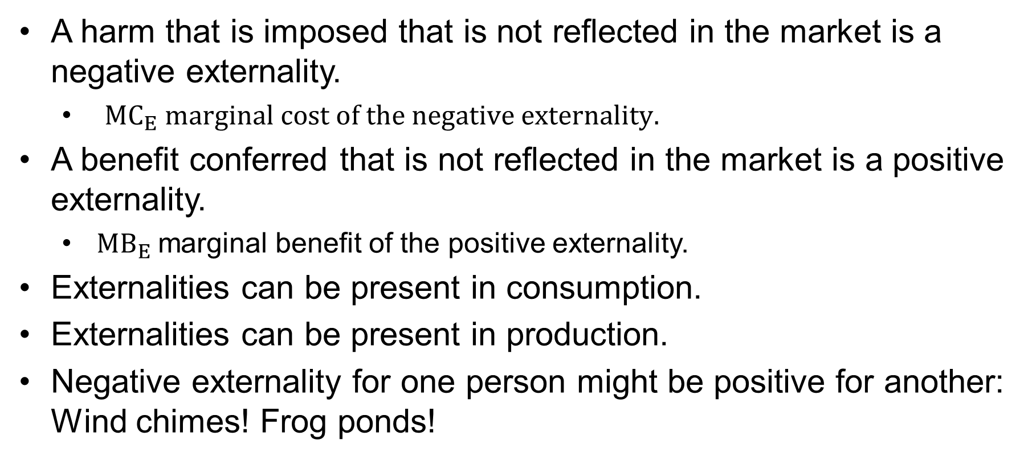
An Externality Can Be Positive or Negative
A harm that is imposed that is not reflected in the market is a negative externality.
  ${MC}_{E} marginal cost of the negative externality.$
A benefit conferred that is not reflected in the market is a positive externality.
  ${MB}_{E}$marginal benefit of the positive externality.
Externalities can be present in consumption.
Externalities can be present in production.
Negative externality for one person might be positive for another: Wind chimes! Frog ponds!

Slide 29










Negative Externality
p
$${MC}_{social}={MC}_{private}+{MC}_{externality}$$
S = ${MC}_{private}$
$${MC}_{Eq′}$$
$$p_{so}$$
so
$$p_{pc}$$
pc
The perfectly competitive price is too low
The perfectly competitive quantity is too high
D
$${MC}_{externality}$$
$${MC}_{Eq′}$$
$$q_{so}$$
$$q_{pc}$$
$$q^{′}$$
q

Slide 30








Positive Externality
p
S = ${MC}_{}$
$$p_{so}$$
The perfectly competitive price is too low
The perfectly competitive quantity is too low
so
$$p_{pc}$$
pc
$$D_{society}={MB}_{private}+{MB}_{external}$$
$${MB}_{externalq′}$$
$${MB}_{external}$$
$${MB}_{private}$$
$${MB}_{externalq′}$$
$$q_{so}$$
$$q^{′}$$
q
$$q_{pc}$$

Slide 31
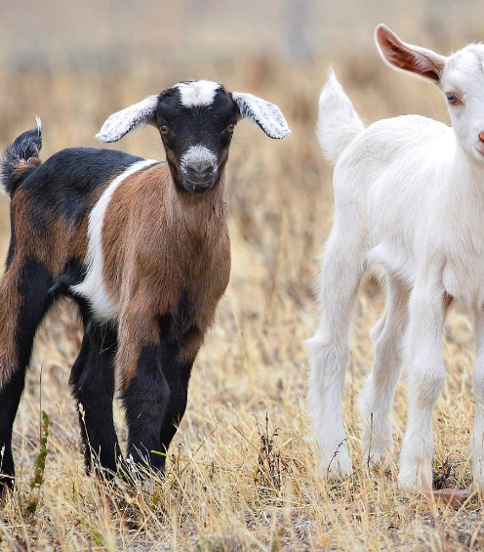
Temporal Distinction
Following Ostrom, we can think of two categories of negative externalities.
Appropriation externality; this occurs at a given point of time.
  If your goats eat that grass, my goats can’t eat that grass during this rainy season.
Provision externality; this occurs over time.
  If my goats eat this grass, they will tear up the root structure so there will be less grass here next rainy season for us both.

Slide 32
Addressing Externalities
If there is an externality, the perfectly competitive market will not take us to the socially optimal outcome.
Public policy is called for to correct for this kind of market failure.
So let us turn to that next.

Slide 33
Negative Externality Policies

Slide 34
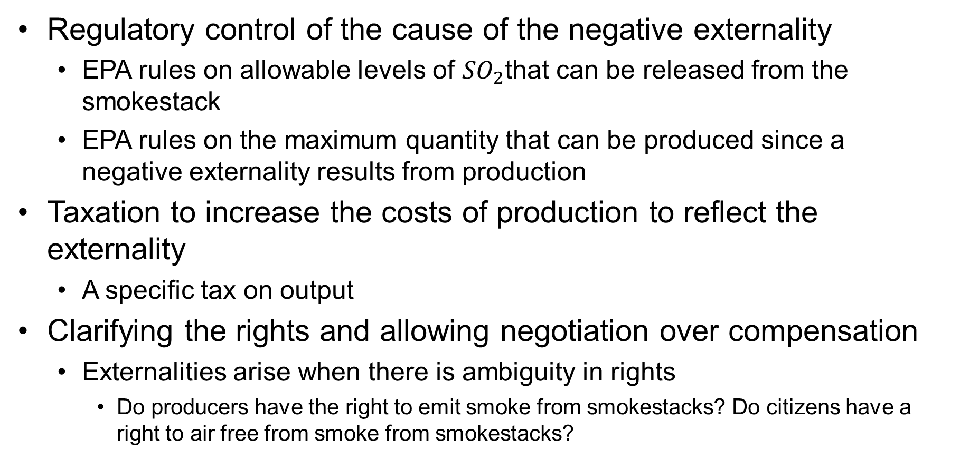
There Are a Variety of Options
Regulatory control of the cause of the negative externality
  EPA rules on allowable levels of ${SO}_{2}$that can be released from the smokestack
  EPA rules on the maximum quantity that can be produced since a negative externality results from production
Taxation to increase the costs of production to reflect the externality
  A specific tax on output
Clarifying the rights and allowing negotiation over compensation
  Externalities arise when there is ambiguity in rights
    Do producers have the right to emit smoke from smokestacks? Do citizens have a right to air free from smoke from smokestacks?

Slide 35











Negative Externality Regulation
Regulate the quantity produced
p
Quota $\overline{q}$ at $q_{so}$
$${MC}_{social}={MC}_{private}+{MC}_{externality}$$
S = ${MC}_{private}$
$${MC}_{Eq′}$$
$$p_{so}$$
Deadweight loss of PC
$$p_{pc}$$
D
$${MC}_{externality}$$
$${MC}_{Eq′}$$
$$q_{so}$$
$$q_{pc}$$
$$q^{′}$$
q
Regulate the emission

Slide 36







Negative Externality Taxation
$${MC}_{social}={MC}_{private}+{MC}_{externality}$$
p
$$S_{τ}{=MC}_{private}+ τ$$
S = ${MC}_{private}$
$$τ={MC}_{externality} at q_{so}$$
$$p_{so}$$
Deadweight loss of PC
$$p_{pc}$$
D
$${MC}_{externality}$$
$$q_{so}$$
$$q_{pc}$$
q
A Pigouvian tax is one that internalizes the externality and takes you to the socially optimal outcome

Slide 37
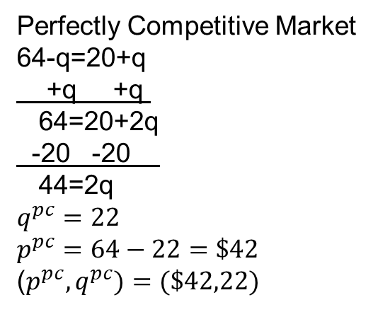
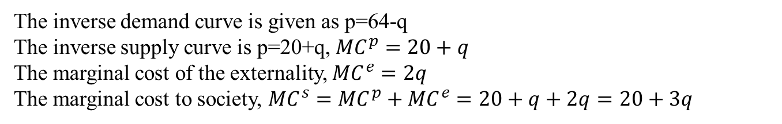
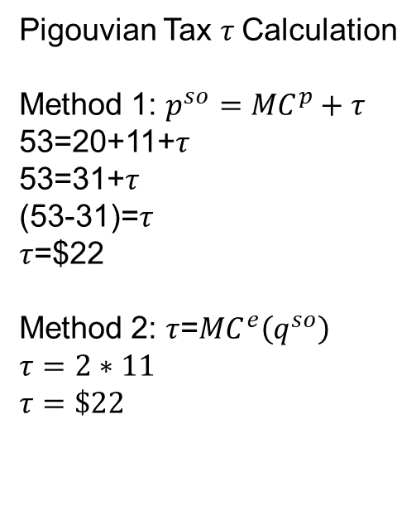
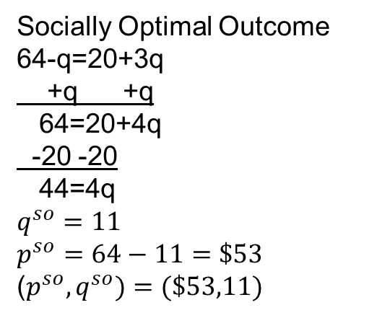
Negative Externality Example
The inverse demand curve is given as p=64-q
The inverse supply curve is p=20+q, ${MC}^{p}=20+q$
The marginal cost of the externality, ${MC}^{e}=2q$
The marginal cost to society, ${MC}^{s}={MC}^{p}+{MC}^{e}=20+q+2q=20+3q$
Perfectly Competitive Market
64-q=20+q
+q +q
64=20+2q
-20 -20
44=2q
$$q^{pc}=22$$
$$p^{pc}=64−22=\$42$$
($p^{pc},q^{pc})=(\$42,22)$
Socially Optimal Outcome
64-q=20+3q
+q +q
64=20+4q
-20 -20
44=4q
$$q^{so}=11$$
$$p^{so}=64−11=\$53$$
($p^{so},q^{so})=(\$53,11)$
Pigouvian Tax $τ$Calculation
Method 1: $p^{so}={MC}^{p}+τ$
53=20+11+$τ$
53=31+$τ$
(53-31)=$τ$
$τ$=$22
Method 2: $τ$=${MC}^{e}\left(q^{so}\right)$
$$τ=2∗11$$
$$τ=\$22$$

Slide 38
Negative Externality Example Continued
 | Perfect Competition | Socially Optimal
Consumer Surplus | =(1/2)*(64-42)*(22-0) =242 | =(1/2)*(64-53)*(11-0) =60.5
Producer Surplus | =(1/2)*(42-20)*(22-0) =242 | =(53-31)*(11-0) +(1/2)*(31-20)*(11-0) =302.5 (Pigouvian TR=22*11=242, PS=(1/2)*11*11=60.5)
Externality | =(1/2)*(44-0)*(22-0) =484 | =(1/2)*(22*11)=121
Dead Weight Loss | =(1/2)*(86-42)*(22-11) =242 | 0
Total Social Welfare | =CS+PS-Ext =242+242-484 =0 | =CS+PS-Ext =60.5+302.5-121 =242
$86
$64
$53
$42

Slide 39
Coase Theorem
In the absence of transactions costs, and with symmetric information, the initial assignment of property rights does not matter in determining the efficient allocation of resources.
  It may matter in terms of the outcomes for the individuals.
Coase frames negative externality problems as a result of a failure to assign initial property rights.
I work in areas where herders and farmers can come into conflict.
  Do the farmers have a right to grow crops that are not damaged by passing livestock?
  Do the herders have a right to graze animals in pastures that are not having cultivated plots blocking their access?
  A Coasian solution would be to assign rights to farmers or assign rights to herders and let them negotiate a system of compensation.
  This is an example of creating a market to correct for a Pareto sub-optimal outcome.

Slide 40
Coasian Property Rights Solution From Perloff, Microeconomics
Shared lake Payoff CF BC |  | Boat company (BC)
 |  | 0 boats | 1 boat | 2 boats
Chemical firm (CF) | 0 production 0 tons dumped | 0 0 | 0 14 | 0 15
 | Low production 1 ton dumped | 0 | 10 | 5
 | High production 2 tons dumped | 15 0 | 2 | 15 −3
If BC 0, CF high If CF 0, BC 2 Nash equilibrium outcome: Not Pareto optimal
If BC 1, CF high If CF low, BC 1 CF plays high gets 15,BC plays 1 gets 2
If BC 2, CF high If CF high, BC 1 Total payoff of 17
Shared lake, BC right to a clean lake, compensate $7 per ton |  | Boat company (BC)
 |  | 0 boats | 1 boat | 2 boats
Chemical firm (CF) | 0 production 0 tons dumped | 0 0 | 0 14 | 0 15
 | Low production 1 ton dumped | 7 | 3 17 | 3 12
 | High production 2 tons dumped | 14 | 1 16 | 1 11
If BC 0, CF low If CF 0, BC 2 Nash equilibrium outcome: Pareto optimal
If BC 1, CF low If CF low, BC 1 CF plays low gets 3, BC plays 1 gets 17 Not Pareto improving
If BC 2, CF low If CF high, BC 1 Total payoff of 20

Slide 41
Coasian Property Rights Solution (cont.)
Shared lake Payoff CF BC |  | Boat company (BC)
 |  | 0 boats | 1 boat | 2 boats
Chemical firm (CF) | 0 production 0 tons dumped | 0 0 | 0 14 | 0 15
 | Low production 1 ton dumped | 0 | 10 | 5
 | High production 2 tons dumped | 15 0 | 2 | 15 −3
If BC 0, CF high If CF 0, BC 2 Nash equilibrium outcome: Not Pareto optimal
If BC 1, CF high If CF low, BC 1 CF plays high gets 15,BC plays 1 gets 2.
If BC 2, CF high If CF high, BC 1 Total payoff of 17
Shared lake, CF right to dump 2 tons, compensate $6 per ton reduced |  | Boat company (BC)
 |  | 0 boats | 1 boat | 2 boats
Chemical firm (CF) | 0 production 0 tons dumped | 12 −12 | 2 | 3
 | Low production 1 ton dumped | 16 −6 | 4 | 16 −1
 | High production 2 tons dumped | 15 0 | 15 2 | 15 −3
If BC 0, CF low If CF 0, BC 2 Nash equilibrium outcome: Pareto optimal
If BC 1, CF low If CF low, BC 1 CF plays low gets 16, BC plays 1 gets 4 Pareto improving
If BC 2, CF low If CF high, BC 1 Total payoff of 20

Slide 42
Negative Externality Policies
There are a variety of policies that can be used to address negative externality problems.
The choice of which one to select is context-specific.
All can improve total social welfare = consumer surplus + producer surplus − externality from the perfectly competitive outcome.
In no case do we eliminate the externality completely.
  The externality is reduced.

Slide 43
Positive Externality Policies

Slide 44








Positive Externality DWL
p
S = MC
$$p_{so}$$
Deadweight loss of PC
$$p_{pc}$$
$$D_{society}={MB}_{private}+{MB}_{external}$$
$${MB}_{external}$$
$${MB}_{private}$$
$$q_{so}$$
$$q^{′}$$
$$q_{pc}$$
q

Slide 45

Positive Externality Subsidy Value
p
S = MC
$$p_{so}$$
Deadweight loss
$$p_{pc}$$
$$D_{society}={MB}_{private}+{MB}_{external}$$
$${MB}_{external}$$
$${MB}_{private}$$
$$σ={MB}_{external}(q_{so})$$
Define the subsidy
$$q_{so}$$
$$q_{pc}$$
q

Slide 46















Subsidy to Get to Socially Optimal Outcome
Subsidize consumer
Subsidize producer
$$S={MC}_{p}$$
p
S
p
σ
$${p_{so = }p}_{s}$$
$$S={MC}_{p}−σ$$
$${p_{so = }p}_{s}$$
$$p_{pc}$$
$$p_{pc}$$
σ
$$σ$$
$$p_{c}$$
$$p_{c}$$
$$σ$$
D + σ
D
D
$$q_{so}$$
q
$$q_{so}$$
$$q_{pc}$$
$$q_{pc}$$
q
$$p_{s}=p_{c}+σ, p_{s}−σ=p_{c}$$

Slide 47
Subsidy Outcome
The outcome is the same whether we subsidize the consumer or the producer
Choice of which is easier to implement

Slide 48
Tragedy of the Commons

Slide 49
Defining Types of Goods
A good can be termed as rival or non-rival.
  Rival means consumption of a given unit of q by one individual precludes consumption of that same unit of q by another individual.
  Non-rival means both individuals can benefit at the same time from the same unit of q.
    Sometimes described as depletable or non-depletable
A good can be termed excludable or non-excludable.
  Excludable means there is a means to control who has access to the good.
  Non-excludable means there is no means to control who has access to the good.

Slide 50
The Four Types of Goods
Types of goods | Rival | Non-rival
Excludable | Private | Club
Non-excludable | (common property) Open access | Public
Examples of goods | Rival | Non-rival
Excludable | Candy bar | Concert that is not sold out
Non-excludable | (rangeland for an ethnic group’s use) Fish in international waters | Clean air

Slide 51
Tragedy of the Commons
In the tragedy of the commons, each herder considers the private cost of adding another animal to the commonly held pasture
They do not consider the marginal cost of the externality this imposes to the other users
At the center of the tragedy is the idea of negative externalities
In addition, it is critical that the pasture is rival and there is no exclusion

Slide 52
Tragedy of the Commons (cont.)
Forests
Rangelands
Roadways under congestion
Wi-Fi signals under capacity limitations
Water in an irrigation system
Water in rivers that cross multiple jurisdictions
Underground resources
Shared work and study areas

Slide 53
The Nature of the Problem
Think of the fixed input in production being the fixed extent of the pasture that the herders share
The variable input is the total herd size that is put on the pasture
The production function mixes pastureland and the size of the herd to generate the output—milk
  Labor is also a variable input, but we assume it is in a fixed ratio to herd size so it can be ignored
Diminishing marginal returns to aggregate herd size in milk production

Slide 54
Milk Production
Total herd size | Total milk in liters | Total milk value in $
0 | 0 | $0
5 | 10 | $10
10 | 20 | $20
15 | 30 | $30
20 | 36 | $36
25 | 40 | $40
30 | 44 | $44
Total herd size
Note diminishing marginal product sets in as the herd size passes 15

Slide 55
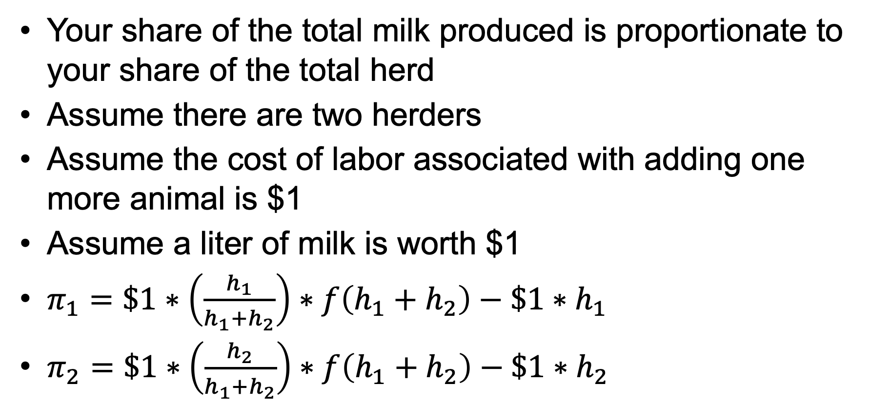
Payoffs to Each Herder
Your share of the total milk produced is proportionate to your share of the total herd
Assume there are two herders
Assume the cost of labor associated with adding one more animal is $1
Assume a liter of milk is worth $1
$π_{1}=\$1∗\left(\frac{h_{1}}{h_{1}+h_{2}}\right)∗f\left(h_{1}+h_{2}\right)−\$1∗h_{1}$
$π_{2}=\$1∗\left(\frac{h_{2}}{h_{1}+h_{2}}\right)∗f\left(h_{1}+h_{2}\right)−\$1∗h_{2}$

Slide 56
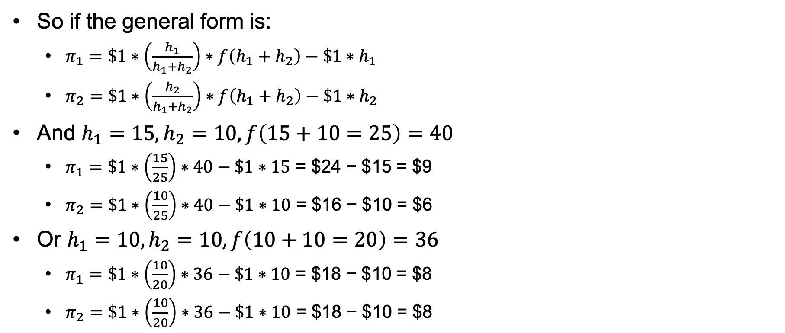
For Example
So if the general form is:
  $π_{1}=\$1∗\left(\frac{h_{1}}{h_{1}+h_{2}}\right)∗f\left(h_{1}+h_{2}\right)−\$1∗h_{1}$
  $π_{2}=\$1∗\left(\frac{h_{2}}{h_{1}+h_{2}}\right)∗f\left(h_{1}+h_{2}\right)−\$1∗h_{2}$
And $h_{1}=15, h_{2}=10, f\left(15+10=25\right)=40$
  $π_{1}=\$1∗\left(\frac{15}{25}\right)∗40−\$1∗15$ = $24 − $15 = $9
  $π_{2}=\$1∗\left(\frac{10}{25}\right)∗40−\$1∗10$ = $16 − $10 = $6
Or $h_{1}=10, h_{2}=10, f\left(10+10=20\right)=36$
  $π_{1}=\$1∗\left(\frac{10}{20}\right)∗36−\$1∗10$ = $18 − $10 = $8
  $π_{2}=\$1∗\left(\frac{10}{20}\right)∗36−\$1∗10$ = $18 − $10 = $8

Slide 57
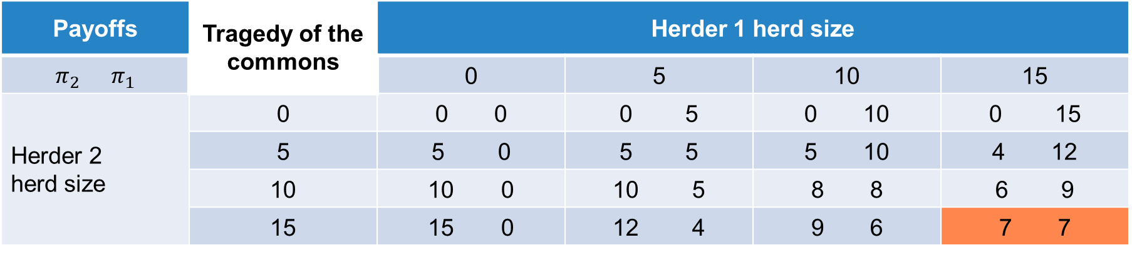
Tragedy of the Commons
Payoffs | Tragedy of the commons | Herder 1 herd size
$$π_{2} π_{1}$$ |  | 0 | 5 | 10 | 15
Herder 2 herd size | 0 | 0 0 | 0 5 | 0 10 | 0 15
 | 5 | 0 | 5 5 | 5 10 | 4 12
 | 10 | 0 | 5 | 8 8 | 6 9
 | 15 | 0 | 4 | 9 6 | 7 7
Best response Nash equilibrium
H1 plays 0, H2 plays 15 H2 plays 0, H1 plays 15 H1 plays 15 gets $7, H2 plays 15 gets $7
H1 plays 5, H2 plays 15 H2 plays 5, H1 plays 15 Nash equilibrium is not Pareto optimal
H1 plays 10, H2 plays 15 H2 plays 10, H1 plays 15
H1 plays 15, H2 plays 15 H2 plays 15, H1 plays 15

Slide 58
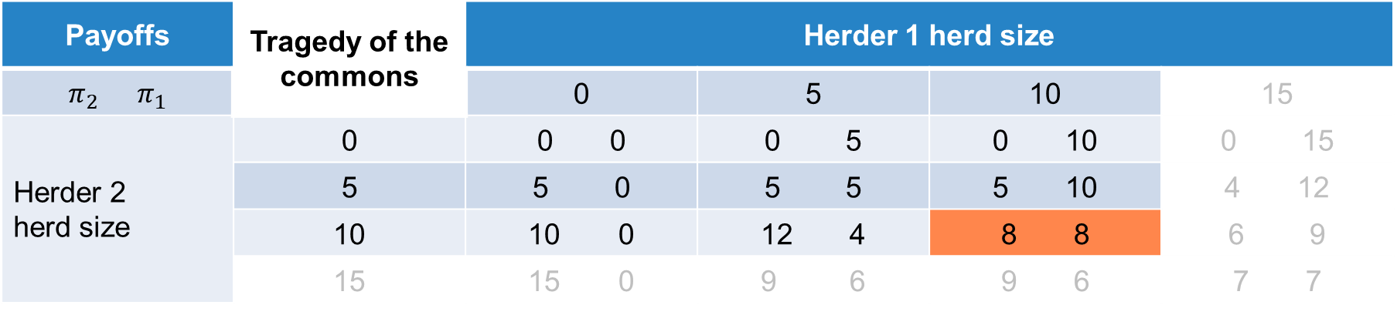
Tragedy of the Commons: Limit Use
Payoffs | Tragedy of the commons | Herder 1 herd size
$$π_{2} π_{1}$$ |  | 0 | 5 | 10 | 15
Herder 2 herd size | 0 | 0 0 | 0 5 | 0 10 | 0 15
 | 5 | 0 | 5 5 | 5 10 | 4 12
 | 10 | 0 | 12 4 | 8 8 | 6 9
 | 15 | 0 | 9 6 | 9 6 | 7 7
Best response Nash equilibrium
H1 plays 0, H2 plays 10 H2 plays 0, H1 plays 10 H1 plays 10 gets $8, H2 plays 10 gets $8
H1 plays 5, H2 plays 10 H2 plays 5, H1 plays 10 Nash equilibrium is Pareto optimal
H1 plays 10, H2 plays 10 H2 plays 10, H1 plays 10 Nash equilibrium is Pareto improving
H1 plays 15, H2 plays 15 H2 plays 15, H1 plays 15

Slide 59

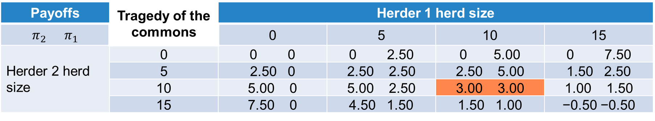
Tragedy of the Commons: User Fee
Charge user fee of $0.50 per animal put on the commons, collected by the state
  $$π_{1}=\$1∗\left(\frac{h_{1}}{h_{1}+h_{2}}\right)∗f\left(h_{1}+h_{2}\right)−\$1∗h_{1}−\$0.50∗h_{1}$$
  $$π_{2}=\$1∗\left(\frac{h_{2}}{h_{1}+h_{2}}\right)∗f\left(h_{1}+h_{2}\right)−\$1∗h_{2}−\$0.50∗h_{1}$$
Payoffs | Tragedy of the commons | Herder 1 herd size
$$π_{2} π_{1}$$ |  | 0 | 5 | 10 | 15
Herder 2 herd size | 0 | 0 0 | 0 2.50 | 0 5.00 | 0 7.50
 | 5 | 2.50 0 | 2.50 2.50 | 2.50 5.00 | 1.50 2.50
 | 10 | 5.00 0 | 5.00 2.50 | 3.00 3.00 | 1.00 1.50
 | 15 | 7.50 0 | 4.50 1.50 | 1.50 1.00 | −0.50 −0.50
Best response Nash equilibrium
H1 plays 0, H2 plays 15 H2 plays 0, H1 plays 15 H1 plays 10 gets $3, H2 plays 10 gets $3, tax is $10
H1 plays 5, H2 plays 10 H2 plays 5, H1 plays 10 Nash equilibrium is Pareto optimal
H1 plays 10, H2 plays 10 H2 plays 10, H1 plays 10 State gets ($0.50 * 10 + $0.50 * 10) = $10, herders $6, total $16
H1 plays 15, H2 plays 5 H2 plays 15, H1 plays 5 Nash equilibrium is not Pareto improving

Slide 60
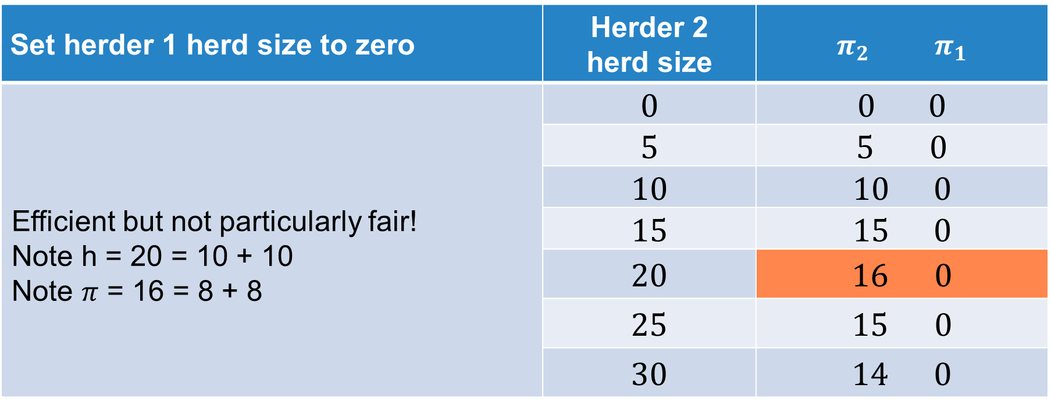
Tragedy of the Commons: Privatize
Set herder 1 herd size to zero | Herder 2 herd size | $$π_{2} π_{1}$$
Efficient but not particularly fair! Note h = 20 = 10 + 10 Note $π$ = 16 = 8 + 8 | 0 | 0 0
 | 5 | 0
 | 10 | 0
 | 15 | 0
 | 20 | 0
 | 25 | 0
 | 30 | 14 0

Slide 61
Tragedy of the Commons
Policy options
  Limit use
  User fees
  Property rights
Next, we turn to the topic of club goods

Slide 62
Club Goods and Congestion

Slide 63


Club Goods
Exclusion is possible.
Consumption of the good is non-rival.
  Movie
  Concert
  Country club
  Toll road
If we don’t restrict access, we may suffer from congestion.

Slide 64
Example of a Road or Bridge
We can start with the idea of a public good.
  Non-rival
  Non-excludable
If we all want to cross the bridge or use the road at the same time, we begin to impose a negative externality on others.
  A club good is excludable and potentially rival if use becomes large
  Two decisions: the amount to provide (number of lanes on our bridge) and the number of users (how many cars per hour)
Usually with a bridge or a road, we have time periods with high demand and time periods with low demand (rush hour).

Slide 65
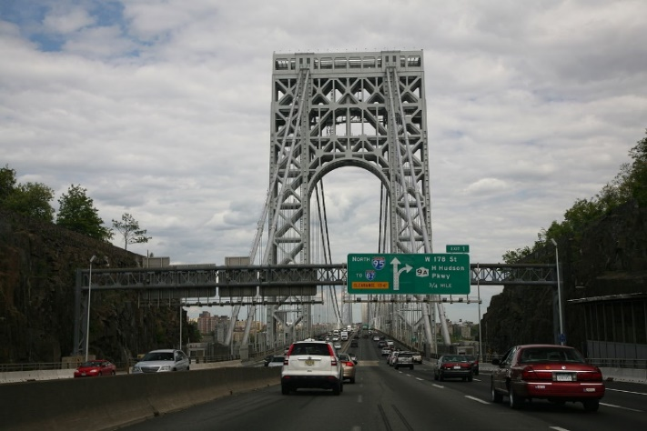





Congestion Pricing
$${MC}_{society}$$
$$D_{low}$$
$${toll}_{S}$$
DWL
$$D_{high}$$
$${bc}_{S}$$
Bridge crossings per hour

Slide 66
Tolls In New York City
Bronx-Whitestone, Throgs Neck, and Robert F. Kennedy Bridges; Hugh L. Carey and Queens Midtown Tunnels
  E-ZPass®: $6.12
  Tolls by mail: $9.50
Verrazzano-Narrows Bridge
  Toll collected entering Staten Island only
  E-ZPass®: $12.24
  Tolls by mail: $19.00
Henry Hudson Bridge
  E-ZPass®: $2.80
  Tolls by mail: $7.00
Cross Bay Veterans Memorial Bridge and Marine Parkway-Gil Hodges Memorial Bridge
  E-ZPass®: $2.29
  Tolls by mail: $4.75

Slide 67
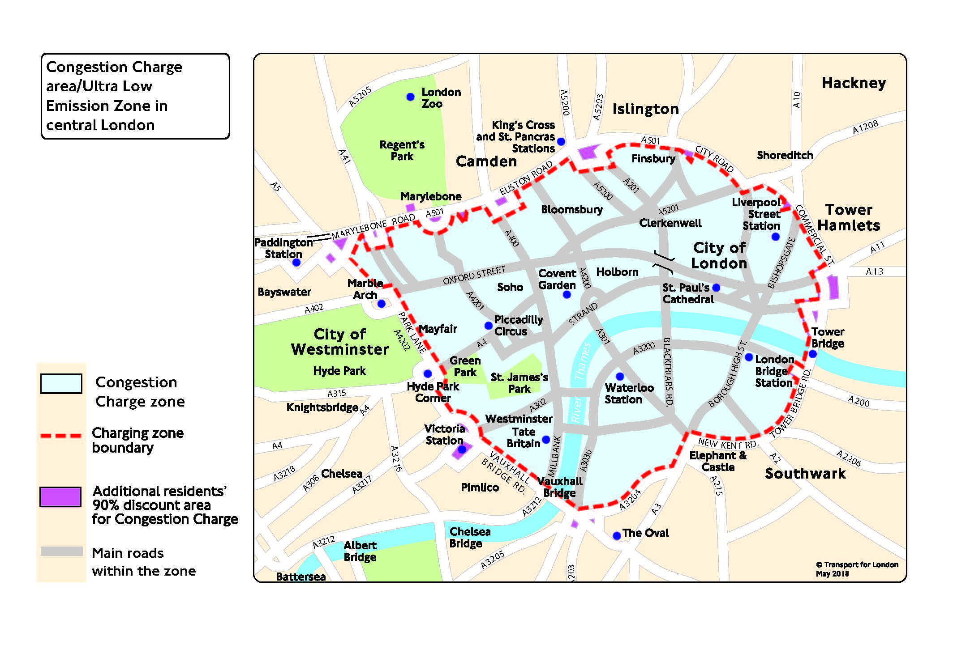
London Congestion and Emission Pricing
You need to pay a £15 daily charge if you drive within the Congestion Charge zone 07:00-22:00, every day, except Christmas Day (25 December). If your vehicle does not meet the Ultra Low Emission Zone (ULEZ) standards, you must also pay the ULEZ charge.
To help improve air quality, an Ultra Low Emission Zone (ULEZ) operates 24 hours a day, 7 days a week, every day of the year, except Christmas Day, within the same area of central London as the Congestion Charge. Most vehicles, including cars and vans, need to meet the ULEZ emissions standards or their drivers must pay a daily charge to drive within the zone:
£12.50 for most vehicle types, including cars, motorcycles and vans (up to and including 3.5 tonnes)
£100 for heavier vehicles, including lorries (over 3.5 tonnes) and buses/coaches (over 5 tonnes)

Slide 68
Public Goods

Slide 69
Recall the Public Good Definition
A public good is non-rival.
A public good is non-excludable.
  There is no market for a public good.
A public good is a good provided by government that confers positive externalities on citizens.
  Not all goods provided by government are public goods.
    Licensing fees, permit to drill on public lands…
  Not all public goods are provided by government.
    Light at the end of a driveway, flowers in the front lawn…

Slide 70
A Public Good Will Suffer from Under-Provision
There is an incentive to benefit from the public good without paying the cost of provision.
The “free rider” problem is the name given to this problem.
The “free rider” problem will lead to under-provision of the public good.
We want as much of it as possible, but don’t want to pay for it if we can get away with it.

Slide 71



Contrast Aggregate Demand for a Private Good
Private good, demand person i and person j
p
p
p
$$D_{i}$$
$$D_{j}$$
$$D_{S}=D_{i}+D_{j}$$
10
10
10
8
8
8
5
+
5
=
5
5
8
9
q
4
7
10
q
9
15
19
q
Horizontal summation of q for a given p since the good is rival
The means of “exclusion” is the price p

Slide 72



Illustrating Aggregate Demand for a Public Good
p
Vertical summation of MWTP for each individual (again person i and person j add up to societal demand) for a given unit of the public good
Over all individuals—non-exclusion
Summing MWTP for a given unit—non-rival
For unit 2, person i has MWTP of 8, person j has MWTP of 7—total of 15 for society
20
15
15 = 8 + 7 at q = 2
12
8
$$D_{s}=D_{i}+D_{j}$$
7
6
$$D_{j}$$
$$D_{i}$$
2
5
6
14
q

Slide 73
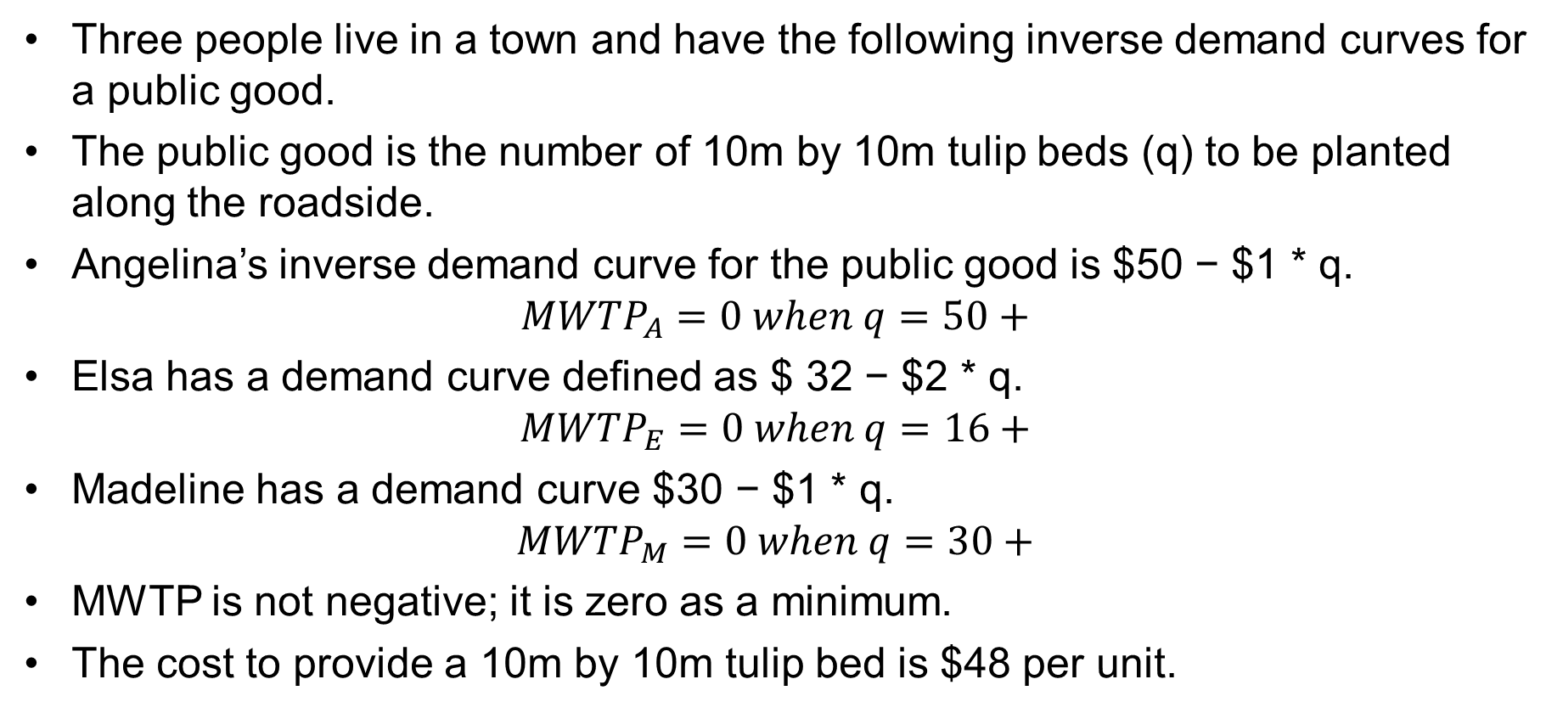
An Example
Three people live in a town and have the following inverse demand curves for a public good.
The public good is the number of 10m by 10m tulip beds (q) to be planted along the roadside.
Angelina’s inverse demand curve for the public good is $50 − $1 * q.
$${MWTP}_{A}=0 when q=50+$$
Elsa has a demand curve defined as $ 32 − $2 * q.
$${MWTP}_{E}=0 when q=16+$$
Madeline has a demand curve $30 − $1 * q.
$${MWTP}_{M}=0 when q=30+$$
MWTP is not negative; it is zero as a minimum.
The cost to provide a 10m by 10m tulip bed is $48 per unit.

Slide 74
Free Riding and Socially Optimal Outcomes
Socially
optimal
outcome

Slide 75
Deriving Willingness to
Pay (WTP) for Public Goods

Slide 76
There Is No Market for a Public Good
Because they are non-rival and non-exclusive, there is no market for public goods.
Public goods are sometimes described as goods provided by government to generate positive externalities.
As economists, we are sometimes asked by government to help come up with an estimate of the size of the public’s willingness to pay (WTP).
We have a few tools in our toolkit to do this.

Slide 77
Hedonic Methods
Look at something sold in a market that has both private and public good characteristics embedded in the bundled commodity.
  Apartments with air quality
  Ranches with permits to graze on public lands
  Lakefront undeveloped land lots
  Genetic characteristics of plants and animals
Regress selling price on characteristics to get the implicit price of the public good characteristics.

Slide 78
Travel Cost
Access to the public good requires both displacement and the use of time.
Look at the cost of the displacement, the opportunity cost of time, and out-of-pocket costs to develop an estimate of the amount spent to access the public good.
  Economic value of recreational fishing
  Economic value of public parks and beaches
  Economic value of fuelwood collected in public lands or commons
  Economic value of endangered species

Slide 79
Averting Behavior Cost
If people are privately paying for a service in the absence of public provision of a service, we can use that as an estimate of what public provision would be worth.
Spending on bottled water and fuel to boil water in the absence of safe publicly-available drinking water
Spending on private security in the absence of adequate public security
Private education expenditure due to the absence of adequate public education

Slide 80
Contingent Valuation
Survey-based method that asks contingent upon a specified change—would you be willing to pay more for a service or in taxes?
Efforts to improve the quality of a lake
Replacing electricity generated by coal with electricity generated by windmills

Slide 81
Discrete Choice Experiments
Hypothetical scenarios that bundle sets of characteristics and ask people to make relative evaluations of them
One of the characteristics is a cost or price
  Public health delivery modalities
  Value of conservation and environmental investment
  Job incentives for public services like medical clinics and public schools

