Slide 1
Producer Theory
PAI 897 Lecture 4

Slide 2

Sets and Subsets of Production
The world of possible production outcomes
Points on the production function
Not technologically
feasible outcomes that are points
above the production function
Technologically
inefficient outcomes that are points under the production function
The frontier of technological efficiency
Technologically and
economically efficient
$$π max$$
The outcome we are after
A single profit-maximizing point
Cost minimizing

Slide 3
Kinds of Conditions, Part I
A necessary but not sufficient condition
  A precondition, one thing that must be true to guarantee an outcome
    “Technological efficiency” is necessary but not sufficient to guarantee “economic efficiency”
      There are technologically efficient outcomes that are not economically efficient
      There are not economically efficient outcomes that are not technologically efficient
Review: A necessary but not sufficient condition for being a father is that the person is a male.
  It is a precondition, but not all males are fathers.
  Other things are needed in addition.

Slide 4
Kinds of Conditions, Part II
Sufficient but not necessary condition
  The truth of the condition guarantees the truth of an outcome
    “Economic efficiency” is sufficient to guarantee “technological efficiency”
      There are no economically efficient points that are not also technologically efficient
      There are technologically efficient points that are not economically efficient
Review: Sufficient and not necessary
  “There is a plane that flies between Syracuse and Chicago each day” is sufficient to establish that “one can get from Syracuse to Chicago in a day”
    If there was not a plane, it would still be possible to get from Syracuse to Chicago in a day on a train, bus, or by driving
      The plane is sufficient to establish the truth, but there are other ways it could be true

Slide 5
Kinds of Conditions, Part III
Necessary and sufficient
  A point being on the production function is necessary and sufficient to establish that the point is produced in a technologically efficient way
    The only way it can be described as technologically efficient is by being on the production function
    A point being on the production function is necessary and sufficient to establish that the point is produced in a technologically efficient way
  Marginal Utility decreased
The consumption level increased

Slide 6
Short-Run Production

Slide 7
Production
Production functions combine inputs to create output
Inputs like capital (machines), labor (workers), energy, materials
A process, a production function is applied to these inputs; f(x)
  This process is the recipe, the technology of production, the state of knowledge about how to use these inputs to make output
The producers create output
  Q = f(K, L, E, M), output is a function of (capital, labor, energy, materials)

Slide 8












The Production Function
E is not feasible to produce $Q_{2}$ using $L_{1}$
D is not feasible to produce $Q_{3}$ using $L_{2}$
Above the production function are
technologically not feasible outcomes
Output
$$Q_{3}$$
The frontier of technological efficiency
D
$$Q=f(\overline{K},L)$$
$$Q_{2}$$
E
A
C
C is inefficient for using $L_{3}$to produce $Q_{2}$
B is inefficient for using $L_{2} to produce$ $Q_{1}$
$$Q_{1}$$
B
A is the maximum amount of output
that can be produced using $L_{2}$
A is the minimum amount of labor
that can produce $Q_{2}$
Below the production function are
technologically inefficient outcomes
$$L_{1}$$
$$L_{2}$$
$$L_{3}$$
$$Labor$$

Slide 9

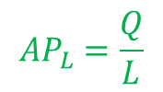
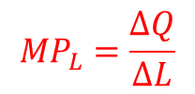
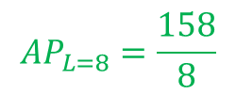
Production Function, MP, AP
L | Q | AP | MP
0 | 0 | NA | NA
1 | 2 | 2.0 | 2
2 | 5 | 2.5 | 3
3 | 11 | 3.7 | 6
4 | 22 | 5.5 | 11
5 | 42 | 8.4 | 20
6 | 80 | 13.3 | 38
7 | 120 | 17.1 | 40
8 | 158 | 19.8 | 38
9 | 178 | 19.8 | 20
10 | 189 | 18.9 | 11
11 | 195 | 17.7 | 6
12 | 198 | 16.5 | 3
13 | 200 | 15.4 | 2
14 | 201 | 14.4 | 1
15 | 200 | 13.3 | –1
16 | 198 | 12.4 | –2
17 | 195 | 11.5 | –3
$${MP}_{L}=\frac{∆Q}{∆L}$$
$${MP}_{l=8}=\frac{\left(158−120\right)}{8−7}$$
$${AP}_{L}=\frac{Q}{L}$$
$${AP}_{L=8}=\frac{158}{8}$$
Diminishing marginal returns
Decreasing returns
Increasing marginal returns

Slide 10
Zero Workers

Slide 11
One Worker

Slide 12
Two Workers
Three Workers

Slide 13

Seven Workers

Slide 14

Seventeen Workers

Slide 15

Seventeen Workers

Slide 16

Seventeen Workers… Two Trucks

Slide 17

Production Function, MP, AP
L | Q | AP | MP
0 | 0 | NA | NA
1 | 2 | 2.0 | 2
2 | 5 | 2.5 | 3
3 | 11 | 3.7 | 6
4 | 22 | 5.5 | 11
5 | 42 | 8.4 | 20
6 | 80 | 13.3 | 38
7 | 120 | 17.1 | 40
8 | 158 | 19.8 | 38
9 | 178 | 19.8 | 20
10 | 189 | 18.9 | 11
11 | 195 | 17.7 | 6
12 | 198 | 16.5 | 3
13 | 200 | 15.4 | 2
14 | 201 | 14.4 | 1
15 | 200 | 13.3 | –1
16 | 198 | 12.4 | –2
17 | 195 | 11.5 | –3
$${MP}_{L}=\frac{∆Q}{∆L}$$
$${MP}_{l=8}=\frac{\left(158−120\right)}{8−7}$$
$$r_{A}$$
$${AP}_{L}=\frac{Q}{L}$$
$${AP}_{L=8}=\frac{158}{8}$$
Diminishing marginal returns
Decreasing returns
Increasing marginal returns

Slide 18
Production Function and Innovation
An innovation shifts up the whole production function.
That which was the frontier of technological efficiency is now inefficient.
That which was not feasible before is the new frontier of technological efficiency.
Output Q
Labor L

Slide 19
Long-Run Production

Slide 20
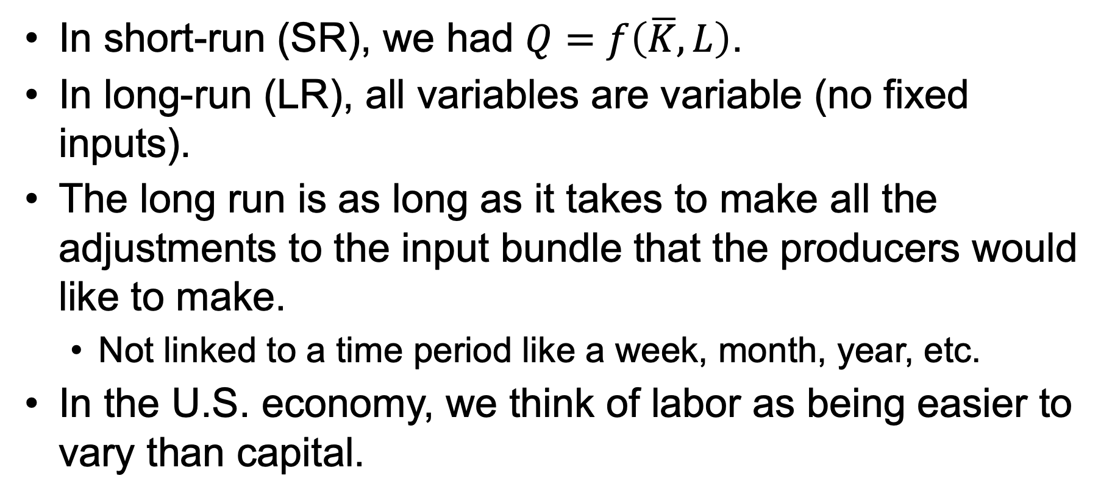
Long-Run Production
In short-run (SR), we had $Q=f\left(\overline{K},L\right)$.
In long-run (LR), all variables are variable (no fixed inputs).
The long run is as long as it takes to make all the adjustments to the input bundle that the producers would like to make.
  Not linked to a time period like a week, month, year, etc.
In the U.S. economy, we think of labor as being easier to vary than capital.

Slide 21

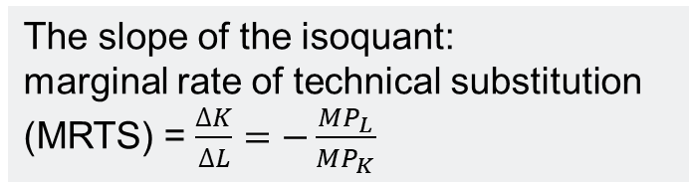
Isoquants
Capital (K)
18
100
The slope of the isoquant:
marginal rate of technical substitution
(MRTS) = $\frac{∆K}{∆L}=−\frac{{MP}_{L}}{{MP}_{K}}$
3
100
Q = 300
Q = 200
Q = 100
4
Labor (L)
48
$$Q=f(K,L)$$

Slide 22
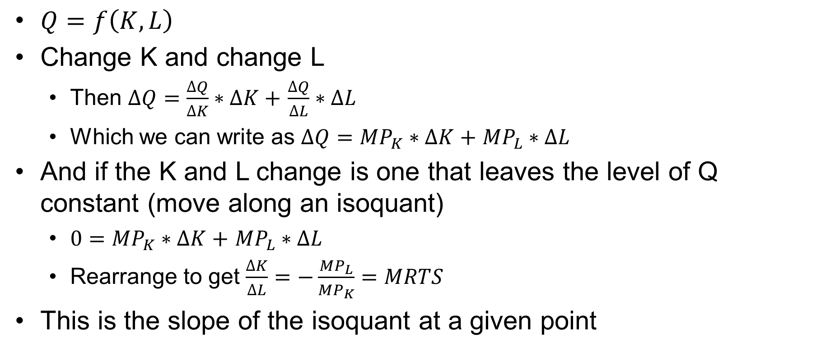
If We Are on an Isoquant
$Q=f\left(K,L\right)$
Change K and change L
  Then $∆Q=\frac{∆Q}{∆K}∗∆K+$ $\frac{∆Q}{∆L}∗∆L$
  Which we can write as $∆Q={MP}_{K}∗∆K+$ ${MP}_{L}∗∆L$
And if the K and L change is one that leaves the level of Q constant (move along an isoquant)
  $0={MP}_{K}∗∆K+$ ${MP}_{L}∗∆L$
  Rearrange to get $\frac{∆K}{∆L}=−\frac{{MP}_{L}}{{MP}_{K}}=MRTS$
This is the slope of the isoquant at a given point

Slide 23
















On a Graph MRTS
Q = f$\left(capital,\overline{labor}\right)$
Capital
$${MP}_{k1}$$
2
1
$${MP}_{k2}$$
$${MRTS}_{1}=−\frac{{MP}_{l1}}{{MP}_{k1}}=−\frac{6}{2}$$
5
$$k_{1}$$
$$k_{2}$$
$$k_{1}$$
Capital
Q = f$\left(\overline{capital,}labor\right)$
$${MRTS}_{2}=−\frac{{MP}_{l2}}{{MP}_{k2}}=−\frac{3}{5}$$
$${MP}_{l2}$$
$$k_{2}$$
3
$${MP}_{l1}$$
2
$$l_{1}$$
$$l_{2}$$
Labor
6
MRTS: marginal rate of technical substitution
$$l_{1}$$
$$l_{2}$$
Labor

Slide 24
Isoquant Shapes
Complements
Substitutes
Peanut
butter
scoops
Number
of cherry tomatoes
3
3
3 sandwiches
2
2
2 sandwiches
1
1
Q=1 Salad
1 sandwich
Q=2 Salads
Q=3 Salads
2
4
6
Slices of bread
1
2
3
Number of
plum tomatoes

Slide 25
Most Things Fall Somewhere in Between
Very similar to the indifference curve shapes
Marginal rate of technical substitution is the production concept that is similar to the MRS
Simplest way to think of capital and labor is to think of labor as people and capital as machines
  When are machines and people complements in production?
  When are machines and people substitutes in production?

Slide 26

Efficiency and Isoquants
View from above the production function
View from the side of the production function
K
Q$=f(\overline{K},L)$
L’ is on the frontier of technological efficiency for q =100
Not efficient inputs for Q=100
Not feasible
Q=100
Not efficient
Not feasible inputs for Q=100
Q=f(K,L)=100
L’
L
L

Slide 27


Innovation and Isoquants
K
$$Q_{t}=f\left(K,L\right)=100$$
$$Q_{t+1}=f\left(K,L\right)=100$$
L

Slide 28
Returns to Scale

Slide 29
Diminishing Marginal Product
Before, I explained that diminishing marginal product in the short run was due to a fixed input
  Now we are in the long run
  The definition of the long run is the time it takes to vary all inputs
    So the shape of the long-run production function can’t be due to an input held fixed while another input varies
We need a new concept to deal with a different kind of input bundle change
  Proportionate scaling up or down of all inputs to see how output changes
  This is called returns to scale

Slide 30
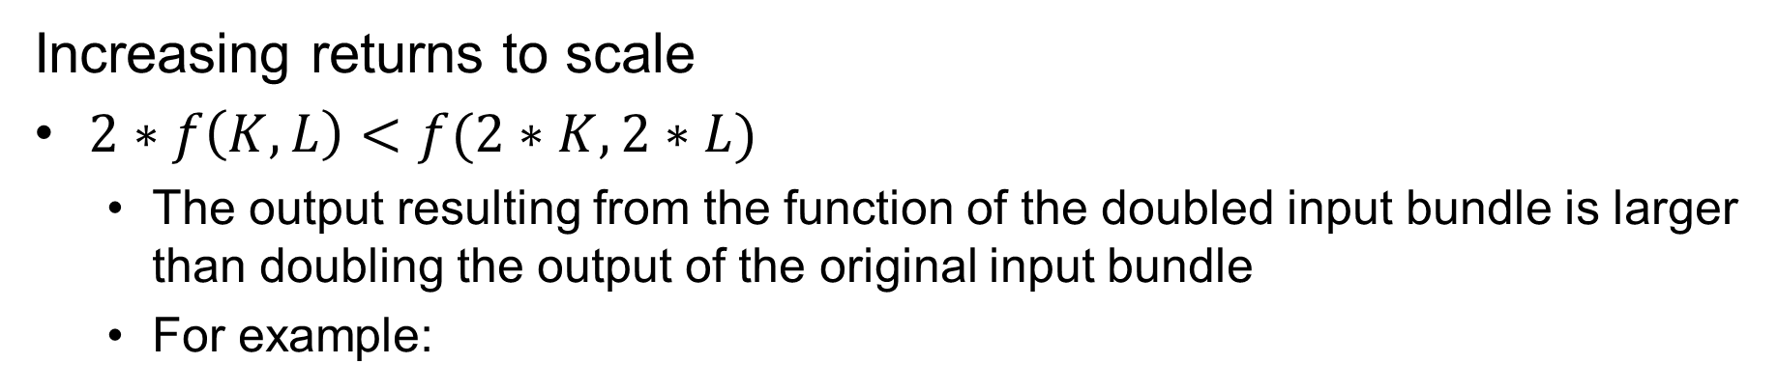

Increasing Returns to Scale
Increasing returns to scale
$2∗f\left(K,L\right)<f(2∗K,2∗L)$
  The output resulting from the function of the doubled input bundle is larger than doubling the output of the original input bundle
  For example:
$Q=f\left(K,L\right), Q=K∗L$, with K = 10, L = 8
$$2∗f\left(K,L\right) compared to f(2∗K,2∗L)$$
$$2∗f\left(10,8\right) compared to f(2∗10,2∗8)$$
$$2∗10∗8 compared to (2∗10)∗(2∗8)$$
$$2∗80 compared to 20∗16$$
$$160 compared to 320$$
$$160< 320$$

Slide 31
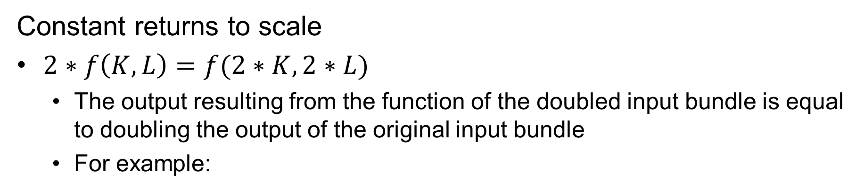
Constant Returns to Scale
Constant returns to scale
$2∗f\left(K,L\right)=f(2∗K,2∗L)$
  The output resulting from the function of the doubled input bundle is equal to doubling the output of the original input bundle
  For example:
$Q=f\left(K,L\right), Q=K+L$, with K = 10, L = 8
$$2∗f\left(K,L\right) compared to f(2∗K,2∗L)$$
$$2∗f\left(10,8\right) compared to f(2∗10,2∗8)$$
$$2∗\left(10+8\right) compared to \left(2∗10\right)+(2∗8)$$
$$2∗\left(18\right) compared to \left(20\right)+(16)$$
$$36 compared to 36$$
$$36= 36$$

Slide 32
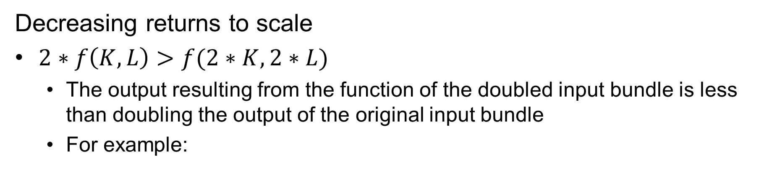


Decreasing Returns to Scale
Decreasing returns to scale
$2∗f\left(K,L\right)>f(2∗K,2∗L)$
  The output resulting from the function of the doubled input bundle is less than doubling the output of the original input bundle
  For example:
$Q=f\left(K,L\right), Q=K^{\frac{1}{2}}$*$L^{\frac{1}{4}}$, with K = 10, L = 8
$$2∗f\left(K,L\right) compared to f(2∗K,2∗L)$$
$$2∗f\left(10,8\right) compared to f(2∗10,2∗8)$$
$$2\text{∗}{10}^{\frac{1}{2}}∗8^{\frac{1}{4}} compared to {\left(2∗10\right)}^{\frac{1}{2}}∗(2∗{8)}^{\frac{1}{4}}$$
$$10.64 compared to 8.94$$
$$10.64 > 8.94$$

Slide 33
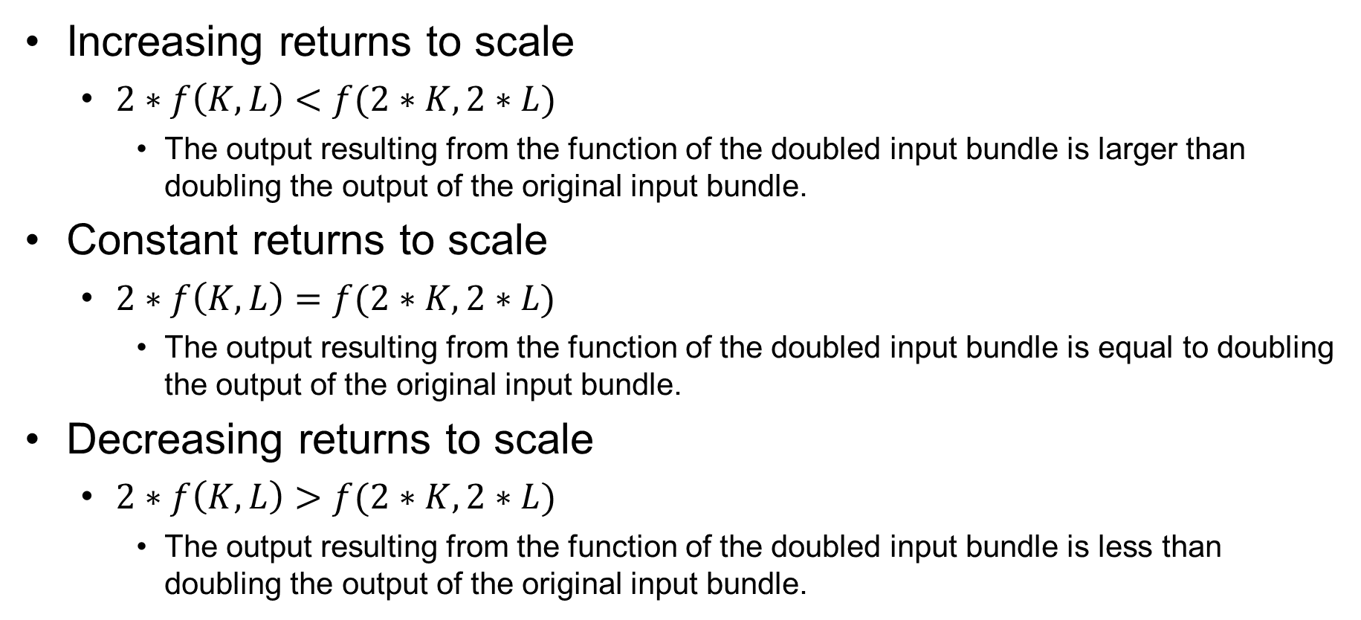
Returns to Scale Summary
Increasing returns to scale
  $2∗f\left(K,L\right)<f(2∗K,2∗L)$
    The output resulting from the function of the doubled input bundle is larger than doubling the output of the original input bundle.
Constant returns to scale
  $2∗f\left(K,L\right)=f(2∗K,2∗L)$
    The output resulting from the function of the doubled input bundle is equal to doubling the output of the original input bundle.
Decreasing returns to scale
  $2∗f\left(K,L\right)>f(2∗K,2∗L)$
    The output resulting from the function of the doubled input bundle is less than doubling the output of the original input bundle.

Slide 34
Returns to Scale Can Vary over Q
Capital (K)
16
90
DRS
Q = 90
8
50
CRS
Q = 50
4
25
IRS
2
12
Q = 25
Q = 12
2
4
8
16
Labor (L)

Slide 35
Cost Concepts

Slide 36









Now We Think about Paying for the Inputs
Start with the production function
Convert it to reflect input costs
Q
Q
Re-label the x-axis
$$∆Q=1$$
$$∆Q=1$$
$$∆Q=1$$
$$∆Q=1$$
$$∆L$$
$$∆L$$
L
$$∆C$$
$$∆C$$
$$w∗L+r∗\overline{K}, measured in \$$$

Slide 37










Production and Costs Are Related
Q
$ cost
-flip-
$$∆Q=1$$
$${MP}_{L}=\frac{∆Q}{∆L}$$
$∆$C
$$∆Q=1$$
$${MC}_{Q}=\frac{∆C}{∆Q}$$
$$∆C$$
$$∆C$$
$$∆C$$
$$∆Q=1$$
$$∆Q=1$$
$$\$C=w∗L+r∗\overline{K}$$
$$\text{Where} ∆C is from ∆L$$

Slide 38
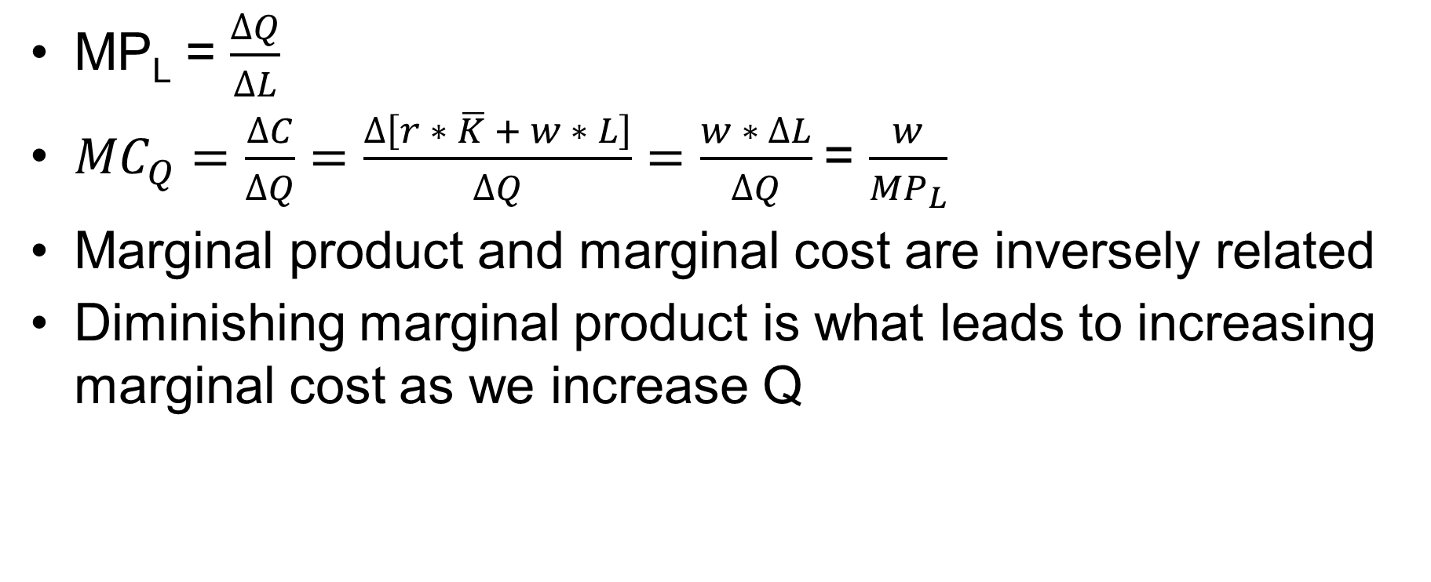
Marginal Product, Marginal Cost
MP_{L} = $\frac{∆Q}{∆L}$
${MC}_{Q}=\frac{∆C}{∆Q}=\frac{∆\left[r ∗ \overline{K} + w ∗ L\right]}{∆Q}=\frac{w ∗ ∆L}{∆Q}$= $\frac{w}{{MP}_{L}}$
Marginal product and marginal cost are inversely related
Diminishing marginal product is what leads to increasing marginal cost as we increase Q

Slide 39
Short-Run Costs

Slide 40
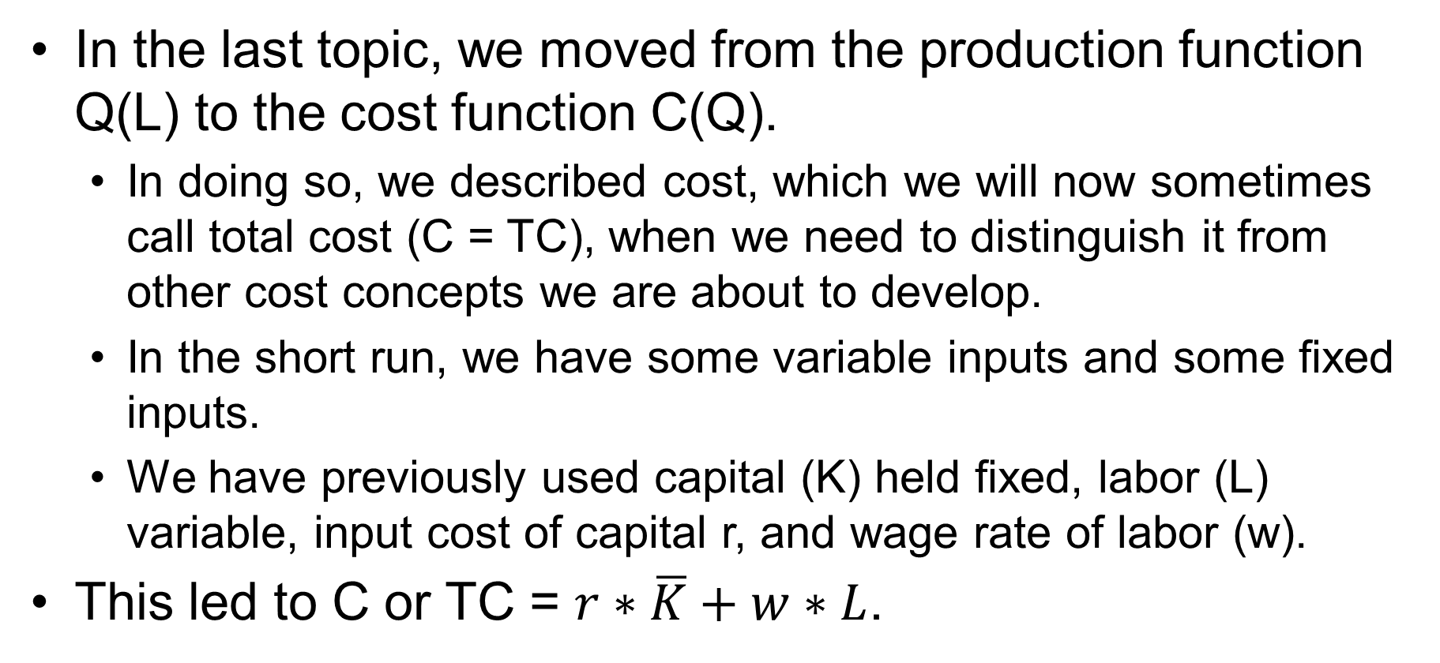
Recap
In the last topic, we moved from the production function Q(L) to the cost function C(Q).
  In doing so, we described cost, which we will now sometimes call total cost (C = TC), when we need to distinguish it from other cost concepts we are about to develop.
  In the short run, we have some variable inputs and some fixed inputs.
  We have previously used capital (K) held fixed, labor (L) variable, input cost of capital r, and wage rate of labor (w).
This led to C or TC = $r∗\overline{K}+w∗L$.

Slide 41
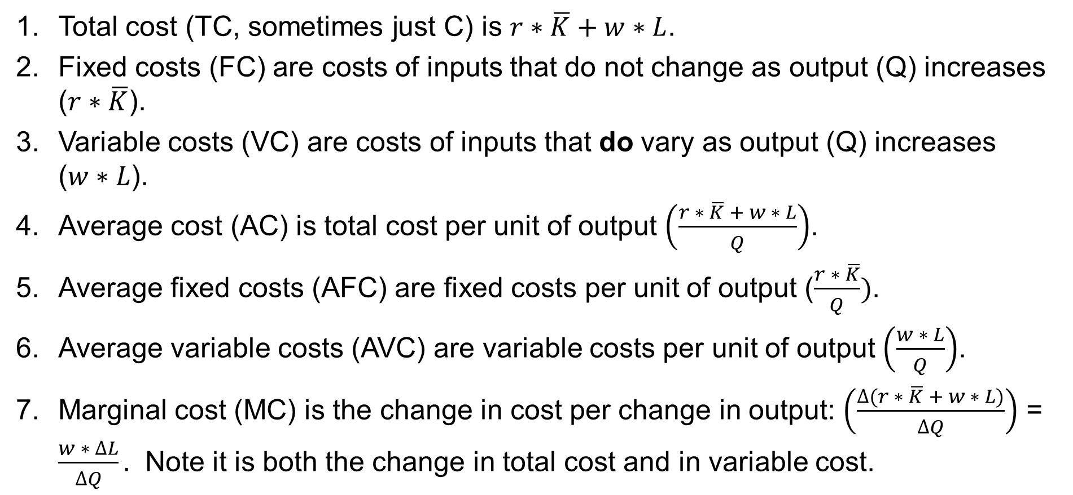
Seven Short-Run Cost Concepts
Total cost (TC, sometimes just C) is $r∗\overline{K}+w∗L$.
Fixed costs (FC) are costs of inputs that do not change as output (Q) increases ($r∗\overline{K}$).
Variable costs (VC) are costs of inputs that do vary as output (Q) increases
($w∗L$).
Average cost (AC) is total cost per unit of output $\left(\frac{r ∗ \overline{K} + w ∗ L}{Q}\right)$.
Average fixed costs (AFC) are fixed costs per unit of output ($\frac{r ∗ \overline{K}}{Q})$.
Average variable costs (AVC) are variable costs per unit of output $\left(\frac{w ∗ L}{Q}\right)$.
Marginal cost (MC) is the change in cost per change in output: $\left(\frac{∆(r ∗ \overline{K} + w ∗ L)}{∆Q}\right)$ = $\frac{w ∗ ∆L}{∆Q}.$ Note it is both the change in total cost and in variable cost.

Slide 42
TC=FC+VC in a Table 1Steinemann, Microeconomics for Public Decisions
Q | FC | VC | TC
0 | $15.00 | $0.00 | $15.00
1 | $15.00 | $3.00 | $18.00
2 | $15.00 | $5.50 | $20.50
3 | $15.00 | $7.50 | $22.50
4 | $15.00 | $10.00 | $25.00
5 | $15.00 | $13.00 | $28.00
6 | $15.00 | $16.50 | $31.50
7 | $15.00 | $20.50 | $35.50
8 | $15.00 | $25.00 | $40.00
9 | $15.00 | $30.00 | $45.00
10 | $15.00 | $35.50 | $50.50
11 | $15.00 | $41.50 | $56.50
12 | $15.00 | $48.00 | $63.00
13 | $15.00 | $55.00 | $70.00

Slide 43
Short-Run Cost Concepts in a Graph 1
TC = FC + VC
Quantity

Slide 44
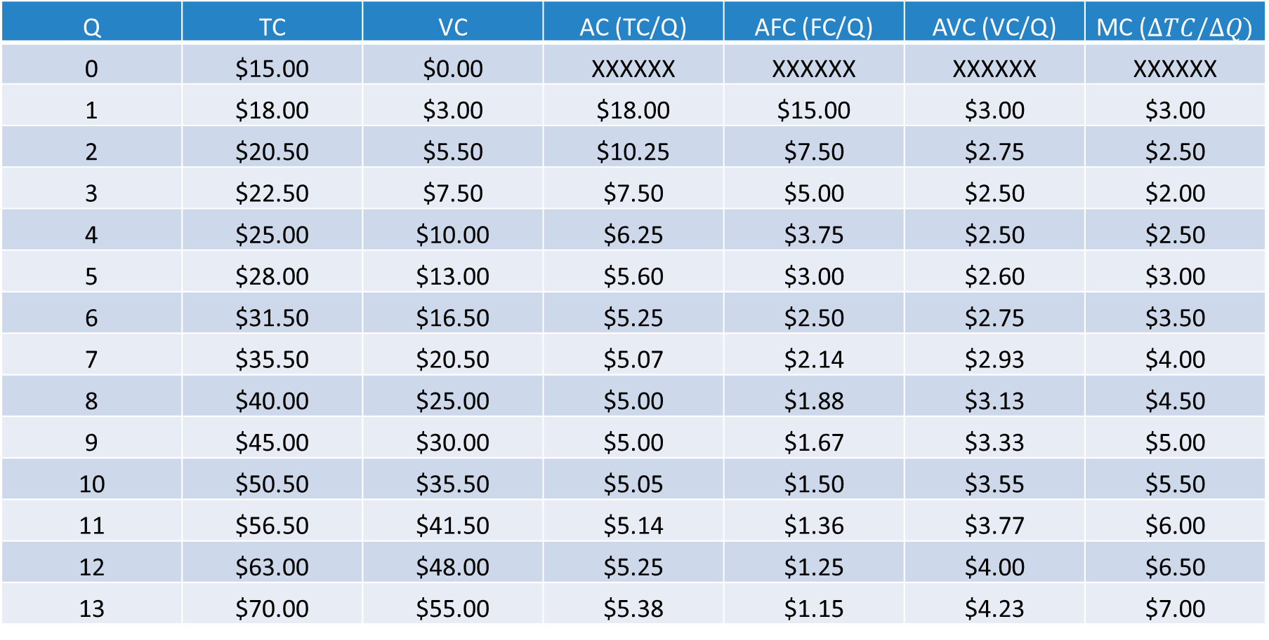
AFC, AVC, MC in a Table 2
Q | TC | VC | AC (TC/Q) | AFC (FC/Q) | AVC (VC/Q) | MC ($∆TC/∆Q)$
0 | $15.00 | $0.00 | XXXXXX | XXXXXX | XXXXXX | XXXXXX
1 | $18.00 | $3.00 | $18.00 | $15.00 | $3.00 | $3.00
2 | $20.50 | $5.50 | $10.25 | $7.50 | $2.75 | $2.50
3 | $22.50 | $7.50 | $7.50 | $5.00 | $2.50 | $2.00
4 | $25.00 | $10.00 | $6.25 | $3.75 | $2.50 | $2.50
5 | $28.00 | $13.00 | $5.60 | $3.00 | $2.60 | $3.00
6 | $31.50 | $16.50 | $5.25 | $2.50 | $2.75 | $3.50
7 | $35.50 | $20.50 | $5.07 | $2.14 | $2.93 | $4.00
8 | $40.00 | $25.00 | $5.00 | $1.88 | $3.13 | $4.50
9 | $45.00 | $30.00 | $5.00 | $1.67 | $3.33 | $5.00
10 | $50.50 | $35.50 | $5.05 | $1.50 | $3.55 | $5.50
11 | $56.50 | $41.50 | $5.14 | $1.36 | $3.77 | $6.00
12 | $63.00 | $48.00 | $5.25 | $1.25 | $4.00 | $6.50
13 | $70.00 | $55.00 | $5.38 | $1.15 | $4.23 | $7.00

Slide 45
Short-Run Cost Concepts in a Graph 2
TC/Q = FC/Q + VC/Q
AC = AFC + AVC
Key crossing 1: MC crosses AVC at the minimum of AVC
MC
AC
AVC
AFC
Quantity

Slide 46
Long-Run Costs

Slide 47
Long-Run Cost Concepts
Seven short-run concepts | Three long-run cost concepts
Total cost | Total cost
Variable cost
Fixed cost | There is no fixed cost in the long run
Average cost | Average cost
Average variable cost
Average fixed cost | There is no fixed cost in the long run
Marginal cost | Marginal cost
Key concept:
There is no fixed cost in the long run;
in the long run, all costs are variable costs.

Slide 48
Long Run Cost Concepts in a Table 1
Q | Total Cost
1 | $18.00
2 | $20.50
3 | $22.50
4 | $25.00
5 | $28.00
6 | $31.50
7 | $35.50
8 | $40.00
9 | $45.00
10 | $50.50
11 | $56.50
12 | $63.00
13 | $70.00
14 | $77.50

Slide 49
Long Run Cost Concepts in a Graph 1
$

Slide 50
Long Run Cost Concepts in a Table 2
Q | Total Cost | AC (TC/Q) | MC (Change TC/Change Q)
1 | $18.00 | $18.00 | $3.00
2 | $20.50 | $10.25 | $2.50
3 | $22.50 | $7.50 | $2.00
4 | $25.00 | $6.25 | $2.50
5 | $28.00 | $5.60 | $3.00
6 | $31.50 | $5.25 | $3.50
7 | $35.50 | $5.07 | $4.00
8 | $40.00 | $5.00 | $4.50
9 | $45.00 | $5.00 | $5.00
10 | $50.50 | $5.05 | $5.50
11 | $56.50 | $5.14 | $6.00
12 | $63.00 | $5.25 | $6.50
13 | $70.00 | $5.38 | $7.00
14 | $77.50 | $5.54 | $7.50

Slide 51
Long-Run Cost Concepts in a Graph 2
$
Quantity

Slide 52
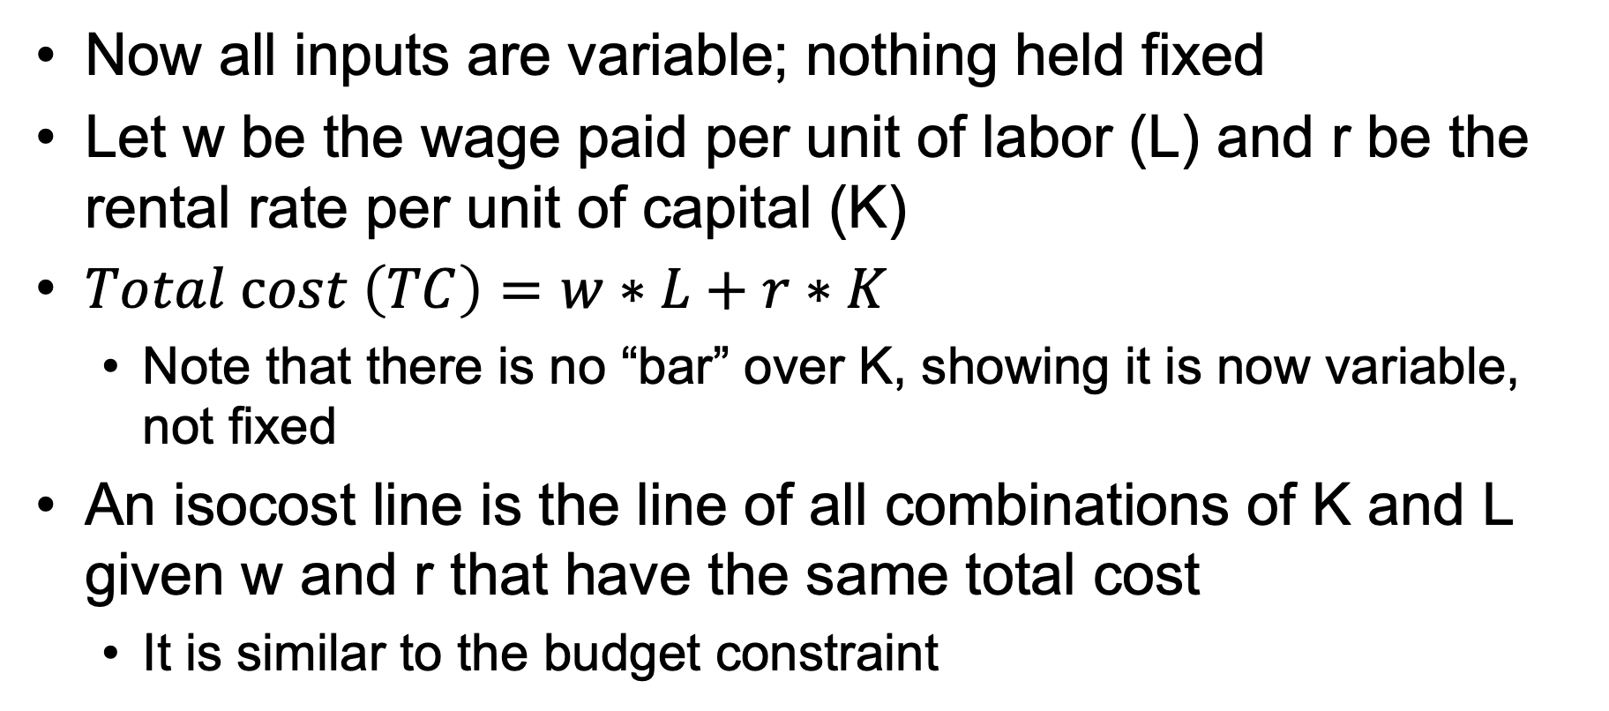
Isocost Line
Now all inputs are variable; nothing held fixed
Let w be the wage paid per unit of labor (L) and r be the rental rate per unit of capital (K)
$Total cost \left(TC\right)=w∗L+r∗K$
  Note that there is no “bar” over K, showing it is now variable, not fixed
An isocost line is the line of all combinations of K and L given w and r that have the same total cost
  It is similar to the budget constraint

Slide 53


Isocost
TC = w * L + r * K
TC − w * L = r * K
(1/r) * (TC − w * L) = (r * K) * (1/r)
(TC/r) − (w/r) * L = K
Intercept (TC/r)
Slope −(w/r)
Capital (K)
$\frac{\$500}{\$5}$=
100
90
80
70
60
50
40
30
20
10
0
TC = $500
Consider different TC levels and the associated input levels
TC = $400
TC = $300
Let w = $10, r = $5
TC = $200
Slope = −10/5 = −2
TC = $100
$$\frac{\$500}{\$10}=$$
Labor (L)
0 10 20 30 40 50 60 70 80 90 100

Slide 54
The Expansion Path and Economic Efficiency

Slide 55
Isocost and Isoquant
Capital (K)
1
Can I make 90 at a cost of $500? Yes.
100
90
80
70
60
50
40
30
20
10
0
2
Can I make 90 at a cost of $400? Yes.
1
Slope of Isoquant is MRTS
3
Can I make 90 at a cost of $300? Yes.
3 is the cost minimizing way of making 90 units.
4
Can I make 90 at a cost of $200? No!
2
Slope of Isocost= -w/r = -10/5 = -2
5
5 is the cost-minimizing way of producing 100 units.
3
TC = $500
TC = $400
Isoquant = 100
4
TC = $300
TC = $200
Isoquant = 90
TC = $100
0 10 20 30 40 50 60 70 80 90 100
Labor (L)

Slide 56
Isocost and Isoquant (cont.)
Capital (K)
The expansion path is a cost-minimizing ways of
making a given level of Q.
All points on this line are technologically efficient
(on a production function/ isoquant) and
economically efficient (the lowest cost way of
making that value of Q).
100
90
80
70
60
50
40
30
20
10
0
5
4
3
TC = $500
2
TC = $400
Isoquant = 100
TC = $300
Isoquant = 95
1
TC = $200
Isoquant = 90
TC = $100
Isoquant = 85
Isoquant=80
0 10 20 30 40 50 60 70 80 90 100
Labor (L)

Slide 57
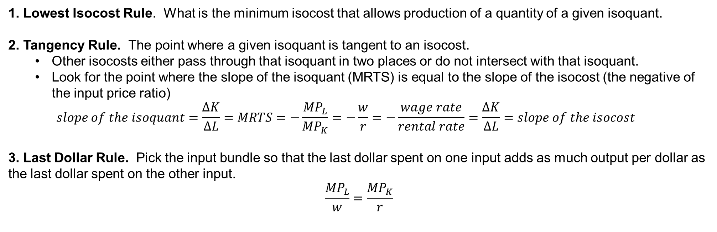
Three Ways of Arriving at Cost-Minimizing Point
1. Lowest Isocost Rule. What is the minimum isocost that allows production of a quantity of a given isoquant.
2. Tangency Rule. The point where a given isoquant is tangent to an isocost.
  Other isocosts either pass through that isoquant in two places or do not intersect with that isoquant.
  Look for the point where the slope of the isoquant (MRTS) is equal to the slope of the isocost (the negative of the input price ratio)
  $$slope of the isoquant=\frac{∆K}{∆L}=MRTS=−\frac{{MP}_{L}}{{MP}_{K}}=−\frac{w}{r}=−\frac{wage rate}{rental rate}=\frac{∆K}{∆L}=slope of the isocost$$
3. Last Dollar Rule. Pick the input bundle so that the last dollar spent on one input adds as much output per dollar as the last dollar spent on the other input.
$$\frac{{MP}_{L}}{w}=\frac{{MP}_{K}}{r}$$
All cost minimizing points are on the expansion path.
All cost minimizing points are:
technologically efficient (on the isoquant) and
economically efficient (the lowest cost way of being on that isoquant)

Slide 58

The Labels from the Expansion Path
Generate the Total Cost Curve
$
Q
From this, you can generate average cost (TC/Q) and marginal cost ($∆TC/∆Q)$.
Now you know that all points on the long run total, average, and marginal cost curves are:
technologically efficient (maximum output at a given level of input) and
economically efficient (lowest cost way of making that level of output).

Slide 59
Profit Maximization

Slide 60
Perfectly Competitive Market
Four assumptions:
Price taking/large number of buyers and sellers
The good is homogeneous; each unit q is the same
There are no costs to the transaction beyond the price
Information is correct and symmetric

Slide 61
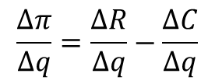
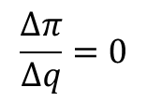
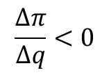

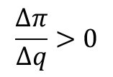

Profit Maximization
$ $π(q)$
$$\frac{∆π}{∆q}=0$$
$$\frac{∆π}{∆q}>0$$
$$\frac{∆π}{∆q}<0$$
q
$$π\left(q\right)=R\left(q\right)−C(q)$$
$$\frac{∆π}{∆q}=\frac{∆R}{∆q}−\frac{∆C}{∆q}$$
$\frac{∆π}{∆q}$ = 0 when $\frac{∆R}{∆q}=\frac{∆C}{∆q}$ or MR(q) = MC(q)
Profit is maximized by selecting q that makes marginal revenue (MR) equal to marginal cost (MC).

Slide 62
Short-Run Profit Maximization

Slide 63
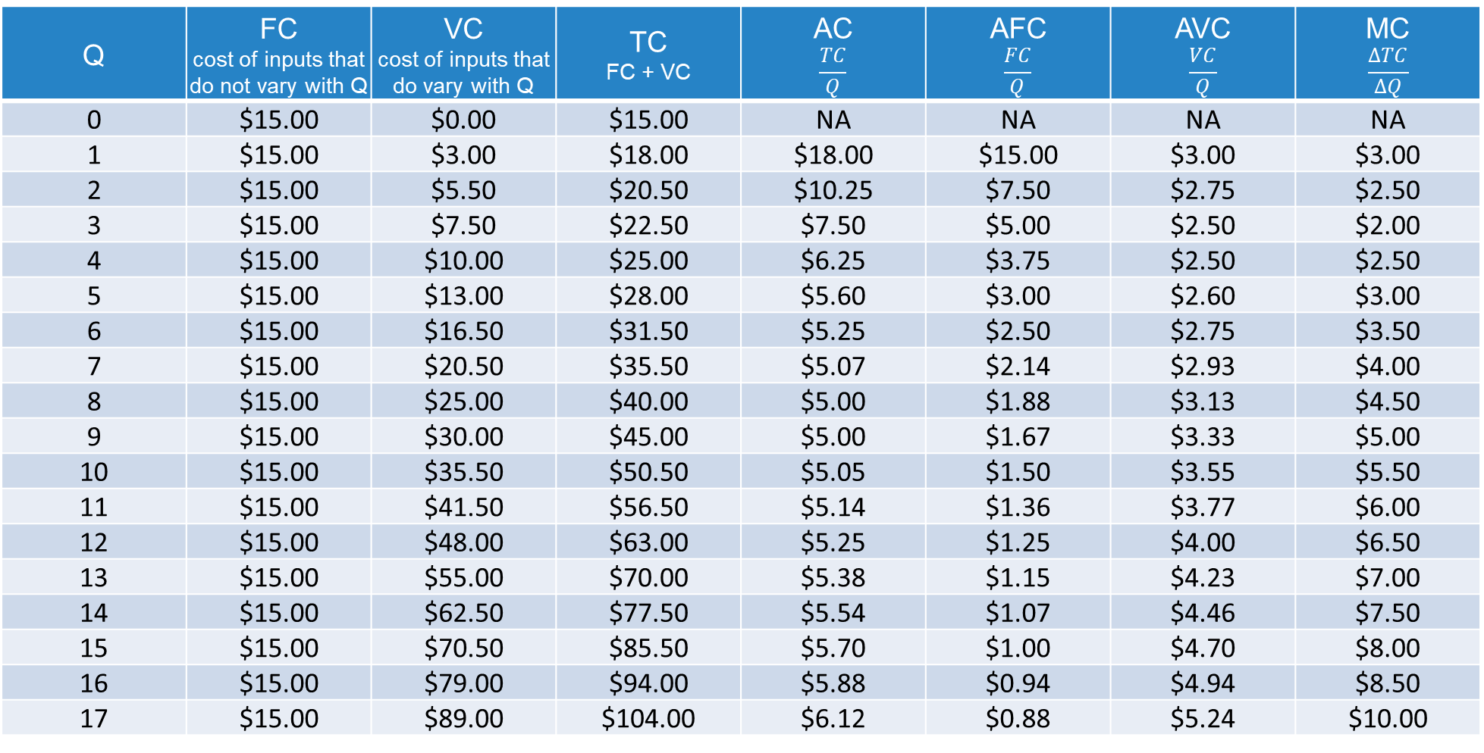
Short-Run Cost Table
Q | FC cost of inputs that do not vary with Q | VC cost of inputs that do vary with Q | TC FC + VC | AC $$\frac{TC}{Q}$$ | AFC $$\frac{FC}{Q}$$ | AVC $$\frac{VC}{Q}$$ | MC $$\frac{∆TC}{∆Q}$$
0 | $15.00 | $0.00 | $15.00 | NA | NA | NA | NA
1 | $15.00 | $3.00 | $18.00 | $18.00 | $15.00 | $3.00 | $3.00
2 | $15.00 | $5.50 | $20.50 | $10.25 | $7.50 | $2.75 | $2.50
3 | $15.00 | $7.50 | $22.50 | $7.50 | $5.00 | $2.50 | $2.00
4 | $15.00 | $10.00 | $25.00 | $6.25 | $3.75 | $2.50 | $2.50
5 | $15.00 | $13.00 | $28.00 | $5.60 | $3.00 | $2.60 | $3.00
6 | $15.00 | $16.50 | $31.50 | $5.25 | $2.50 | $2.75 | $3.50
7 | $15.00 | $20.50 | $35.50 | $5.07 | $2.14 | $2.93 | $4.00
8 | $15.00 | $25.00 | $40.00 | $5.00 | $1.88 | $3.13 | $4.50
9 | $15.00 | $30.00 | $45.00 | $5.00 | $1.67 | $3.33 | $5.00
10 | $15.00 | $35.50 | $50.50 | $5.05 | $1.50 | $3.55 | $5.50
11 | $15.00 | $41.50 | $56.50 | $5.14 | $1.36 | $3.77 | $6.00
12 | $15.00 | $48.00 | $63.00 | $5.25 | $1.25 | $4.00 | $6.50
13 | $15.00 | $55.00 | $70.00 | $5.38 | $1.15 | $4.23 | $7.00
14 | $15.00 | $62.50 | $77.50 | $5.54 | $1.07 | $4.46 | $7.50
15 | $15.00 | $70.50 | $85.50 | $5.70 | $1.00 | $4.70 | $8.00
16 | $15.00 | $79.00 | $94.00 | $5.88 | $0.94 | $4.94 | $8.50
17 | $15.00 | $89.00 | $104.00 | $6.12 | $0.88 | $5.24 | $10.00

Slide 64

Short-Run Profit Maximization
$
3
2
1
0
Quantity
1
$$q=0, π=−\$15$$
2
$$q=7, π=\$4.00∗7−\$5.07∗7=−\$7.49$$
$$q=15 π=\$8.00∗15−\$5.70∗15=\$34.50$$
3

Slide 65
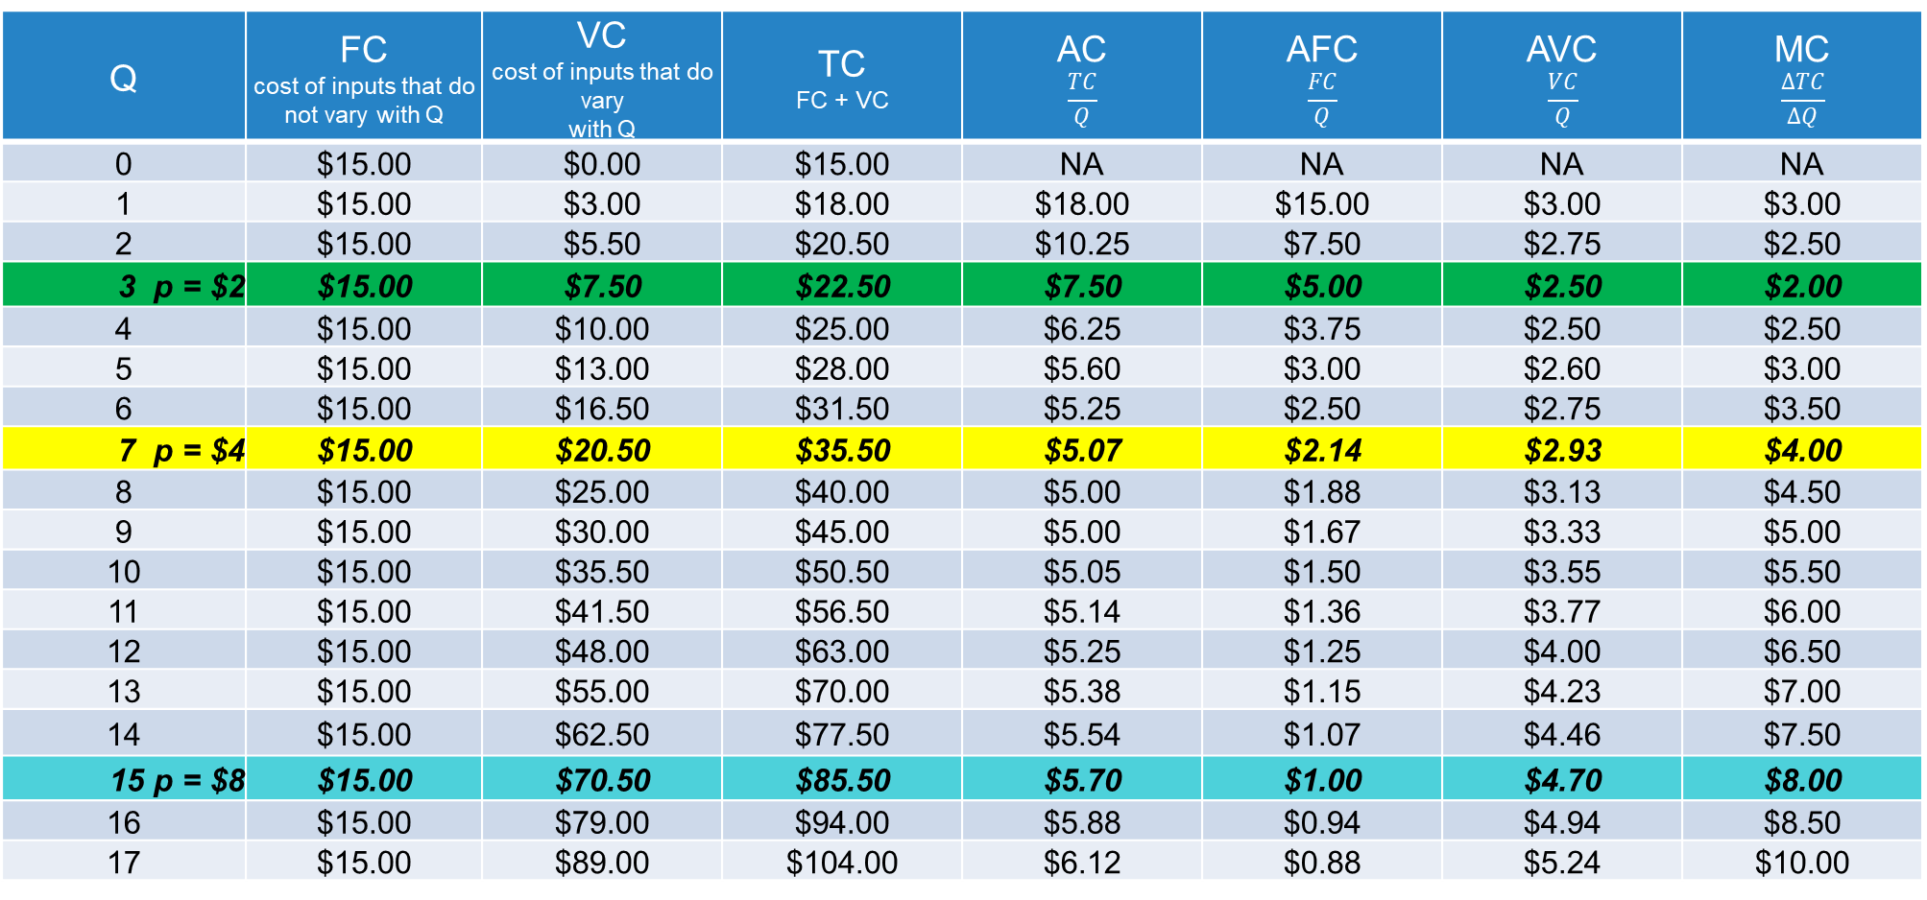
Short-Run Cost Table
Q | FC cost of inputs that do not vary with Q | VC cost of inputs that do vary with Q | TC FC + VC | AC $$\frac{TC}{Q}$$ | AFC $$\frac{FC}{Q}$$ | AVC $$\frac{VC}{Q}$$ | MC $$\frac{∆TC}{∆Q}$$
0 | $15.00 | $0.00 | $15.00 | NA | NA | NA | NA
1 | $15.00 | $3.00 | $18.00 | $18.00 | $15.00 | $3.00 | $3.00
2 | $15.00 | $5.50 | $20.50 | $10.25 | $7.50 | $2.75 | $2.50
3 p = $2 | $15.00 | $7.50 | $22.50 | $7.50 | $5.00 | $2.50 | $2.00
4 | $15.00 | $10.00 | $25.00 | $6.25 | $3.75 | $2.50 | $2.50
5 | $15.00 | $13.00 | $28.00 | $5.60 | $3.00 | $2.60 | $3.00
6 | $15.00 | $16.50 | $31.50 | $5.25 | $2.50 | $2.75 | $3.50
7 p = $4 | $15.00 | $20.50 | $35.50 | $5.07 | $2.14 | $2.93 | $4.00
8 | $15.00 | $25.00 | $40.00 | $5.00 | $1.88 | $3.13 | $4.50
9 | $15.00 | $30.00 | $45.00 | $5.00 | $1.67 | $3.33 | $5.00
10 | $15.00 | $35.50 | $50.50 | $5.05 | $1.50 | $3.55 | $5.50
11 | $15.00 | $41.50 | $56.50 | $5.14 | $1.36 | $3.77 | $6.00
12 | $15.00 | $48.00 | $63.00 | $5.25 | $1.25 | $4.00 | $6.50
13 | $15.00 | $55.00 | $70.00 | $5.38 | $1.15 | $4.23 | $7.00
14 | $15.00 | $62.50 | $77.50 | $5.54 | $1.07 | $4.46 | $7.50
15 p = $8 | $15.00 | $70.50 | $85.50 | $5.70 | $1.00 | $4.70 | $8.00
16 | $15.00 | $79.00 | $94.00 | $5.88 | $0.94 | $4.94 | $8.50
17 | $15.00 | $89.00 | $104.00 | $6.12 | $0.88 | $5.24 | $10.00
1
2
3

Slide 66
Short-Run Profit Maximization
p
$$q=0, π=−\$15 better than q=3, π=\$2.00∗3−\$22.50=−\$16.50$$
1
$$q=7, π=\$4.00∗7−\$5.07∗7=−\$7.49$$
2
3
$$q=15 π=\$8.00∗15−\$5.70∗15=\$34.50$$
3
2
1
0
q
$$π\left(q\right)=R\left(q\right)−C\left(q\right) π=p∗q−ac(q)∗q$$

Slide 67

Short-Run Profit Maximization (cont.)
p
From here out, q > 0, π > 0
In here, q > 0, $π∈\left[−FC,0\right]$
In here, q = 0,
profit = −FC
Quantity

Slide 68
The Marginal Cost Curve above AVC Equals Supply
p
This firm’s short-run supply curve
0
Quantity

Slide 69




Short-Run Market Supply
p
20
10
5
$${MC}_{i}=S_{i}$$
S
p
20
10
5
$${MC}_{j}=S_{j}$$
p
20
10
5
+
=
$${AVC}_{i}$$
$${AVC}_{j}$$
17 30
q
q
q
4 12 16
4 29 46
Horizontal summation of q at a given p

Slide 70
Long-Run Profit Maximization

Slide 71
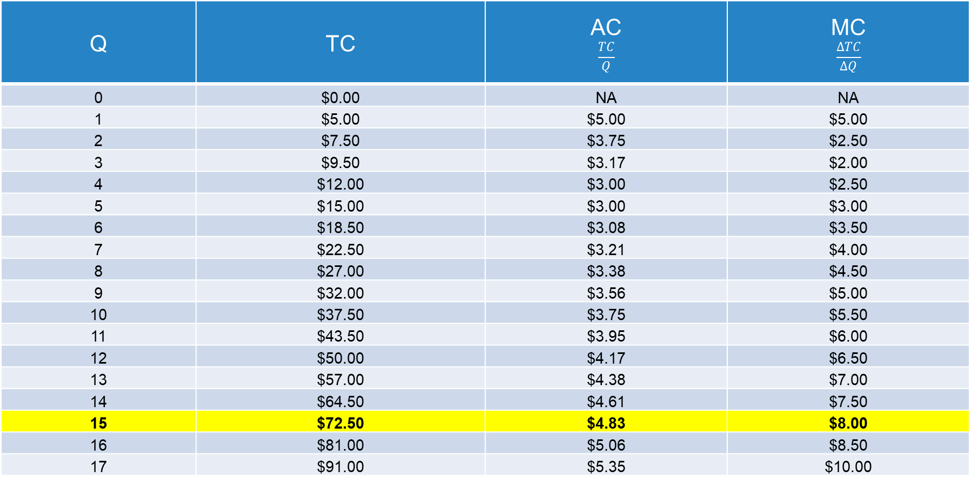
Long-Run Costs
Q | TC | AC $$\frac{TC}{Q}$$ | MC $$\frac{∆TC}{∆Q}$$
0 | $0.00 | NA | NA
1 | $5.00 | $5.00 | $5.00
2 | $7.50 | $3.75 | $2.50
3 | $9.50 | $3.17 | $2.00
4 | $12.00 | $3.00 | $2.50
5 | $15.00 | $3.00 | $3.00
6 | $18.50 | $3.08 | $3.50
7 | $22.50 | $3.21 | $4.00
8 | $27.00 | $3.38 | $4.50
9 | $32.00 | $3.56 | $5.00
10 | $37.50 | $3.75 | $5.50
11 | $43.50 | $3.95 | $6.00
12 | $50.00 | $4.17 | $6.50
13 | $57.00 | $4.38 | $7.00
14 | $64.50 | $4.61 | $7.50
15 | $72.50 | $4.83 | $8.00
16 | $81.00 | $5.06 | $8.50
17 | $91.00 | $5.35 | $10.00

Slide 72

Total Cost
$
$$AC = \$4.83$$
Quantity

Slide 73

Average and Marginal Cost
p
3
$3.75
2
$3.95
$3.00
$3.00
$2.50
1
$$q=0,π=0$$
q

Slide 74
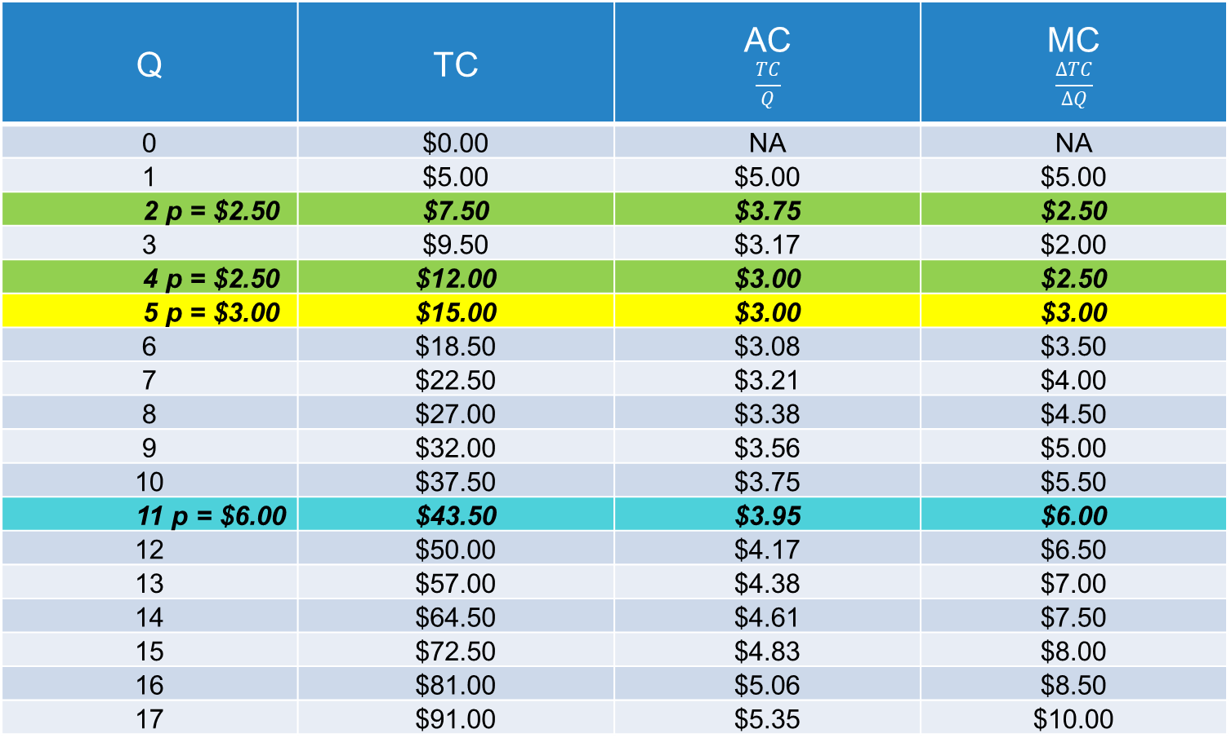
Long-Run Costs
Q | TC | AC $$\frac{TC}{Q}$$ | MC $$\frac{∆TC}{∆Q}$$
0 | $0.00 | NA | NA
1 | $5.00 | $5.00 | $5.00
2 p = $2.50 | $7.50 | $3.75 | $2.50
3 | $9.50 | $3.17 | $2.00
4 p = $2.50 | $12.00 | $3.00 | $2.50
5 p = $3.00 | $15.00 | $3.00 | $3.00
6 | $18.50 | $3.08 | $3.50
7 | $22.50 | $3.21 | $4.00
8 | $27.00 | $3.38 | $4.50
9 | $32.00 | $3.56 | $5.00
10 | $37.50 | $3.75 | $5.50
11 p = $6.00 | $43.50 | $3.95 | $6.00
12 | $50.00 | $4.17 | $6.50
13 | $57.00 | $4.38 | $7.00
14 | $64.50 | $4.61 | $7.50
15 | $72.50 | $4.83 | $8.00
16 | $81.00 | $5.06 | $8.50
17 | $91.00 | $5.35 | $10.00
1
2
3

Slide 75
Average and Marginal Cost
p
3
$3.00
2
$2.50
1
$$q=0,π=0$$
q

Slide 76
The Marginal Cost Curve Equals Supply
p
The supply curve for firm i
is the marginal cost curve
above average cost.
0
q

Slide 77




Input Cost Increase Shifts Supply
p
$${{MC}_{i}^{increase}=S}_{i}^{increase}$$
$${{MC}_{i}^{original}=S}_{i}^{original}$$
$${AC}_{i}^{increase}$$
$${AC}_{i}^{original}$$
q

Slide 78
Long-Run Supply
In the short run, supply slopes up due to diminishing marginal returns in production.
That cannot explain upward sloping supply in the long run.
Supply is horizontal (perfectly elastic) if:
Free entry and exit into the industry
All firms have identical:
  Technology
  Regulation
  Environment
Input costs are not changed as q increases
p
MC = AC = S = p*
q
Deviation from these three conditions tend to make long-run supply slope up

Slide 79
Perfectly Competitive Markets

Slide 80
Assumptions of a Perfectly Competitive Market
Four key assumptions (repeated from earlier slide)
Large number of buyers and sellers/price-taking behavior/no market power
Information is symmetric for buyers and sellers (and assumed to be “correct”)
The good is homogeneous
There are no costs beyond the selling price associated with the transaction/no transaction costs

Slide 81





Under These Conditions, Revisit the Perfectly Competitive Market
p
$${MWTP}_{q′}$$
S: consider as MC
$$p^{∗}$$
$$p_{q′}$$
D: consider as MWTP
$${MC}_{q′}$$
q’
$$q^{∗}$$
q

Slide 82
Consumer Surplus and Producer Surplus
p
Consumer
surplus (CS)
S: consider as MC
Total social welfare: TSW, also called social surplus
Total social welfare = Consumer surplus + Producer surplus
TSW = CS + PS
$$p^{∗}$$
Producer
surplus
(PS)
D: consider as MWTP
$$q^{∗}$$
q

Slide 83
Fundamental Theorem of Welfare Economics
A perfectly competitive market will lead to outcomes that are Pareto optimal/efficient.
  Pareto optimality/efficiency means that there is no way to make one individual better off without making another individual worse off.
    There is no slack, no waste, no inefficiency.
A benevolent social dictator can at best equal the Pareto optimal/efficient outcome of a perfectly competitive market.
  History suggests that we should not count on benevolent social dictators!

Slide 84
Perfectly Competitive Markets
Consumers are acting in their own self-interest.
  Maximizing utility subject to a budget constraint
Producers are maximizing profit.
  Producing up to the point where price is equal to marginal cost of production (if equal to or above AVC in the short run and AC in the long run)
Self-interested behavior by consumers and producers takes us to the socially optimal outcome.
  How cool is that!

Slide 85
Efficiency and Equity Are Different Concepts
The outcome of a perfectly competitive market is a statement about efficiency.
If we redistribute wealth and allow the perfectly competitive market to operate, we will end up at a different distribution of goods among consumers that is also Pareto optimal.
  It will differ from the original distribution to reflect the redistribution of wealth.
  There are as many efficient solutions to which the market will take us as there are possible configurations of initial wealth.

Slide 86












Edgeworth-Bowley Box
I have gone shopping and bought 20 apples and 25 bananas.
My two daughters Katie (K) and Janis (J) will eat the fruit.
$${bananas}_{K}$$
KATIE
 | 25 | 24 | 23 | 22 | 21 | 20 | 19 | 18 | 17 | 16 | 15 | 14 | 13 | 12 | 11 | 10 | 9 | 8 | 7 | 6 | 5 | 4 | 3 | 2 | 1 | 0 | K
20 |  |  |  |  |  |  |  |  |  |  |  |  |  |  |  |  |  |  |  |  |  |  |  |  |  |  | 0
19 |  |  |  |  |  |  |  |  |  |  |  |  |  |  |  |  |  |  |  |  |  |  |  |  |  |  | 1
18 |  |  |  |  |  |  |  |  |  |  |  |  |  |  |  |  |  |  |  |  |  |  |  |  |  |  | 2
17 |  |  |  |  |  |  |  |  |  |  |  |  |  |  |  |  |  |  |  |  |  |  |  |  |  |  | 3
16 |  |  |  |  |  |  |  |  |  |  |  |  |  |  |  |  |  |  |  |  |  |  |  |  |  |  | 4
15 |  |  |  |  |  |  |  |  |  |  |  |  |  |  |  |  |  |  |  |  |  |  |  |  |  |  | 5
14 |  |  |  |  |  |  |  |  |  |  |  |  |  |  |  |  |  |  |  |  |  |  |  |  |  |  | 6
13 |  |  |  |  |  |  |  |  |  |  |  |  |  |  |  |  |  |  |  |  |  |  |  |  |  |  | 7
12 |  |  |  |  |  |  |  |  |  |  |  |  |  |  |  |  |  |  |  |  |  |  |  |  |  |  | 8
11 |  |  |  |  |  |  |  |  |  |  |  |  |  |  |  |  |  |  |  |  |  |  |  |  |  |  | 9
10 |  |  |  |  |  |  |  |  |  |  |  |  |  |  |  |  |  |  |  |  |  |  |  |  |  |  | 10
9 |  |  |  |  |  |  |  |  |  |  |  |  |  |  |  |  |  |  |  |  |  |  |  |  |  |  | 11
8 |  |  |  |  |  |  |  |  |  |  |  |  |  |  |  |  |  |  |  |  |  |  |  |  |  |  | 12
7 |  |  |  |  |  |  |  |  |  |  |  |  |  |  |  |  |  |  |  |  |  |  |  |  |  |  | 13
6 |  |  |  |  |  |  |  |  |  |  |  |  |  |  |  |  |  |  |  |  |  |  |  |  |  |  | 14
5 |  |  |  |  |  |  |  |  |  |  |  |  |  |  |  |  |  |  |  |  |  |  |  |  |  |  | 15
4 |  |  |  |  |  |  |  |  |  |  |  |  |  |  |  |  |  |  |  |  |  |  |  |  |  |  | 16
3 |  |  |  |  |  |  |  |  |  |  |  |  |  |  |  |  |  |  |  |  |  |  |  |  |  |  | 17
2 |  |  |  |  |  |  |  |  |  |  |  |  |  |  |  |  |  |  |  |  |  |  |  |  |  |  | 18
1 |  |  |  |  |  |  |  |  |  |  |  |  |  |  |  |  |  |  |  |  |  |  |  |  |  |  | 19
0 |  |  |  |  |  |  |  |  |  |  |  |  |  |  |  |  |  |  |  |  |  |  |  |  |  |  | 20
J | 0 | 1 | 2 | 3 | 4 | 5 | 6 | 7 | 8 | 9 | 10 | 11 | 12 | 13 | 14 | 15 | 16 | 17 | 18 | 19 | 20 | 21 | 22 | 23 | 24 | 25
c
e
$${apples}_{J}$$
d
$${apples}_{K}$$
$$I_{J}^{4}$$
b
$$I_{J}^{3}$$
f
$$I_{K}^{2}$$
$$I_{K}^{1}$$
a
$$I_{J}^{2}$$
$$I_{K}^{4}$$
$$I_{K}^{3}$$
$$I_{J}^{1}$$
JANIS
$${bananas}_{J}$$
Contract curve: Pareto optimal outcomes

Slide 87
Efficiency
Economic analysis is primarily focused on the efficiency of outcomes.
Do we achieve the maximum total social welfare with the resources we have available in society?
Is there no waste, no leftover, no benefit that would be possible to achieve given the resources we have available?
Economics has tools to look at inequality, but it is more about aggregate benefits than who gets the benefits.

Slide 88
Total Social Welfare

Slide 89



The Price Floor
Recall a price floor, a legally enforced minimal price, $\underline{p}$
Perfect competition
CS = 1 + 2 + 4
PS = 3 + 5
TSW = 1 + 2 + 3 + 4 + 5
1
S
Price floor
CS = 1
PS = 2 + 3
DWL = 4 + 5
$$\underline{p}$$
2
4
p*
8
3
5
CS is consumer surplus
PS is producer surplus
DWL is dead weight loss
TSW is total social welfare
6
7
Surplus
D
$$q_{D}^{\underline{p}}$$
q*
$$q_{S}^{\underline{p}}$$

Slide 90
Price Floor Implementation
Recall a price floor, a legally enforced minimal price, $\underline{p}$
Price floor targeted at low cost producers without purchase of surplus
CS = 1
PS = 2 + 3
DWL = 4 + 5
Price floor with purchase of surplus
With efficient distribution to consumers of the surplus
Transfer of surplus from consumers and government to producers: 2 + 4 + 9
Consumers get 5 + 6 + 7 (4)
Loss to society of 8
With destruction of surplus to support price floor
Transfer of surplus from consumers and government to producers: 2 + 4 + 9
Loss to society of 4 + 5 + 6 + 7 + 8
1
S
$$\underline{p}$$
2
4
9
p*
8
3
5
6
7
Surplus
D
$$q_{D}^{\underline{p}}$$
q*
$$q_{S}^{\underline{p}}$$

Slide 91



The Price Ceiling
Recall a price ceiling, a legally enforced maximum price, $\overline{p}$
Perfect competition
CS = 1 + 2 + 4
PS = 3 + 5 + 6
TSW = 1 + 2 + 3 + 4 + 5 + 6
1
S
Price ceiling
CS = 1 + 2 + 3
PS = 6
DWL = 4 + 5
2
4
p*
3
5
$$\overline{p}$$
6
D
$$q_{S}^{\overline{p}}$$
q*
$$q_{D}^{\underline{\overline{p}}}$$

Slide 92
Price Ceiling Implementation
Recall a price ceiling, a legally enforced maximum price, $\overline{p}$
Perfect competition
CS = 1 + 2 + 4
PS = 3 + 5 + 6
TSW = 1 + 2 + 3 + 4 + 5 + 6
1
S
Price ceiling
CS = 1 + 2 + 3
Potential dissipation of CS
PS = 6
DWL = 4 + 5
2
4
p*
3
5
$$\overline{p}$$
Dissipation
Costs of waiting in lines
Search costs
Bribes
6
D
$$q_{S}^{\overline{p}}$$
q*
$$q_{D}^{\underline{\overline{p}}}$$

Slide 93
Economic Efficiency
If there is deadweight loss (DWL), then the outcome is not Pareto optimal.
If it is not Pareto optimal, then the outcome is economically inefficient.
  There are people willing to pay for units that can be produced at a cost below the consumer’s willingness to pay.
If there is a market outcome that is not Pareto optimal, we have suffered from a market failure.
  We may choose to do this for policy reasons like we just looked at, but we need to do this with an awareness that the policy will lead to an outcome that does not efficiently use societal resources to maximize TSW.

