Slide 1
The Role of Microeconomics in Policy Analysis

Slide 2
Microeconomics
The study of the allocation of scarce resources among competing alternatives
The study of how best to use limited means in the pursuit of unlimited ends
The study of decisions made by:
  Individuals
  Households
  Firms

Slide 3
Microeconomics (cont.)
We focus on interpreting the meaning of choices we observe
  Consumers: Why did they choose this apple when they could have bought a pear?
  Producers: Why did the firm use a capital-intense production method rather than a labor-intense method?

Slide 4
Three Key Microeconomic Questions
What goods and services will we produce given the resources we have available?
How will we allocate the available inputs to the production of the different goods and services we have decided to produce?
How will we allocate the produced goods and services to consumers?
In an economy like that of the United States, the idea is that there is a market operating to answer these three questions.

Slide 5
Microeconomics in Policy Analysis
We will develop the idea that answering these three questions through market forces is the ideal.
We will see ways in which this ideal is not always possible.
We will identify how this relates to public policy decisions.
We will look at ways to use economic tools and concepts to move the outcome closer to the ideal.

Slide 6
Economics
Microeconomics is distinguished from macroeconomics.
Macroeconomics studies an economy at an aggregate level.
  The focus is on things like aggregate consumption, inflation rates, and unemployment rates.
  We will mostly focus on microeconomics with a few references to macroeconomics in this policy analysis course.

Slide 7
Demand

Slide 8
Demand
Inverse relationship between price per unit and the number of units that consumers demand
A set of counterfactuals
  If the price per unit is at a given level, what will be the quantity demanded?
  If the quantity demanded is at a given level, what will be the price per unit?
Only one point on the demand curve is observable at a given point in time
“Law of demand” is that price and quantity move in opposite directions (are inversely related)
Exists as a concept, a drawing, an equation

Slide 9
Demand (cont.)
Interpret the value of the demand curve at a given quantity as the “marginal willingness to pay” for that unit
Embedded in the concept of demand are:
  Preferences of a consumer
  Ability (buying power) of consumers
  Rules and regulations
  Trade-offs between different uses of the available buying power

Slide 10
Demand Curve Example for Processed Pork
Perloff, Microeconomics
A math example: q = 286 − 20 * p
  Inverse demand: p = (286/20) − (1/20) * q; intercept: (286/20); slope: −1/20
Price per unit (p)
Quantity of units demanded (q)

Slide 11
All Else Equal (Ceteris Paribus)
Holding constant in the background
Incomes of consumers
Preferences of consumers
Information about the commodity
Government rules and regulations
Prices of logically-related commodities
  Consume together (complements)
  Consume instead of (substitutes)

Slide 12
Demand Shifts Up/Out/to the Northeast
Price per unit (p)
D
Quantity of units demanded (q)
Incomes for consumers increase
Consumers have preferences change to demand more of the good
Consumers’ information changes about the good to be more favorable
Government rules and regulations become less restrictive concerning consumption of the good
Price of a complement (consume together) goes down/price of a substitute (consume instead of)
goes up

Slide 13
Demand Shifts Down/In/Southwest
Price per unit (p)
D
D‘
Quantity of units demanded (q)
Incomes decrease
Preference shifts away from the good
Adverse information about the good becomes available
Rules and regulations make access to the good more difficult
The price of a complement (consume together) increases, and the price of a substitute (consume instead of) decreases

Slide 14
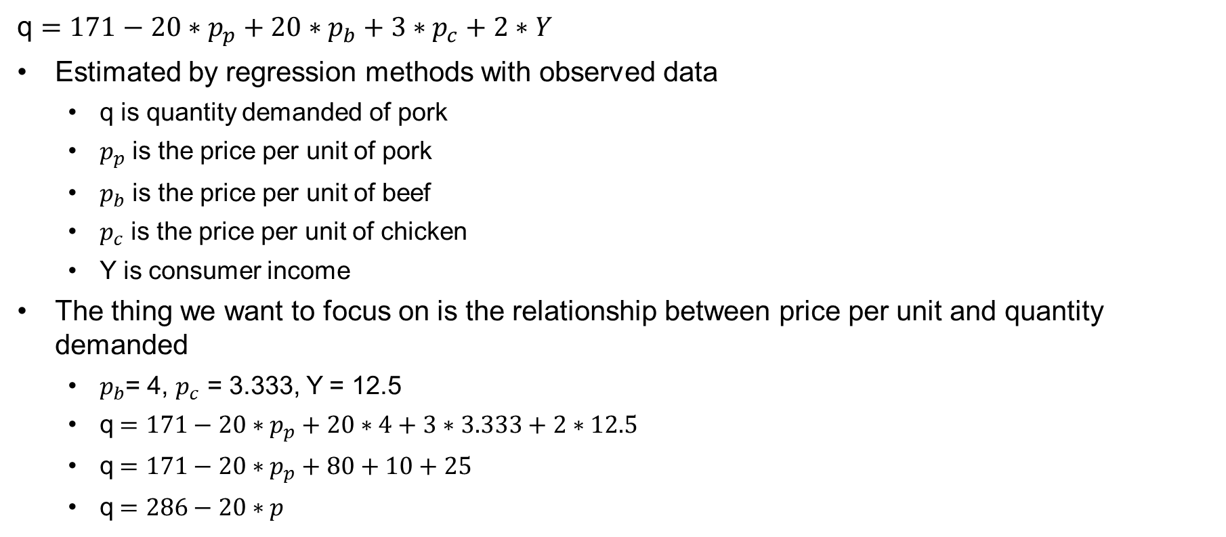
The Underlying Equation
q $=171−20∗p_{p}+20∗p_{b}+3∗p_{c}+2∗Y$
Estimated by regression methods with observed data
  q is quantity demanded of pork
  $p_{p}$ is the price per unit of pork
  $p_{b}$ is the price per unit of beef
  $p_{c}$ is the price per unit of chicken
  Y is consumer income
The thing we want to focus on is the relationship between price per unit and quantity demanded
  $p_{b}$= 4, $p_{c}$ = 3.333, Y = 12.5
  q$=171−20∗p_{p}+20∗4+3∗3.333+2∗12.5$
  q$=171−20∗p_{p}+80+10+25$
  q$=286−20∗p$

Slide 15
Supply

Slide 16
Supply Curve
A supply curve traces out the amount of the good that will be supplied by producers at a given price.
Also a set of counterfactuals: If this is the price per unit, then this will be the quantity supplied (or vice versa).
Each point on the supply curve can be thought of as the “marginal cost” of producing that unit.
If a buyer is willing to pay that marginal cost, then the producer will sell that unit.

Slide 17
Supply Curve Example also from Perloff, Microeconomics
Math example:
q = 88 + 40 * p
  Inverse: p = (−88/40) + (1/40) * q
Price per unit (p)
Quantity of units supplied (q)

Slide 18
All Else Equal (Ceteris Paribus)
Prices of inputs used in production of what is being supplied
Government rules and regulations
Technology of production

Slide 19
Supply Shifts Up/In/to the Northwest
Price per unit (p)
S’
S
Quantity of units supplied (q)
Input costs increase
Complying with rules and regulations becomes more costly
(Rare) technology of production gets worse

Slide 20
Supply Shift Down/Out/to the Southeast
Price per unit (p)
S
S’
Quantity of units supplied (q)
Input costs decrease.
Complying with rules and regulations becomes less costly.
Technology of production gets better.

Slide 21
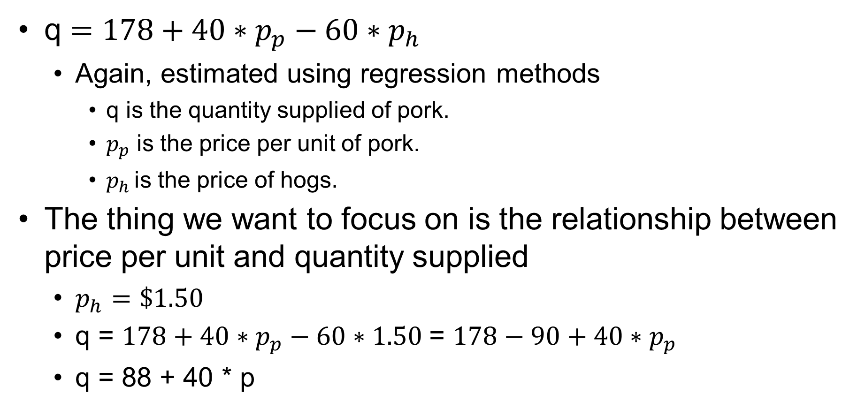
The Underlying Equation
q $=178+40∗p_{p}−60∗p_{h}$
  Again, estimated using regression methods
    q is the quantity supplied of pork.
    $p_{p}$ is the price per unit of pork.
    $p_{h }$is the price of hogs.
The thing we want to focus on is the relationship between price per unit and quantity supplied
  $p_{h}=\$1.50$
  q = $178+40∗p_{p}−60∗1.50$= $178−90+40∗p_{p}$
  q = 88 + 40 * p

Slide 22
Market Equilibrium

Slide 23
Market Equilibrium
Price per unit (p)
$3.30
Quantity of units (q)

Slide 24
Solving for the Equilibrium
Demand: q = 286 − 20 * p
Supply: q = 88 + 40 * p
Question: What p will make the q supplied equal to the q demanded?
286 − 20 * p = 88 + 40 * p
+ 20 * p + 20 * p
286 = 88 + 60 * p
− 88 − 88
198 = 60 * p, multiply both sides by (1/60),
p* = 198/60 or $3.30, q* = 286 − 20 * $3.30 = 88 + 40 * $3.30 = 220
(p*, q*) = ($3.30, 220)

Slide 25
Out of Equilibrium (Price Too High)?
Price per unit (p)
Surplus of 42
206
248
Quantity of units (q)
At a price of $4.00:
q supplied is 88 + 40 * $4.00 = 248,
q demanded is 286 − 20 * $4.00 = 206
Surplus of 42

Slide 26
Out of Equilibrium (Price Too Low)?
Price per unit (p)
Shortage of 78
168
246
Quantity of units (q)
At a price of $2.00:
q supplied is 88 + 40 * $2.00 = 168,
q demanded is 286 − 20 * $2.00 = 246
Shortage of 78

Slide 27
Markets Are Self-Regulating
If price is too high, there will be a surplus.
If price is too low, there will be a shortage.
The equilibrium price is the “market clearing price”, where the quantity demanded and the quantity supplied are equal.
  No shortage
  No surplus

Slide 28
What Does Equilibrium Look Like?
Firms not entering or leaving the sector
Firms not expanding or contracting production
Prices are relatively stable over time
No visible surplus
No visible shortage

Slide 29
Shifts in Supply and Demand

Slide 30
Market Equilibrium
Price per unit (p)
$3.30
Quantity of units (q)

Slide 31
A Shift Up in Supply Leads to
Movement along a Demand Curve
p
q
1
206
Increase in input costs, more costly to meet regulation

Slide 32
A Shift Down in Supply Leads to
Movement along a Demand Curve
p
p
q
1
2
S’
$2.64
234
q
Input cost decrease, regulations less costly to meet, technological progress

Slide 33
A Shift Up in Demand Causes
Movement along a Supply Curve
p
p
q
$3.64
2
1
233
Income increase, preference shift, information changes, price of complement decreases, price of a substitute increases, regulations change

Slide 34
A Shift Down in Demand Causes
Movement along a Supply Curve
p
p
q
$3.30
1
$2.95
2
206
q
Income decreases, preference shift, information changes, price of complement increases, price of a substitute decreases, regulations change

Slide 35
There Are Four Possible Outcomes
P
Q
Supply shift up
P
Q
Supply shift down
P
Q
Demand shift up
P
Q
Demand shift down

Slide 36
Elasticity Measures

Slide 37
Qualitative to Quantitative Change
For the last topic, we looked at particular kinds of changes (supply and demand shifts) to identify the qualitative change in terms of p and q.
Now we want to think about the quantitative change.
  Not just which direction, but how much change will there be to p and how much to q?
To understand this, we will introduce the concept of elasticity.

Slide 38
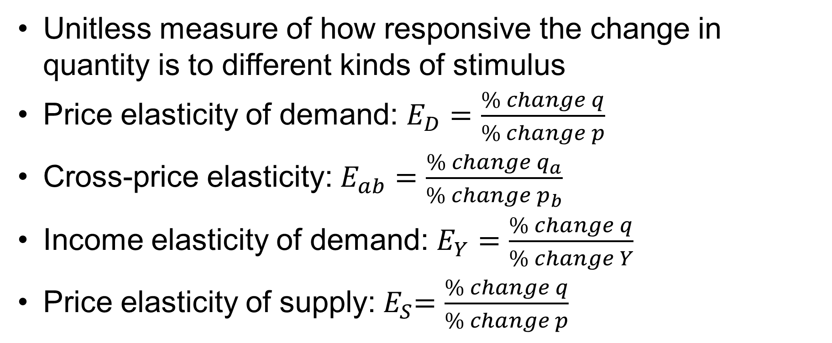
Elasticity
Unitless measure of how responsive the change in quantity is to different kinds of stimulus
Price elasticity of demand: $E_{D}=\frac{\% change q}{\% change p}$
Cross-price elasticity: $E_{ab}=\frac{{\% change q}_{a}}{{\% change p}_{b}}$
Income elasticity of demand: $E_{Y}=\frac{\% change q}{\% change Y}$
Price elasticity of supply:${ E}_{S}=\frac{\% change q}{\% change p}$

Slide 39
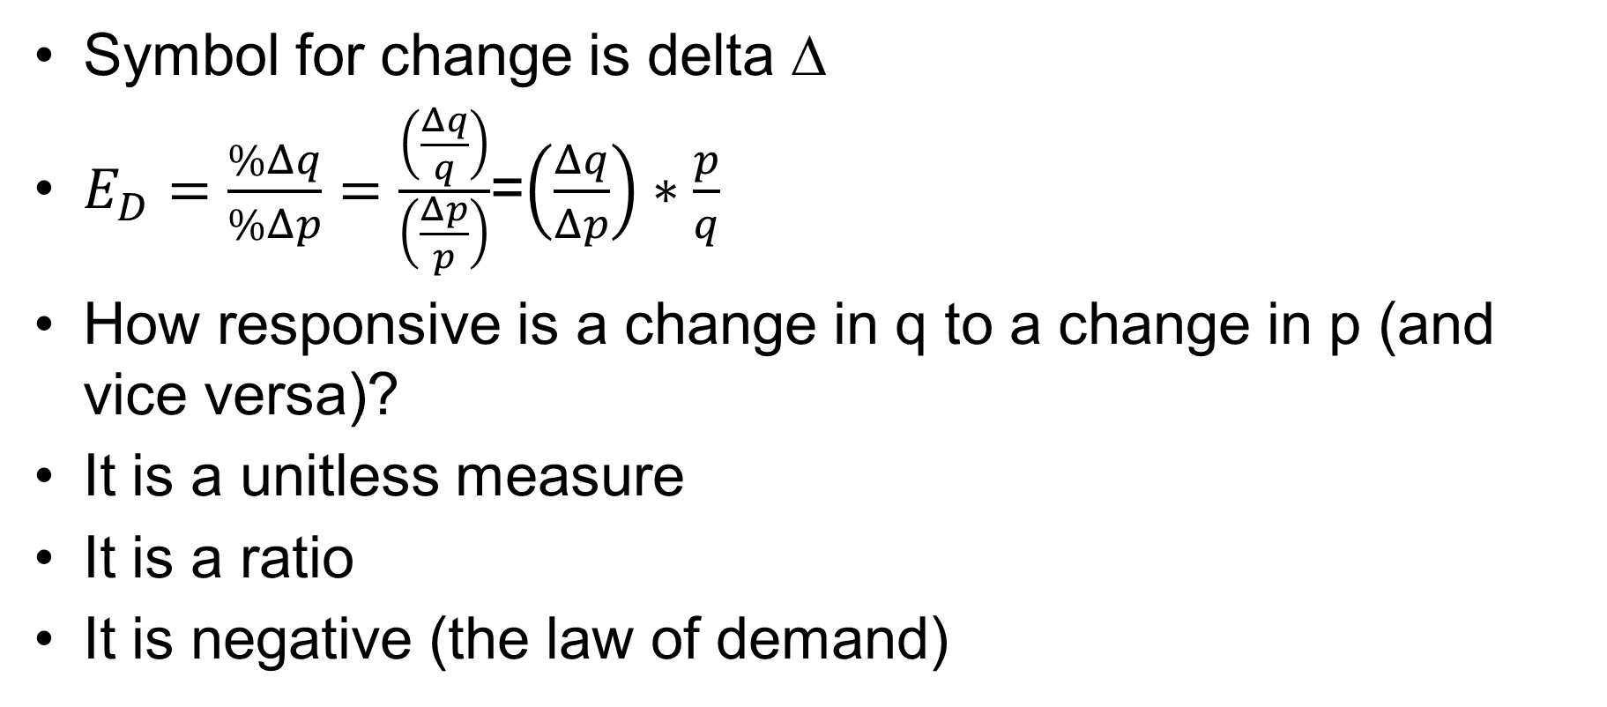
(Own) Price Elasticity of Demand
Symbol for change is delta ∆
$E_{D}=\frac{\%Δq}{\%Δp}=\frac{\left(\frac{Δq}{q}\right)}{\left(\frac{Δp}{p}\right)}$=$\left(\frac{Δq}{Δp}\right)∗\frac{p}{q}$
How responsive is a change in q to a change in p (and vice versa)?
It is a unitless measure
It is a ratio
It is negative (the law of demand)

Slide 40
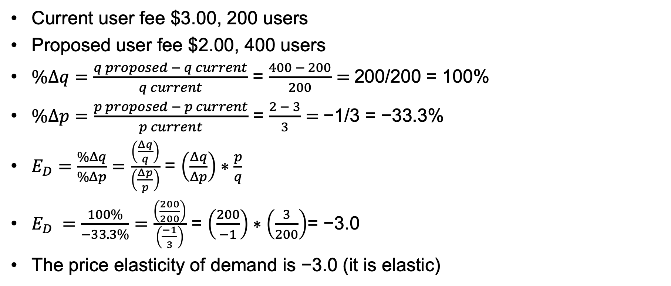
Example of a Public Park User Fee Steinemann, Microeconomics for Public Decisions
Current user fee $3.00, 200 users
Proposed user fee $2.00, 400 users
$\%Δq=\frac{q proposed − q current}{q current}$ = $\frac{400 − 200}{200}=$200/200 = 100%
$\%Δp=\frac{p proposed − p current}{p current}$ = $\frac{2 − 3}{3}=$−1/3 = −33.3%
$E_{D}=\frac{\%Δq}{\%Δp}=\frac{\left(\frac{Δq}{q}\right)}{\left(\frac{Δp}{p}\right)}$ = $\left(\frac{Δq}{Δp}\right)∗\frac{p}{q}$
$E_{D} =\frac{100\%}{−33.3\%}=\frac{\left(\frac{200}{200}\right)}{\left(\frac{−1}{3}\right)}$ = $\left(\frac{200}{−1}\right)∗\left(\frac{3}{200}\right)$= −3.0
The price elasticity of demand is −3.0 (it is elastic)

Slide 41
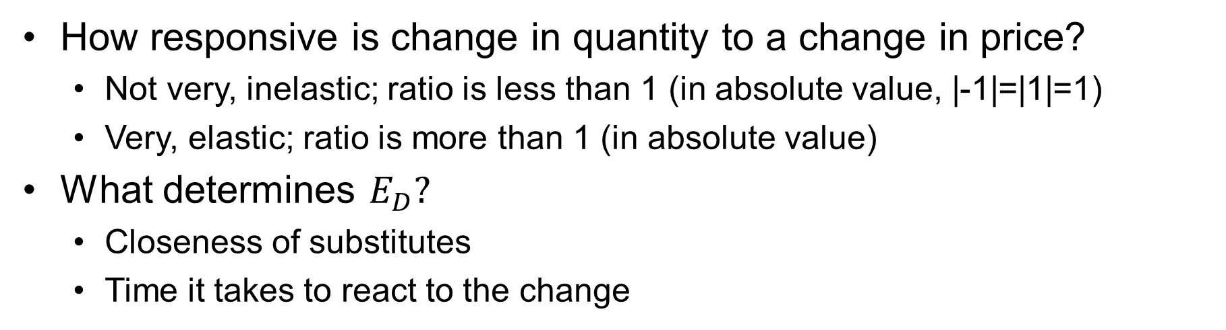
Interpreting Price Elasticity of Demand
−∞
−1
0
1
+∞
Perfectly elastic
Unit elastic
Perfectly inelastic
Unit elastic
Perfectly elastic
Elastic
Inelastic
Elastic
How responsive is change in quantity to a change in price?
  Not very, inelastic; ratio is less than 1 (in absolute value, |-1|=|1|=1)
  Very, elastic; ratio is more than 1 (in absolute value)
What determines $E_{D}?$
  Closeness of substitutes
  Time it takes to react to the change

Slide 42
Examples
Residential electricity: −0.1
Coffee: −0.3
Cigarettes: −0.5
Tires short run: −0.9
Tires long run: −1.2
  Long run is as long as it takes for people to make all the desired adjustments
  Long run is usually more elastic than short run
Restaurant meals: −2.3
Foreign travel: −4.0
  The more essential/addictive, the more inelastic
  The more optional, the more elastic

Slide 43
Intuitive but Not Quite Correct
p
Not much change in p, large change in q
Not technically correct since elasticity changes at each point on the respective linear demand curves as we will see, but intuitively helpful

Slide 44
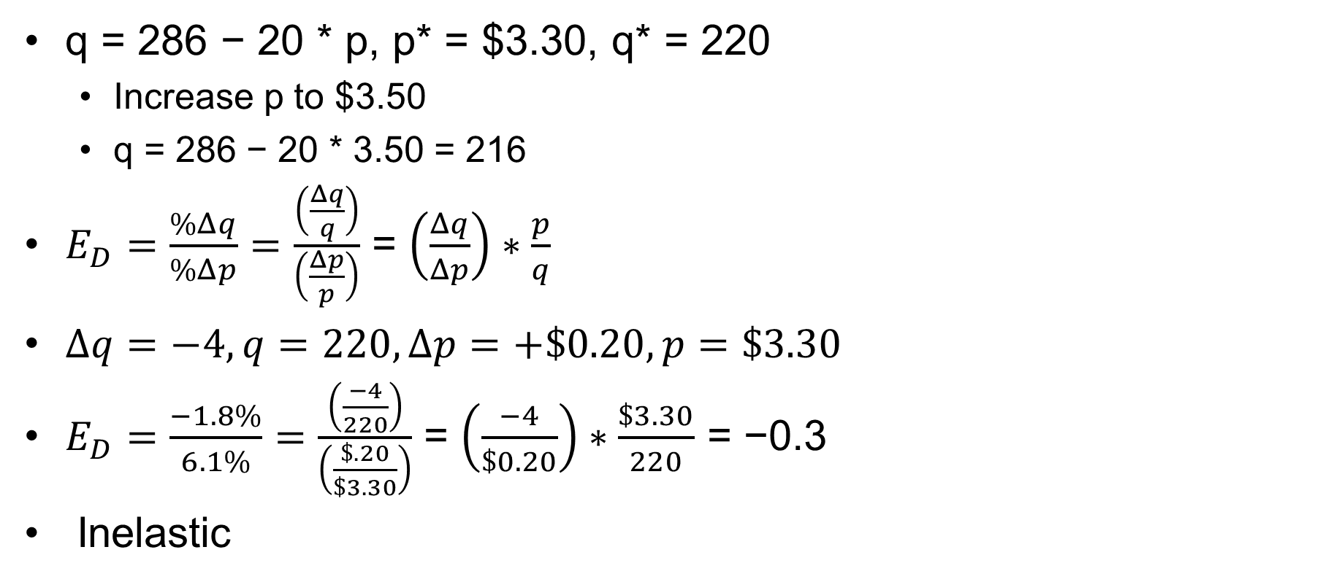
Price Elasticity of Demand Example Perloff, Microeconomics
q = 286 − 20 * p, p* = $3.30, q* = 220
  Increase p to $3.50
  q = 286 − 20 * 3.50 = 216
$E_{D}=\frac{\%Δq}{\%Δp}=\frac{\left(\frac{Δq}{q}\right)}{\left(\frac{Δp}{p}\right)}$ = $\left(\frac{Δq}{Δp}\right)∗\frac{p}{q}$
$∆q=−4,q=220,∆p=+\$0.20, p=\$3.30$
$E_{D}=\frac{−1.8\%}{6.1\%}=\frac{\left(\frac{−4}{220}\right)}{\left(\frac{\$.20}{\$3.30}\right)}$ = $\left(\frac{−4}{\$0.20}\right)∗\frac{\$3.30}{220}$ = −0.3
Inelastic

Slide 45
Cross-Price Elasticity and
Income Elasticity

Slide 46

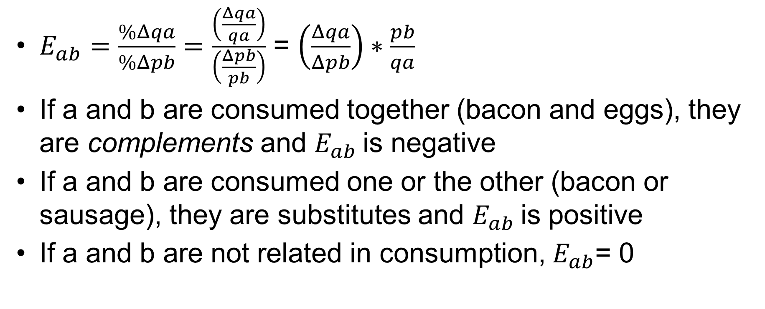
Cross-Price Elasticity: $E_{ab}=\frac{{\% change q}_{a}}{{\% change p}_{b}}$
$E_{ab}=\frac{\%Δqa}{\%Δpb}=\frac{\left(\frac{Δqa}{qa}\right)}{\left(\frac{Δpb}{pb}\right)}$ = $\left(\frac{Δqa}{Δpb}\right)∗\frac{pb}{qa}$
If a and b are consumed together (bacon and eggs), they are complements and $E_{ab}$is negative
If a and b are consumed one or the other (bacon or sausage), they are substitutes and $E_{ab}$is positive
If a and b are not related in consumption, $E_{ab}$= 0

Slide 47
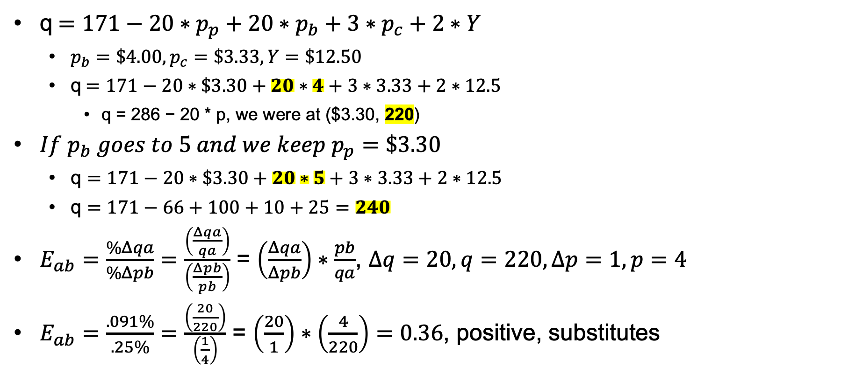
Cross-Price Elasticity Example for Pork
q$=171−20∗p_{p}+20∗p_{b}+3∗p_{c}+2∗Y$
  $p_{b}=\$4.00, p_{c}=\$3.33, Y=\$12.50$
  q$=171−20∗\$3.30+20∗4+3∗3.33+2∗12.5$
    q = 286 − 20 * p, we were at ($3.30, 220)
${If p}_{b} goes to 5 and we keep p_{p}=\$3.30$
  q $=171−20∗\$3.30+20∗5+3∗3.33+2∗12.5$
  q $=171−66+100+10+25=240$
$E_{ab}=\frac{\%Δqa}{\%Δpb}=\frac{\left(\frac{Δqa}{qa}\right)}{\left(\frac{Δpb}{pb}\right)}$ = $\left(\frac{Δqa}{Δpb}\right)∗\frac{pb}{qa}$, $∆q=20, q=220,∆p=1,p=4$
$E_{ab}=\frac{.091\%}{.25\%}=\frac{\left(\frac{20}{220}\right)}{\left(\frac{1}{4}\right)}$ = $\left(\frac{20}{1}\right)∗\left(\frac{4}{220}\right)=0.36$, positive, substitutes

Slide 48
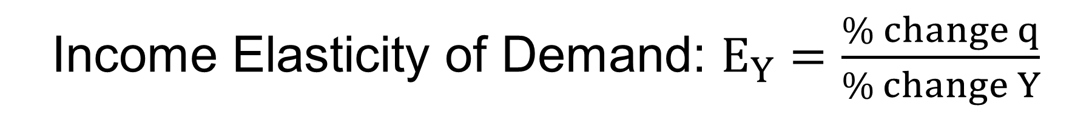
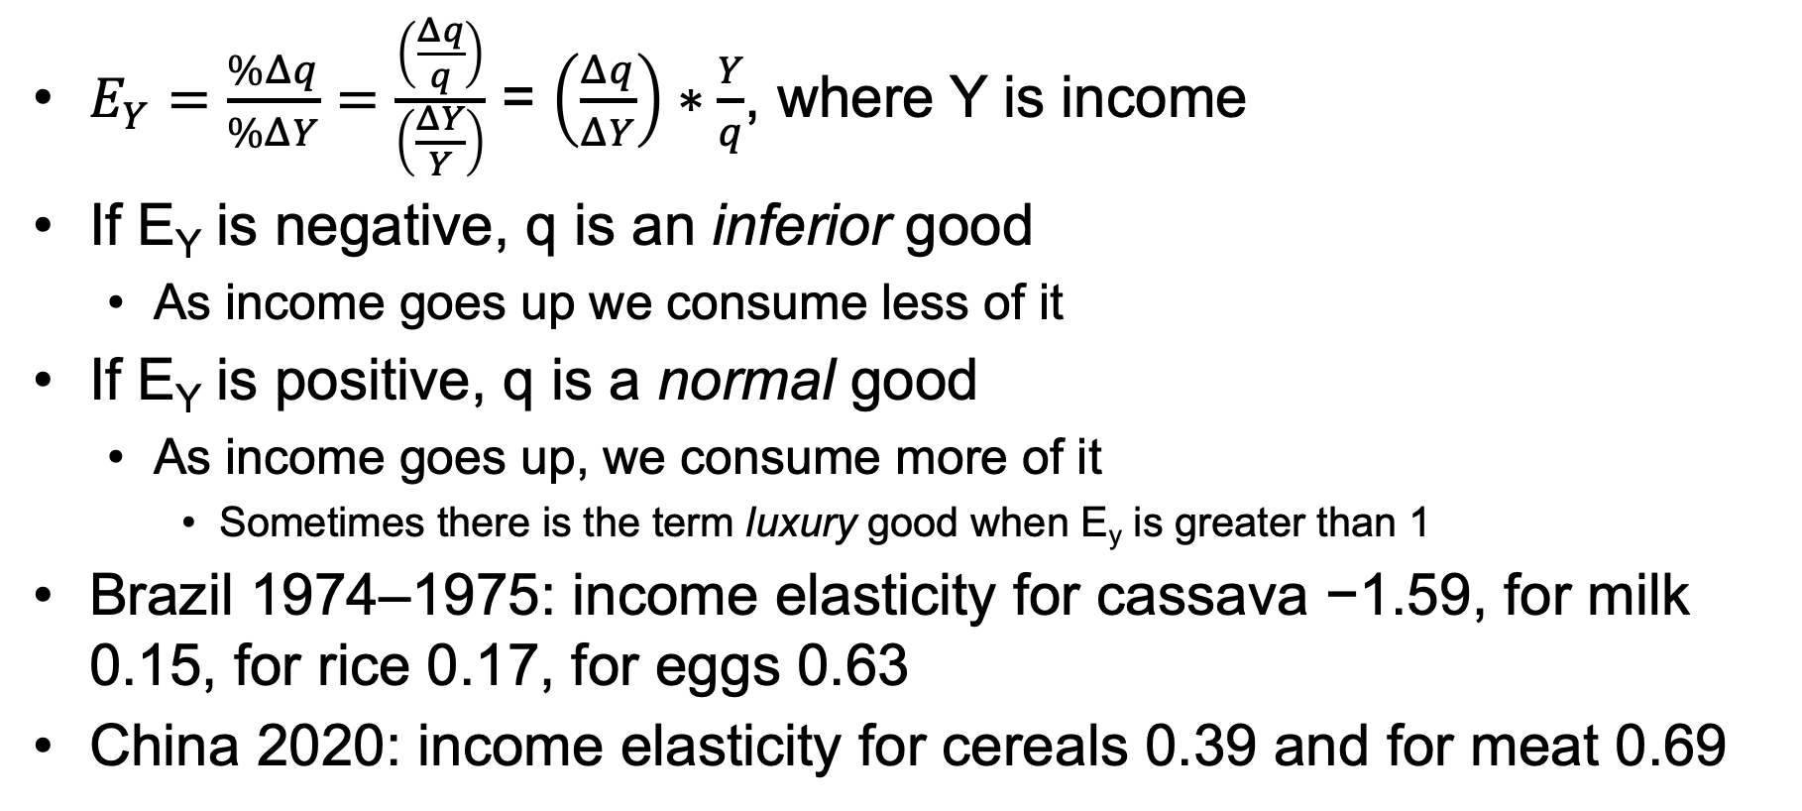
Income Elasticity of Demand: $E_{Y}=\frac{\% change q}{\% change Y}$
$E_{Y}=\frac{\%Δq}{\%ΔY}=\frac{\left(\frac{Δq}{q}\right)}{\left(\frac{ΔY}{Y}\right)}$ = $\left(\frac{Δq}{ΔY}\right)∗\frac{Y}{q}$, where Y is income
If E_{Y} is negative, q is an inferior good
  As income goes up we consume less of it
If E_{Y} is positive, q is a normal good
  As income goes up, we consume more of it
    Sometimes there is the term luxury good when E_{y} is greater than 1
Brazil 1974–1975: income elasticity for cassava −1.59, for milk 0.15, for rice 0.17, for eggs 0.63
China 2020: income elasticity for cereals 0.39 and for meat 0.69

Slide 49
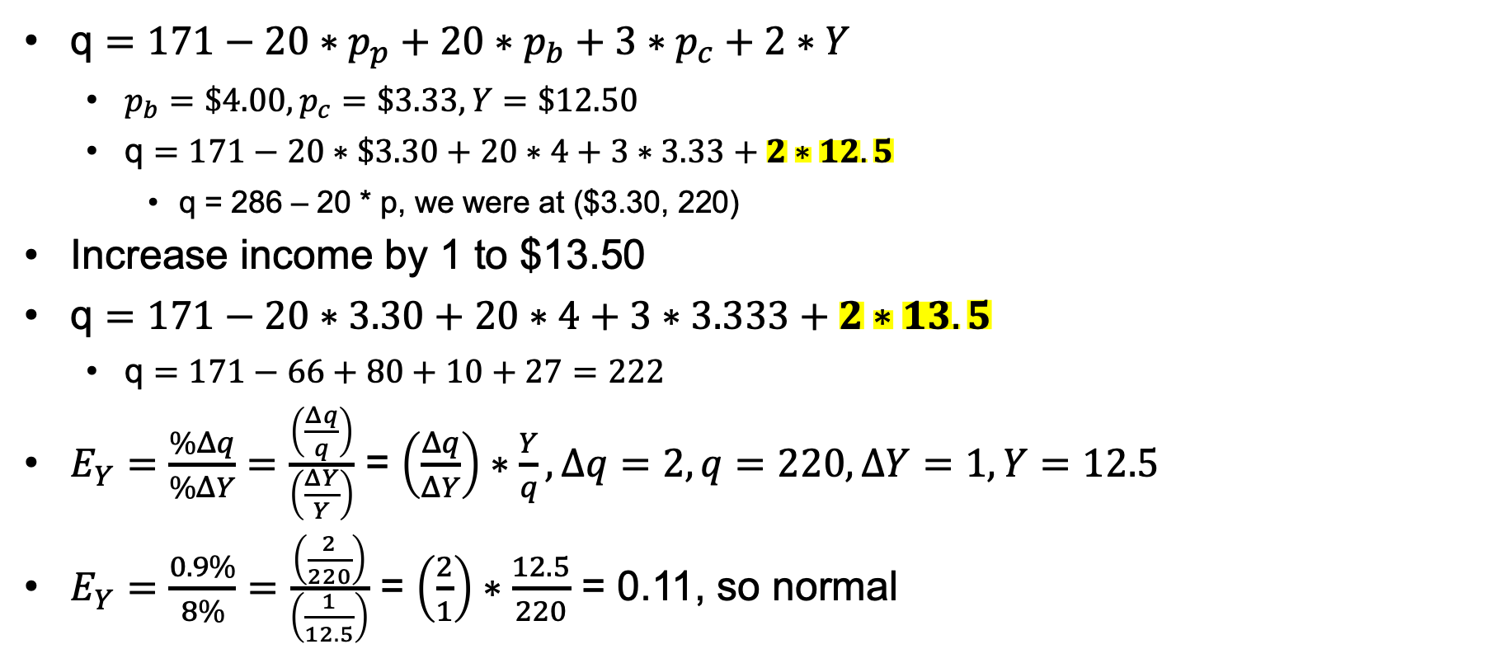
Income Elasticity Example
q $=171−20∗p_{p}+20∗p_{b}+3∗p_{c}+2∗Y$
  $p_{b}=\$4.00, p_{c}=\$3.33, Y=\$12.50$
  q $=171−20∗\$3.30+20∗4+3∗3.33+2∗12.5$
    q = 286 – 20 * p, we were at ($3.30, 220)
Increase income by 1 to $13.50
q $=171−20∗3.30+20∗4+3∗3.333+2∗13.5$
  q $=171−66+80+10+27=222$
$E_{Y}=\frac{\%Δq}{\%ΔY}=\frac{\left(\frac{Δq}{q}\right)}{\left(\frac{ΔY}{Y}\right)}$ = $\left(\frac{Δq}{ΔY}\right)∗\frac{Y}{q}, ∆q=2, q=220,∆Y=1, Y=12.5$
$E_{Y}=\frac{0.9\%}{8\%}=\frac{\left(\frac{2}{220}\right)}{\left(\frac{1}{12.5}\right)}$ = $\left(\frac{2}{1}\right)∗\frac{12.5}{220}$ = 0.11, so normal

Slide 50
Price Elasticity of Supply

Slide 51
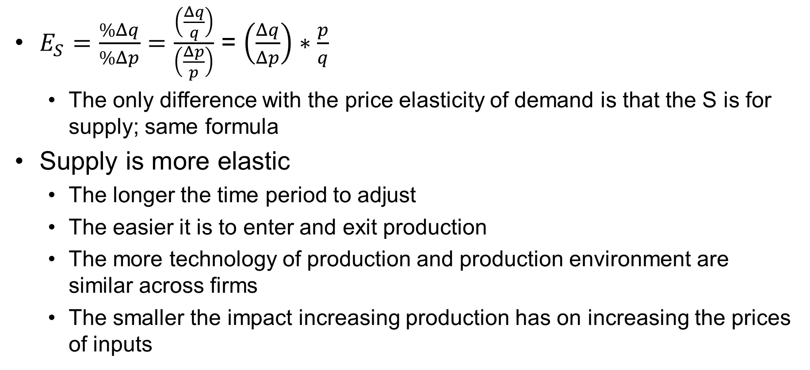

Price Elasticity of Supply:${ E}_{S}=\frac{\% change q}{\% change p}$
$E_{S}=\frac{\%Δq}{\%Δp}=\frac{\left(\frac{Δq}{q}\right)}{\left(\frac{Δp}{p}\right)}$ = $\left(\frac{Δq}{Δp}\right)∗\frac{p}{q}$
  The only difference with the price elasticity of demand is that the S is for supply; same formula
Supply is more elastic
  The longer the time period to adjust
  The easier it is to enter and exit production
  The more technology of production and production environment are similar across firms
  The smaller the impact increasing production has on increasing the prices of inputs

Slide 52
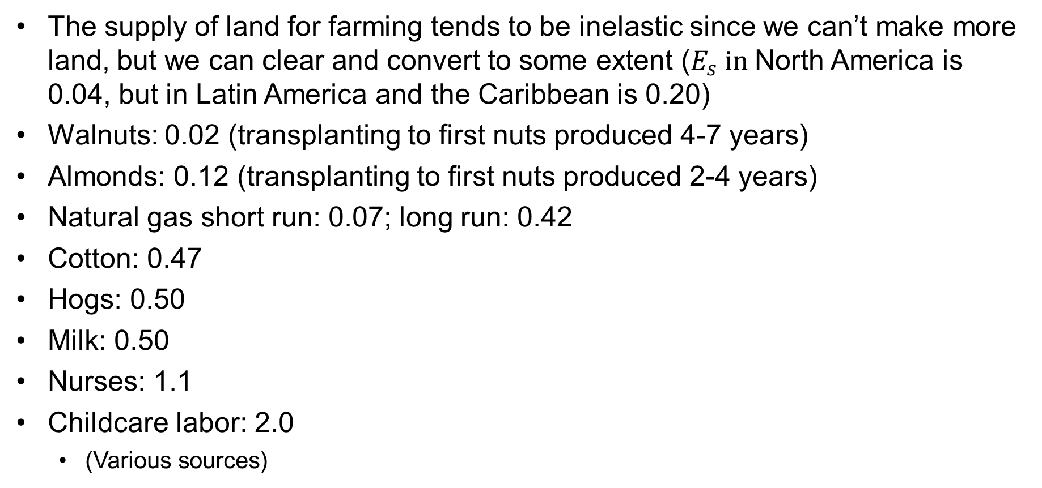
Price Elasticity of Supply Examples
The supply of land for farming tends to be inelastic since we can’t make more land, but we can clear and convert to some extent ($E_{s} in$North America is 0.04, but in Latin America and the Caribbean is 0.20)
Walnuts: 0.02 (transplanting to first nuts produced 4-7 years)
Almonds: 0.12 (transplanting to first nuts produced 2-4 years)
Natural gas short run: 0.07; long run: 0.42
Cotton: 0.47
Hogs: 0.50
Milk: 0.50
Nurses: 1.1
Childcare labor: 2.0
  (Various sources)

Slide 53
Policy Application of Elasticity

Slide 54
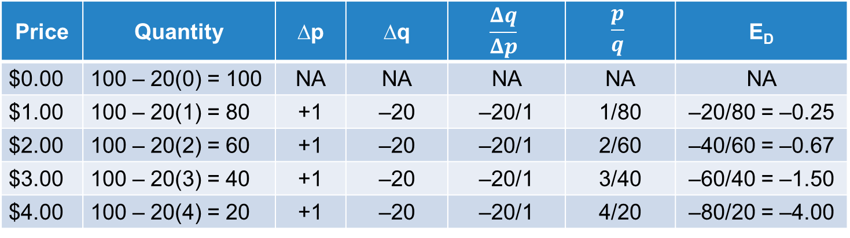
Elasticity Changes as We Move along a Curve
Price | Quantity | ∆p | ∆q | $$\frac{Δq}{Δp}$$ | $$\frac{p}{q}$$ | E_{D}
$0.00 | 100 – 20(0) = 100 | NA | NA | NA | NA | NA
$1.00 | 100 – 20(1) = 80 | +1 | –20 | –20/1 | 1/80 | –20/80 = –0.25
$2.00 | 100 – 20(2) = 60 | +1 | –20 | –20/1 | 2/60 | –40/60 = –0.67
$3.00 | 100 – 20(3) = 40 | +1 | –20 | –20/1 | 3/40 | –60/40 = –1.50
$4.00 | 100 – 20(4) = 20 | +1 | –20 | –20/1 | 4/20 | –80/20 = –4.00
p
inelastic
q

Slide 55
Application Based on Perloff, Microeconomics
Washington, DC increased the tax on gasoline sold in the district so that the price increased by 6% in an attempt to increase tax revenue.
  Before the increase, the tax per gallon was already $0.25 per gallon.
  The amount sold per day before they raised the price was 100,000 gallons.
  Tax revenue was $25,000 per day.
The price changed from $2.00 per gallon (including the $0.25 tax) to $2.12 (so total tax per gallon was $0.37).
  The price elasticity of demand for gasoline in the United States is reported to be −0.6 in the text.
  What percent reduction in quantity and level of tax revenue does this predict?

Slide 56
Application
E_{D} = −0.60 = (% change in q)/(% change in p [+6%]), % change in q = (–0.60) * (0.06), a reduction by 3.6%.
  If we calculate the decline in quantity demanded, it should go from 100,000 to 96,400 gallons per day. That should give us tax revenue of ($0.37) * (96,400) = $35,688 per day, an increase of $10,688 from the $25,000 they were already getting.
What happened? Well, six months after implementing the policy, sales of gasoline in the district had reduced 33%.
  What was the implied price elasticity of demand? −33%/6%, or −5.5.
  A 33% reduction from 100,000 takes us to 67,000 gallons per day. That gives us a revenue of ($0.37) * 67,000 = $24,790, a reduction of $210. What went wrong?
(Some of these numbers are made up for the purposes of the example, but the basic story line is true.)

Slide 57
Price Regulation in a Market

Slide 58
Policies Influencing Supply and Demand
In this session, we will consider:
The impact of a price floor
The impact of a price ceiling

Slide 59
A Price Floor
A legal minimum price that is allowed
surplus
qd
Agricultural commodities, minimum wage laws

Slide 60
A Price Ceiling
A legal maximum price that is allowed
shortage
qs
Rent controls, price of bread, price of rice

Slide 61
Policy Instruments
Taxation

Slide 62





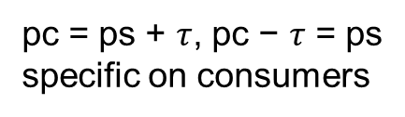

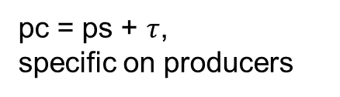

A Specific (per Unit of q) Tax $τ$
is tax revenue = $τ∗q_{τ}$
p
p
pc
pc
p*
$$τ$$
p*
$$τ$$
ps
ps
$$τ$$
$$q_{τ}$$
q*
$$q_{τ}$$
q*
q
q
pc = ps + $τ$,
specific on producers
pc = ps + $τ$, pc − $τ$ = ps
specific on consumers

Slide 63
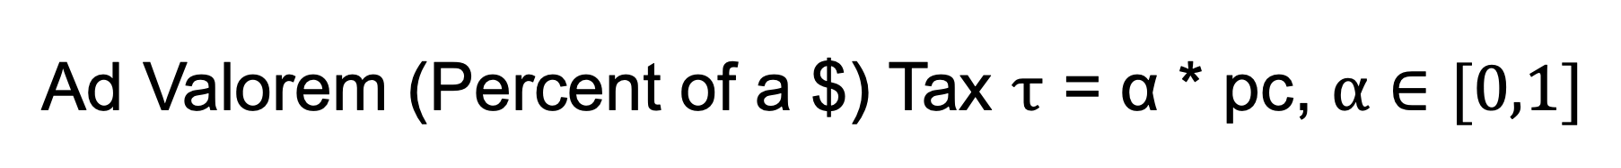
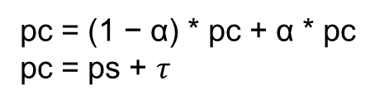
Ad Valorem (Percent of a $) Tax $τ$ = α * pc, $α∈[0,1]$
p
ps
q*
q
pc = (1 − α) * pc + α * pc
pc = ps + $τ$

Slide 64
The Burden of Taxation: Consumer Incidence
p
p
pc
p*
pc
ps
p*
ps
qT
q*
q
q*
q
qT
The higher incidence is borne by the more inelastic party
Consumer incidence (CI) = $\frac{Es}{Es−ED};as supply becomes more elastic, CI will increase$;
$$as demand becomes more inelastic, CI will increase$$

Slide 65
Taxation and Revenue
Taxing a good for which there is inelastic price elasticity of demand is good for generating revenue (smaller change in q).
Taxing a good for which there is elastic price elasticity of demand is less effective at generating revenue (larger change in q).

Slide 66
Policy Instruments
Subsidy

Slide 67



Subsidy of Consumer
is size of the subsidy
p
$$p_{s}$$
p*
σ
$$p_{c}$$
q*
qS
q
$$p_{s}\text{−} σ=p_{c, } p_{s}=p_{c}+σ$$
In tax, we describe tax incidence
With a subsidy, it is benefits incidence

Slide 68




Subsidy of Producer
is size of the subsidy
p
$$p_{s}$$
p*
$$σ$$
$$p_{c}$$
q*
$$q_{σ}$$

