Slide 1
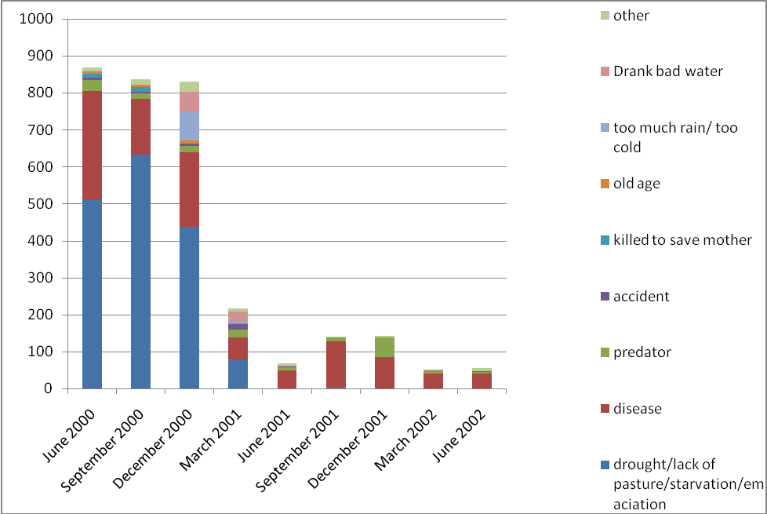
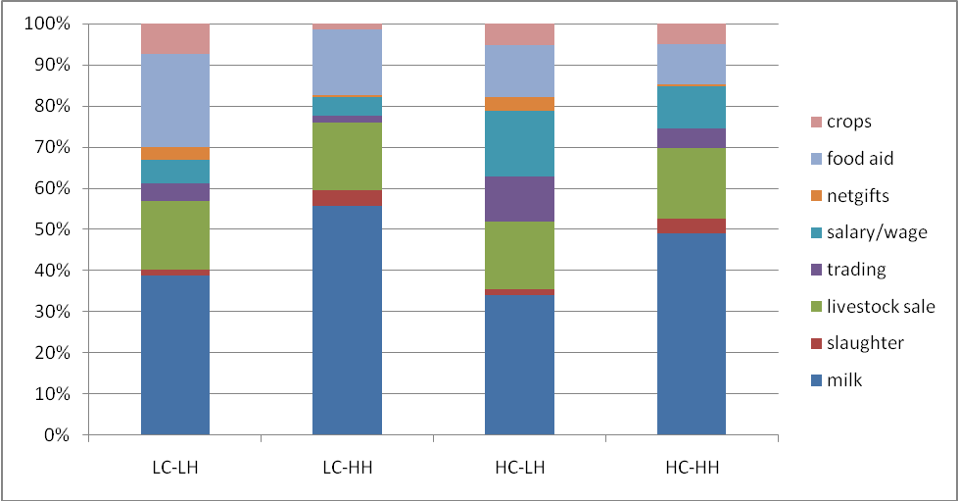
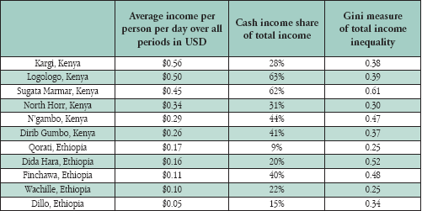
Changing Livelihoods in a Risky Environment
Average total Income per person per day by group (CV over time). Poor are not only poor in terms of lower income but also more variability about mean income.
Access to Cash by Livelihood Group. Note the main difference between the high cash and low cash groups is the importance of income from wage, salary, trade, and business.
John McPeak, Cheryl Doss, Peter Little, and Chris Barrett
Abstract:
The PARIMA research team has been investigating what our data reveal about livelihood strategies in our study sites. We argue that two critical variables to consider are access to livestock and access to the cash economy. Our findings indicate that greater access to both increases mean income and decreases income variability. We come to two main conclusions: one, livestock are and will for the foreseeable future be the foundation of the economy both in terms of livestock marketing and in terms of the contribution of milk to household income; two, improved access to the cash economy in the long term fostered by improved access to training and education offers an opportunity to build new income generating opportunities on the livestock based economy.
 | Lower Cash | Higher Cash
Lower Livestock | $0.20 (1.32) | $0.27 (0.90)
Higher Livestock | $0.34 (0.82) | $0.46 (0.63)
Access to Livestock by livelihood group. Median TLU per households
The total income generation profile by livelihood group emphasizes the importance of livestock and livestock products in the generation of total income.
Note the importance of milk.
Note the small share attributed to food aid
Also should note spatial pattern
Pattern of animal deaths over time in the sample. This sums the total number of animal deaths reported in a survey round and categorizes deaths by what respondents noted as the reason for death. Over half of all deaths are ‘drought’, and most deaths occurred in the first nine months of the study
Conclusion: Livestock are critical to the most people and are the most critical pathway to improved well being. Better access to the cash economy over time (and across space) also offers a more long term possible route to reducing poverty and vulnerability.
This research is a component of the Global Livestock Collaborative Research Support program support by USAID Grant No. PCE-G-00-98-00036-00 and by contributions from the participating institutions. The opinions expressed herein are those of the author(s) and do not necessarily reflect the views of the U.S. Agency for International Development.

