Slide 1
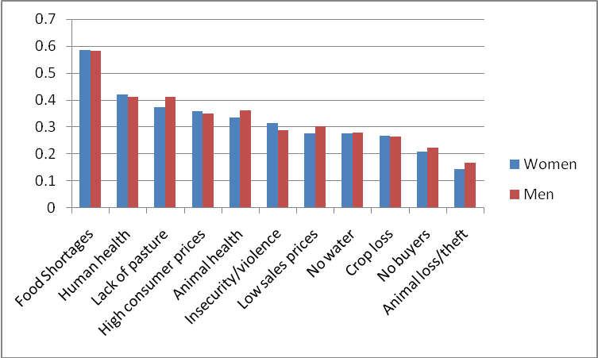
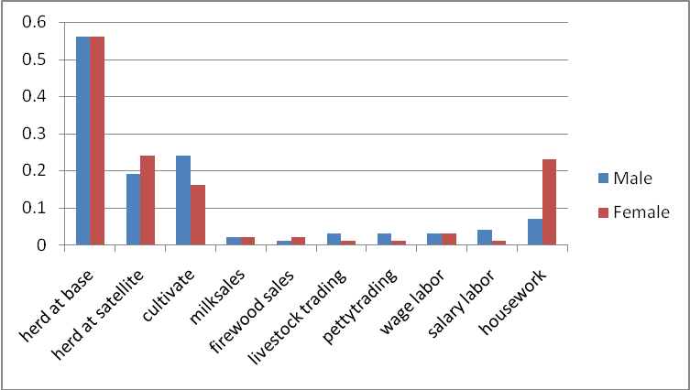
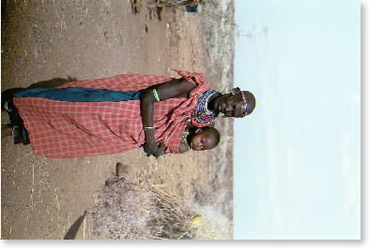
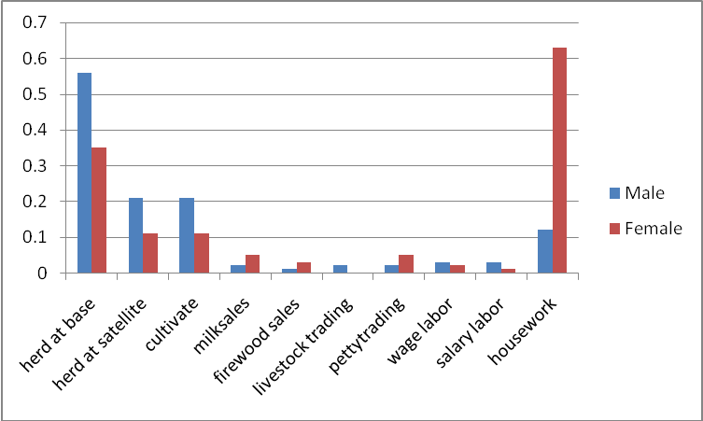
Gender Analysis of the PARIMA Data
Cheryl Doss and John McPeak
Abstract:
The Parima research team has been explicitly considering gender issues in the analysis of risk management within pastoralist communities in Northern Kenya and Southern Ethiopia. We found a high proportion of women who reported that they were the head of the household. Many of our analyses were done both by comparing male and female-headed households, and by comparing a broader range of male and female respondents that included household heads, a wife, and another adult living in the household. While there are variations in activities by gender, both men and women are primarily engaged in herding animals, both at the base and satellite camps. When we asked about the concerns facing the households, we obtained similar responses from men and women. Yet, other work by PARIMA researchers suggests that it is critical to consider the intrahousehold dynamics of new opportunities. We find that among the Gabra, men decide where to locate the household in order to limit women’s ability to take advantage of milk marketing opportunities.
Livelihood Activities
We asked everyone interviewed to rank the activities in which they participated. We normalized these across the 0 to 1 interval, where 0 means that they did not participate in the activity at all and 1 is the activity which the person reported spending the most time.
Risk Rankings by Gender
Household Heads
The key determinants of differences in risk rankings were time and space. The shocks that varied across communities over time had a bigger impact on the perceptions of risk than did household and individual characteristics, such as gender. The biggest concerns were food shortages and human health, followed by concerns about livestock and high consumer prices.
All Respondents
Gender and Household Decision Making
Parima researchers used data collected in a earlier work in the region to examine intrahousehold decisions regarding location and milk sales. Tradition among the Gabra is that men make the decisions about where to locate the household, while decisions about the use of milk is women’s domain. The development of markets for milk within towns results in new opportunities and possible contestation over the rights regarding milk. We proposed three models:
Traditional: Men continue to make decisions about where to locate the household, without considering the impact on milk sales. Women then decide whether or not to walk to town to sell milk.
Cooperative: A decision on location and milk sales are made concurrently, either as a joint household decision or by the head taking over both decisions.
Contested: Men decide where to locate the household and do so in order to resist women’s ability to sell milk.
Empirical analysis finds that the data supports the contested model of the household. This suggests that new opportunities may have unexpected impacts and that it is critical for researchers and policy-makers to consider the gender implications of their programs and policies.
Female Headed Households
We found relatively high proportions of households headed by women:
29% in Ethiopia and 36% in Kenya.
In part, these high numbers are a reflection of the fact that we are interviewing households in pastoral communities, whether or not pastoralism is their current source of livelihood.
In Kenya, we asked 50 of the 61 female heads about how they became the head of the household:
Over 50% through the death of their husband
24% through divorce or separation
20% were de facto heads of household
1 woman claimed to be head of household because she never married.
Herding is the highest ranked activity for both male and female household heads. They are involved with herding at both the base camp and the satellite camps. When all respondents are included, many of the women are the wives of the household head and they are less involved in herding and more involved in housework; yet, overall, women rank herding high among their activities.
This research is a component of the Global Livestock Collaborative Research Support program support by USAID Grant No. PCE-G-00-98-00036-00 and by contributions from the participating institutions. The opinions expressed herein are those of the author(s) and do not necessarily reflect the views of the U.S. Agency for International Development.

